Slide 1


Become a Startup Superhero for your Faculty/Staff Associations (FSA) or
Employee Resource Group (ERG)
Tuesday, September 23, 2025
Amita Suhrid
District Director, Professional Development
Human Resources
Flavio Medina-Martin, MPA, Ed.D.
District Director, Diversity, Culture, and Inclusion
Chancellor’s Office
Mylene Daniels
District Director, Human Resources Operations
Human Resources
Introductions
First Name/Last Name/Position
Notes:
Group

Slide 2
Become a Startup Superhero for your Faculty/Staff Associations (FSA) or
Employee Resource Group (ERG)
Professional Learning Outcomes - For today’s presentation, we will:
By the end of this session, participants will:
✅ Get a Better understanding of how FSAs/ERGs are formed and their importance ✅ Recognize workplace collegiality shows up in various ways within community-building ✅ Learn the various components of a developing an effective affinity group ✅ Leverage FSAs as platforms to develop inclusive & responsive communication strategies ✅ Identify one action step to enhance equity in their work space
Notes:
Flavio

Slide 3
Become a Startup Superhero for your Faculty/Staff Associations (FSA) or
Employee Resource Group (ERG)
Starting a new Faculty and Staff Association (FSA) or Employee Resource Group (ERG) can be an exciting and innovative way to build a sense of belonging, community, and inclusivity at your campus.
Difference between FSA and ERG – FSA is specific to Higher Educational employment platforms (mostly); ERGs is term that is used other platforms such as Healthcare, other forms of public service, and the private sector.
At the North Orange County Community College District (NOCCCD) we label affinity groups – FSAs.
Notes:
Flavio

Slide 4
Become a Startup Superhero for your Faculty/Staff Associations (FSA)
What are FSAs and what do they do?
Advocate, support, and serve as amplified voices for specific identity affiliations
Intended to promote a sense of belonging
Provide employees time and space to meet with others
Help build community and influence change throughout the District and through that shared identity.
Aim to increase awareness of issues that foster a more inclusive and informed campus environment.
Through education, cultural engagement, and community-building
Notes:
Flavio

Slide 5
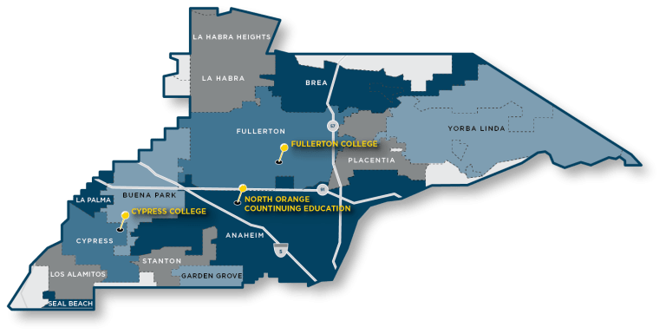
Become a Startup Superhero for your Faculty/Staff Associations (FSA) or
Employee Resource Group (ERG)
Who and Where Are We:
A
Notes:
Amita

Slide 6
Become a Startup Superhero for your Faculty/Staff Associations (FSA) or
Employee Resource Group (ERG)
Who and Where Are We:
Almost 60,000
The District includes two award-winning credit colleges – Cypress College and Fullerton College – as well as one of the largest noncredit institutions in the state – North Orange Continuing Education.
Chancellor Byron D. Clift Breland
2,800 people
$2 billion in income to OC Our students come from diverse backgrounds and experiences in order to achieve their educational, professional and personal goals. We create and nurture inclusive, equitable learning environments to empower students to reach their full potential while providing well-trained graduates needed by local employers.
“The Destination District”
A
Notes:
Amita

Slide 7
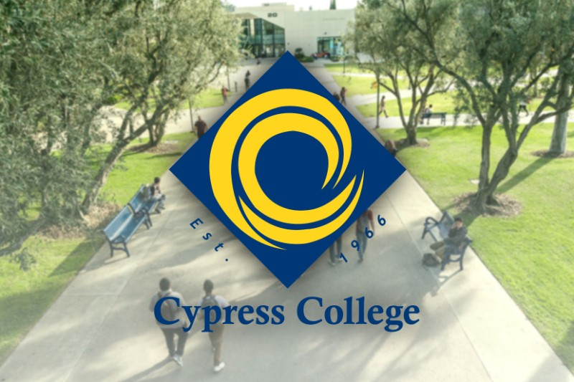

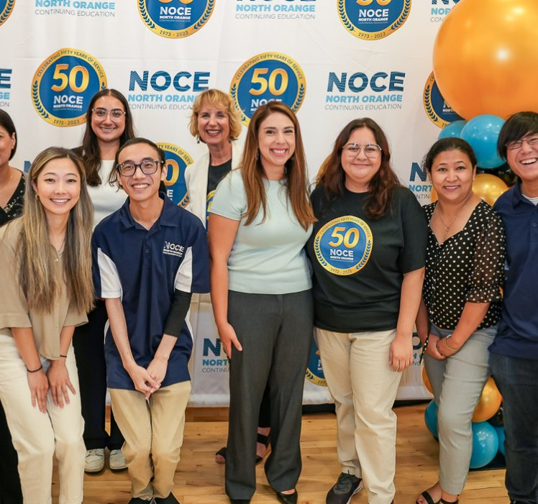
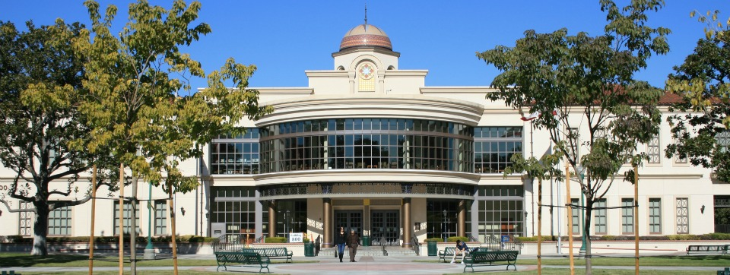
Become a Startup Superhero for your Faculty/Staff Associations (FSA) or
Employee Resource Group (ERG)
Who are we as an organization
A
Notes:
Amita

Slide 8
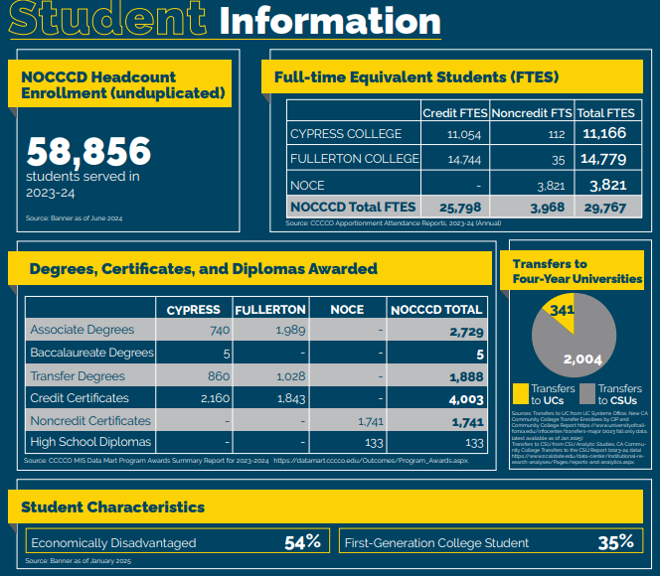
Become a Startup Superhero for your Faculty/Staff Associations (FSA) or
Employee Resource Group (ERG)
Our Students/Demographics
A
Notes:
Amita

Slide 9
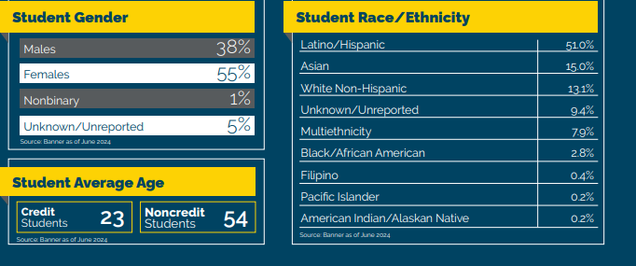
Become a Startup Superhero for your Faculty/Staff Associations (FSA) or
Employee Resource Group (ERG)
Our Students/Demographics:
A
Notes:
Amita

Slide 10
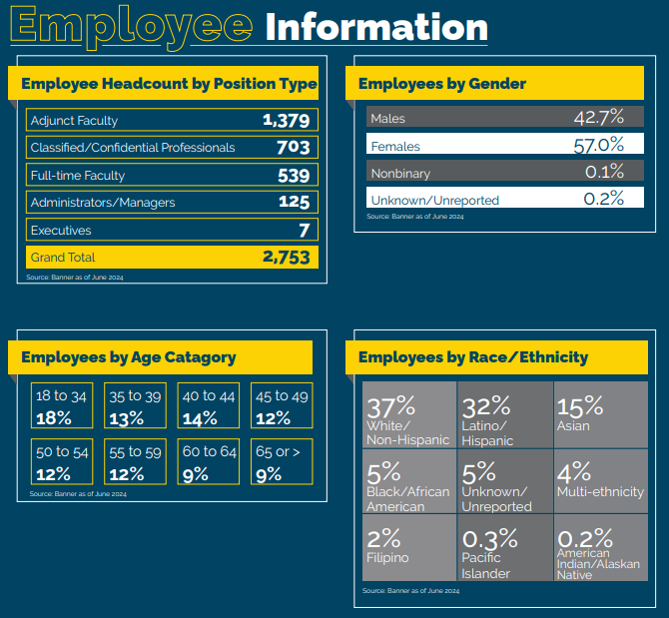
Become a Startup Superhero for your Faculty/Staff Associations (FSA) or
Employee Resource Group (ERG)
Our Employee/Demographics:
A
Notes:
Amita

Slide 11
Become a Startup Superhero for your Faculty/Staff Associations (FSA) or
Employee Resource Group (ERG)
Asian Pacific Islander Desi American Faculty & Staff Association (APIDA)
Rainbow Alliance of District Employees (RAD-E)
Latino Faculty & Staff Association (LFSA)
Native American Faculty & Staff Alliance (NAFSA)
Black Faculty & Staff Association
South West Asian, North African Faculty & Staff Association (SWANA)
What FSAs exist at NOCCCD?
Notes:
Flavio

Slide 12
NOCCCD Disclaimer statement
Become a Startup Superhero for your Faculty/Staff Associations (FSA) or
Employee Resource Group (ERG)
The views, opinions and conclusions expressed on the Faculty and Staff Association webpages are those of the authors and organization and not necessarily those of the North Orange County Community College District, its administration, or its Board of Trustees.
Outbound links, such as third party websites or personal pages of NOCCCD's students, faculty and staff represent individual views and do not necessarily reflect the views and/or policies of the District. NOCCCD and its designees do not guarantee the authenticity, accuracy, appropriateness, nor security of any link, website or content linked thereto. NOCCCD urges site visitors to exercise all due caution and internet security best practices when accessing any unfamiliar website.

Slide 13
Become a Startup Superhero for your Faculty/Staff Associations (FSA) or
Employee Resource Group (ERG)
1.LFSA
2.BFSA
3.SWANA
4.RAD-E
5.NAFSA
6.APIDA
What is the role of the District and how has that evolved in supporting our FSAs?
Led to the development/expansion of a District FSA Resource Guide

Slide 14


FSA Resource Guide
Introduction
Approval of Application
Financial Structures & Bookkeeping
FSA Operating Principles
FSA
Comm
Purpose
Office of DCI
Suggested Criteria for developing an FSA
District FSA Resource Guide
District & Institutional Registration

Slide 15
Purpose
Intro-Starting a new Faculty and Staff Association (FSA) at the North Orange County Community College District (NOCCCD) involves several steps to ensure that the association represents the issues and needs of the identified community and aligns with the mission, vision, and values of the District.
FSA work is comprehensive but generally spans the following purposes:
Knowledge building and advocacy specific to the cultural, social or professional identity the FSA represents (e.g. Black Faculty/Staff, Latinx, LGBTQ+, etc.)
Hosting, participation, and promotion of various cultural events on the campus and/or external to campus communities
Building partnerships and intersections across the District in order to inspire greater collaboration and shared decision making
Fundraising, scholarships and mentorship for students and others in the NOCCCD community
Recruitment and retention of diverse faculty and staff through participation in the community and through the intentional building of an inclusive campus climate
Introduction
Notes:
Flavio

Slide 16
Suggested Criteria for developing an FSA
*FSAs are all-volunteer organizations, officially recognized by the institution through our office, which allows them to host events on campus.
*Monthly Community Forums; the presidents of each FSA will meet with the District Director, Diversity, Culture & Inclusion once every semester to coordinate activities and discover opportunities for collaboration.
Suggested criteria for establishing an FSA
*Establish a list of at least five (5) interested
*Prepare a mission statement & goals for first year of the group.
a. What will the FSA bring to its members?
b. How will the FSA contribute to strategic plan?
c. How will the events/programs contribute and align with community, value, and mission?
Determine financial revenue and uses for FSA monies:
Membership dues
Fundraising events
Events/Programs
Scholarships
Partnerships
Office of DCI

Slide 17
Suggested Criteria for developing an FSA
*Create Bylaws-roles and responsibilities of the Executive Board: President, Vice-President, Treasurer, Secretary, etc
*Prepare introductory message
*Host first meeting, in collaboration with DCI office
Note: When selecting executive board members, be mindful of the amount of time that needs to be invested in order to create a functioning and sustainable FSA. Include an estimated time commitment, so people have an idea of what they are committing to.
Notes:
Flavio

Slide 18
NOCCCD Office of Diversity, Culture and Inclusion:
Once approved, the DCI Office will formally register the association with Human Resources.
After registration, the FSA leadership will reach out to the District Department of Public & Governmental Affairs to establish FSA webpage on www.nocccd.edu.
Payroll employee dues setup: the FSA leadership must get established with our Payroll department, by submitting a “OCDE New Vendor/Vendor Information Update Form.” This will create a path for employees to contribute dues through their individual payroll cycles
Approval of Application
District & Institutional Registration
Notes:
Flavio

Slide 19
Bursar’s Office account setup.
FSA can identify ongoing initiatives or programs they wish to fund that they can request their members to support.
FSA’s may fundraise and accept donations in accordance with NOCCCD policies.
All money transactions for FSAs must be done through an account with a campus Bursar’s Office. FSAs must follow all Fiscal Services regulations and procedures and are subject to financial audit.
If an FSA does not plan on collecting membership dues or fundraising, they may still become an official FSA without a financial account.
Financial Structures & Bookkeeping
M
Notes:
Mylene

Slide 20
Members must be actively employed or affiliated with NOCCCD.
Faculty and Staff associations may not pressure any employees into joining. Membership in an FSA shall be entirely voluntary.
The FSA must operate exclusively for educational, civic, social, charitable, and nonprofit purposes.
The FSA should be organized to assist and support NOCCCD’s mission and values by hosting activities such as:
Recruitment events
Community programs
Promoting social and intellectual enrichment
Networking and professional development opportunities
Any programs sponsored by the FSA must be financially self-supporting.
Meetings may be held before or after work hours. If meetings are held during work times, it should be done so during the employee’s time or with permission with the employee’s immediate supervisor (IMS).
Consistent with NOCCCD’s commitment to diversity, equity, inclusion, accessibility, and anti-racism, FSA groups are encouraged to collaborate with each other to maximize resources and community-building opportunities.
All FSAs must be inclusive and may not limit participation to any particular identities such as race, gender, sexual orientation, age, veteran status, citizenship status, or other protected classification.
FSA Operating Principles
M
Notes:
Mylene

Slide 21



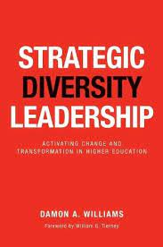








Infusing Diversity, Equity, and Inclusion in our Educational Spaces
-Books to Consider-
Notes:
Flavio

Slide 22

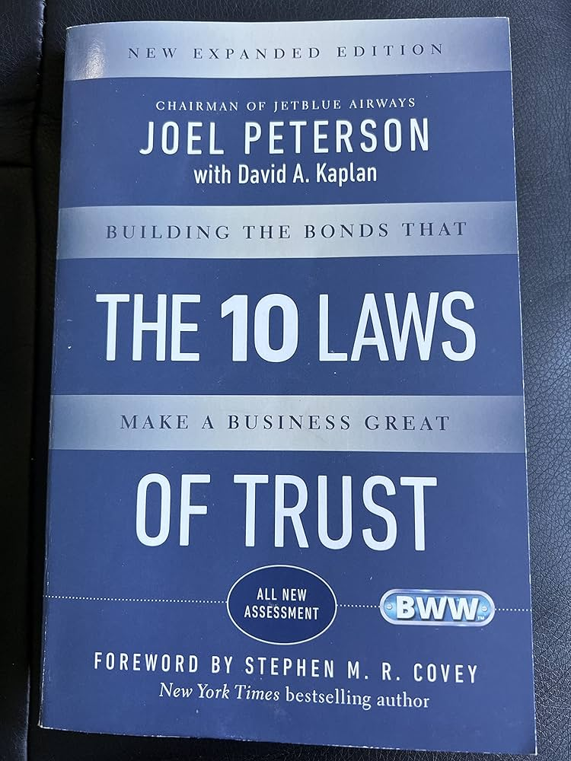







Building on Management/Leadership Skills
-Books to Consider-
Notes:
Flavio

Slide 23
Become a Startup Superhero for your Faculty/Staff Associations (FSA) or
Employee Resource Group (ERG)
Tuesday, September 23, 2025
Flavio Medina-Martin, MPA, Ed.D.
District Director, Diversity, Culture, and Inclusion
Chancellor’s Office
Amita Suhrid
District Director, Professional Development
Human Resources
Mylene Daniels
District Director, Human Resources Operations
Human Resources

