Slide 1

How to Handle the Tsunami of Changes Facing Community Colleges Without Getting Seasick
Erika Endrijonas, Ph.D.
Superintendent/President

Slide 2
How Did I Get Here?
Army Brat
CSUN - BA in History
USC - MA, Ph.D. American and Women’s History
TA & Academic Advisor - USC
Granite State College
Oglethorpe University
Union Institute & University
Santa Barbara City College
Oxnard College
Los Angeles Valley College
Pasadena City College
Santa Barbara City College 2.0

Slide 3
Leadership Philosophy
Official Leadership Style: Authentic & Transformational
Preferred Leadership Term: Human
Most Important Attributes: Adaptability, Resilience, Fearlessness, & A Sense of Humor

Slide 4
Challenges Along the Way
Being an Out Lesbian My Entire Career…even in the South
Several experiences of not being taken seriously due to being too young for a particular administrative role
Taking risks by calling out sexist comments, treatment, and language

Slide 5
Challenges Along the Way - Cont’d
Saying no to directives that were unethical
Filing a complaint as a President about wage discrimination
Having a Vote of No Confidence for requiring faculty to return to teaching in person months after classified staff and managers had safely returned to campus

Slide 6
Food & Leadership
No Experience Required: American Middle Class Families and their Cookbooks, 1945-1960
Chocolate Chip Cookies vs. Brownies

Slide 7

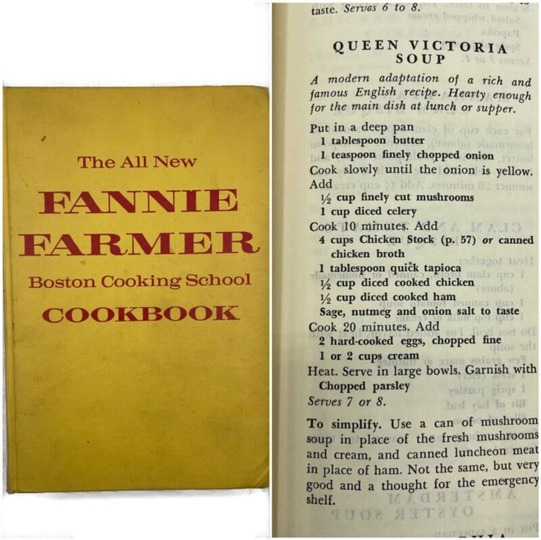

Slide 8
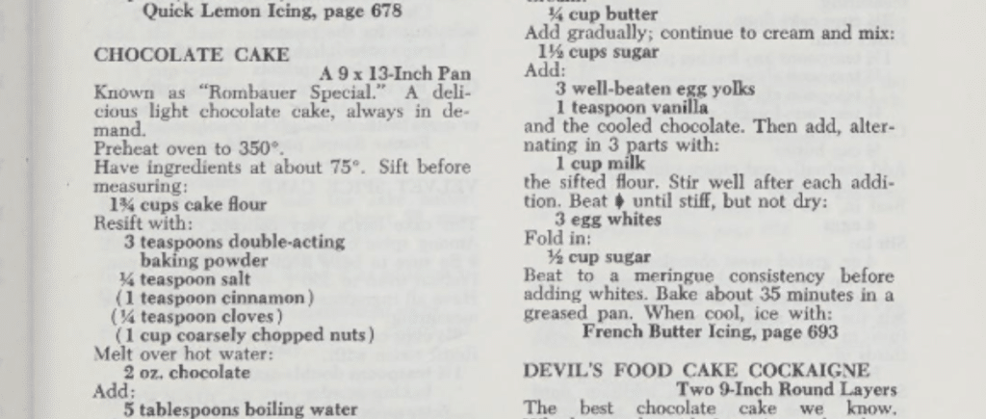
Joy of Cooking

Slide 9
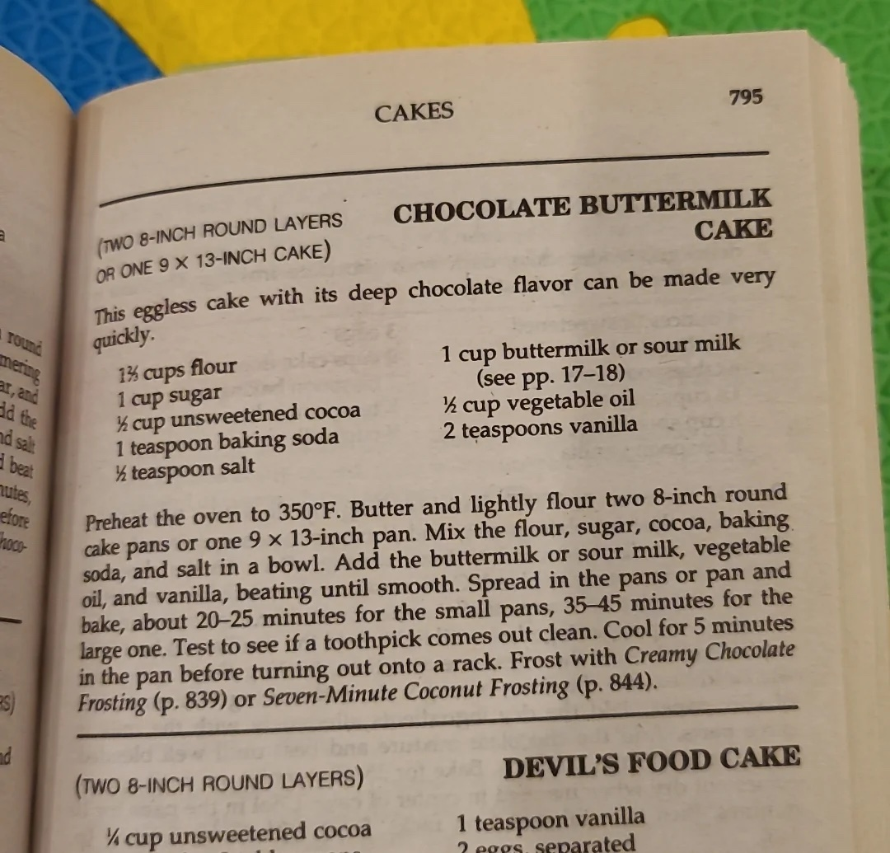
Fannie Farmer

Slide 10
Many Cooks Make the Broth
Cooking is Chemistry
Quality of Ingredients
Structured AND Unstructured
Part Journey, Part Product
Early Career: Seemed Like The Joy of Cooking
Mid and Later Career: Quest for Fannie Farmer

Slide 11
The Times They Are a Changin’
Speed & Magnitude of Change in Higher Education Has Never Been So Great
…and the value of a college degree has never been questioned more than right now
5 ¼ inch Floppy Disc vs. USB
Library Card File vs. Google Search

Slide 12
The Times They Are a Changin’ - Cont’d
Sage on the Stage vs. Guide by the Side
Synchronous vs. Asynchronous
Well-Rounded Liberal Education vs. Only Learn What you Need to Know
The Student as Customer
In Loco Parentis In a New Format

Slide 13
Generational Differences
Majority of Workplaces - Especially in Higher Education - have 5 Generations of workers
The California Community College Employment Structure, the Education Code, Title 5, and Collective Bargaining Agreements are designed based on Baby Boomers and their preferred working conditions.

Slide 14
Generational Differences - Cont’d
Working hours, breaks, narrow position descriptions
Seat-time and Task Completion vs. Job Satisfaction
Theoretically designed to avoid role & task confusion….helped to create toxic working environments that do not meet the needs of all generations

Slide 15
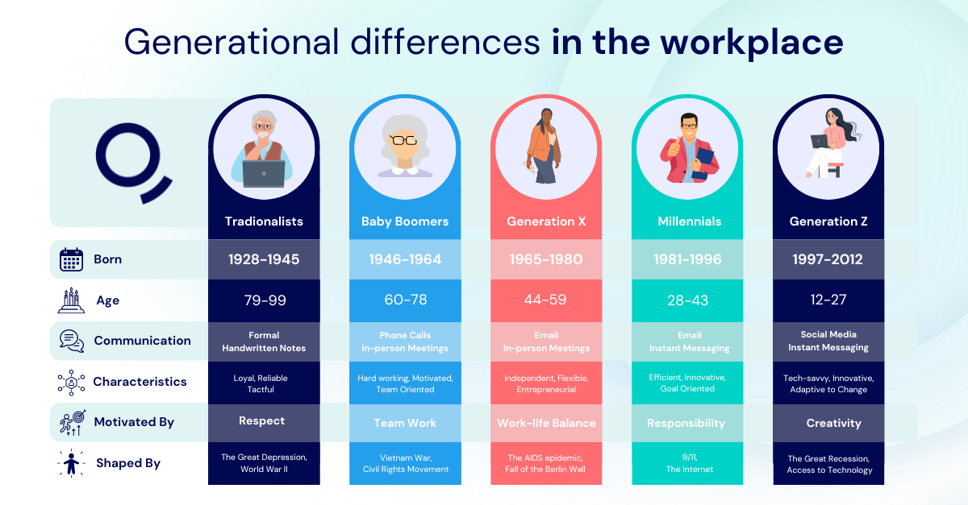
Harnessing Strengths of Each Generation: www.Qualee.com

Slide 16
Why Does This Matter So Much?
The employment world is changing and California Community Colleges need to change with it.
Millennials and Gen Z comprise 45% of the workforce and are truly different
“That’s how we have always done it” does not work for them….they don’t care
They want recognition, autonomy, and tasks that interest them
They want to feel like they are adding value to the organization

Slide 17
Why Does this Matter So Much - Cont’d
They want a sense of belonging at work
They want a healthy amount of time when they are not at work
And, they also won’t work for the same employer for their entire career
HR PROFESSIONALS NEED TO BE AT THE FOREFRONT OF CHANGE

Slide 18
CEO & HR: Two Sides of the Same Coin
THE CEO AND HR MUST BE PARTNERS IN LEADING INSTITUTIONAL CHANGE
The CEO provides the institutional vision and the authority to move the organization forward.
HR understands the people, culture, labor relationships, organizational structures, and systems that must support that vision.

Slide 19
CEO & HR: Two Sides of the Same Coin - Cont’d
Neither can successfully manage transformational change without the other.
When the CEO and HR are aligned, change moves from being an initiative to becoming part of the institution.

Slide 20
Recommendation #1
WE NEED TO FOCUS ON WHAT IS POSSIBLE RATHER THAN WHAT IS ALLOWED….

Slide 21
Recommendation #2
WE NEED TO RECONCEPTUALIZE AND REDESIGN THE EDUCATION CODE AND THE EERA TO BRING THEM INTO THIS DECADE OF THIS CENTURY.

Slide 22
Recommendation #3
WE NEED TO REVISE JOB DESCRIPTIONS AND COLLEGE ORGANIZATIONAL CHARTS TO ALLOW FOR BROADER TASKS AND RESPONSIBILITIES

Slide 23
RECOMMENDATION #4
WE NEED TO BE REALISTIC ABOUT THE IMPACT OF AI IN THE WORKPLACE….
WHICH CAN ONLY HAPPEN AFTER RECOMMENDATIONS 1-3 HAVE BEEN ADDRESSED

Slide 24

TWO PHILOSOPHIES TO LIVE BY
SEMPER GUMBY!
ALWAYS FLEXIBLE
OUT OF THE CHAOS COMES CLARITY

Slide 25


