Slide 1
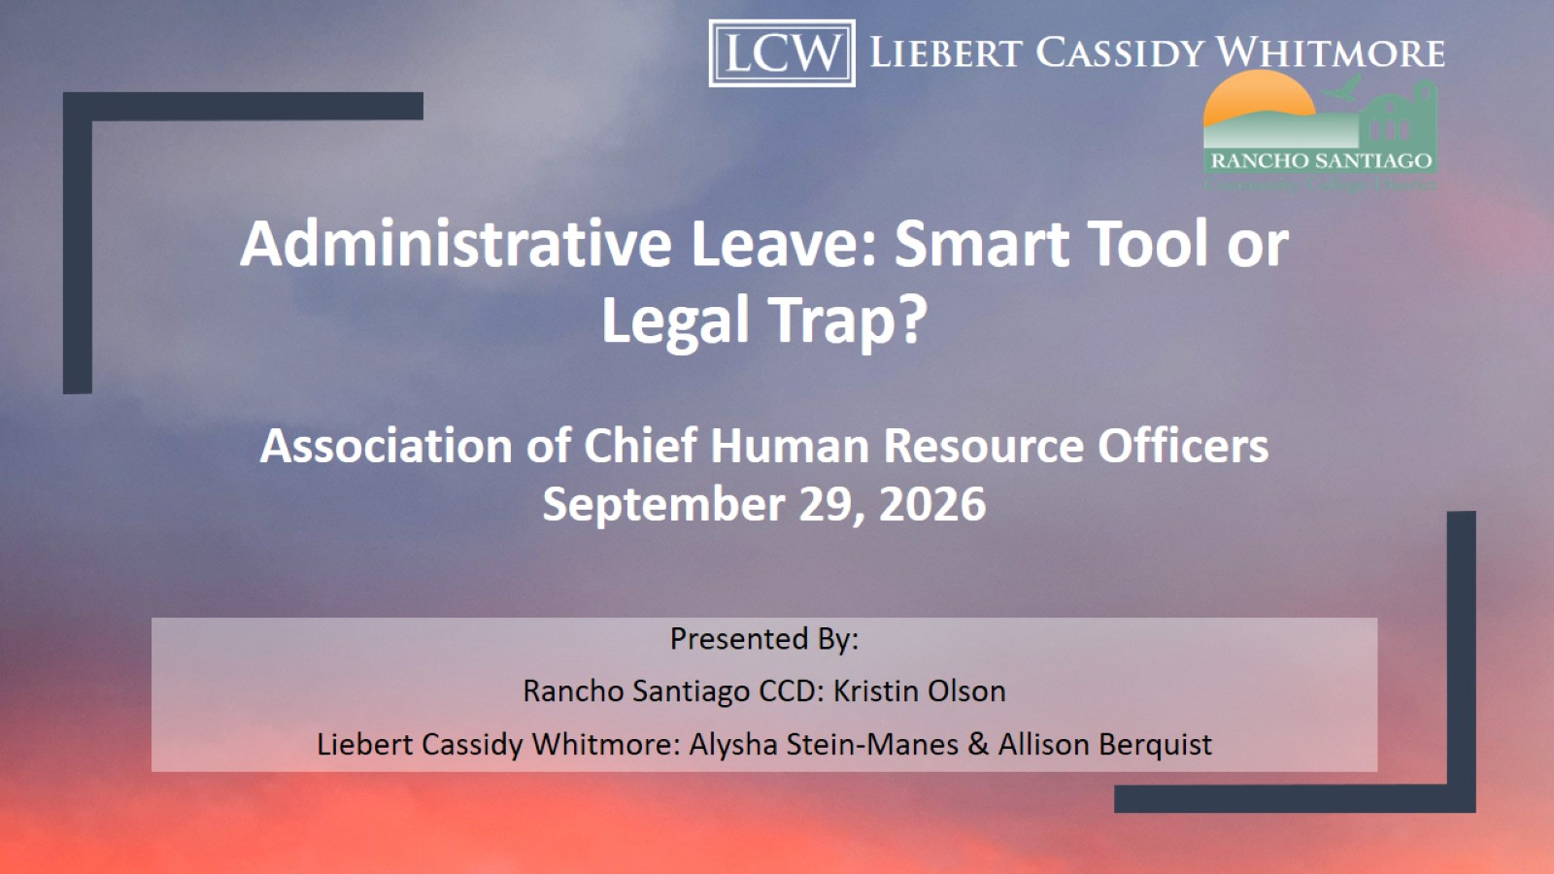
Administrative Leave: Smart Tool or Legal Trap?
Association of Chief Human Resource Officers
September 29, 2026

Slide 2
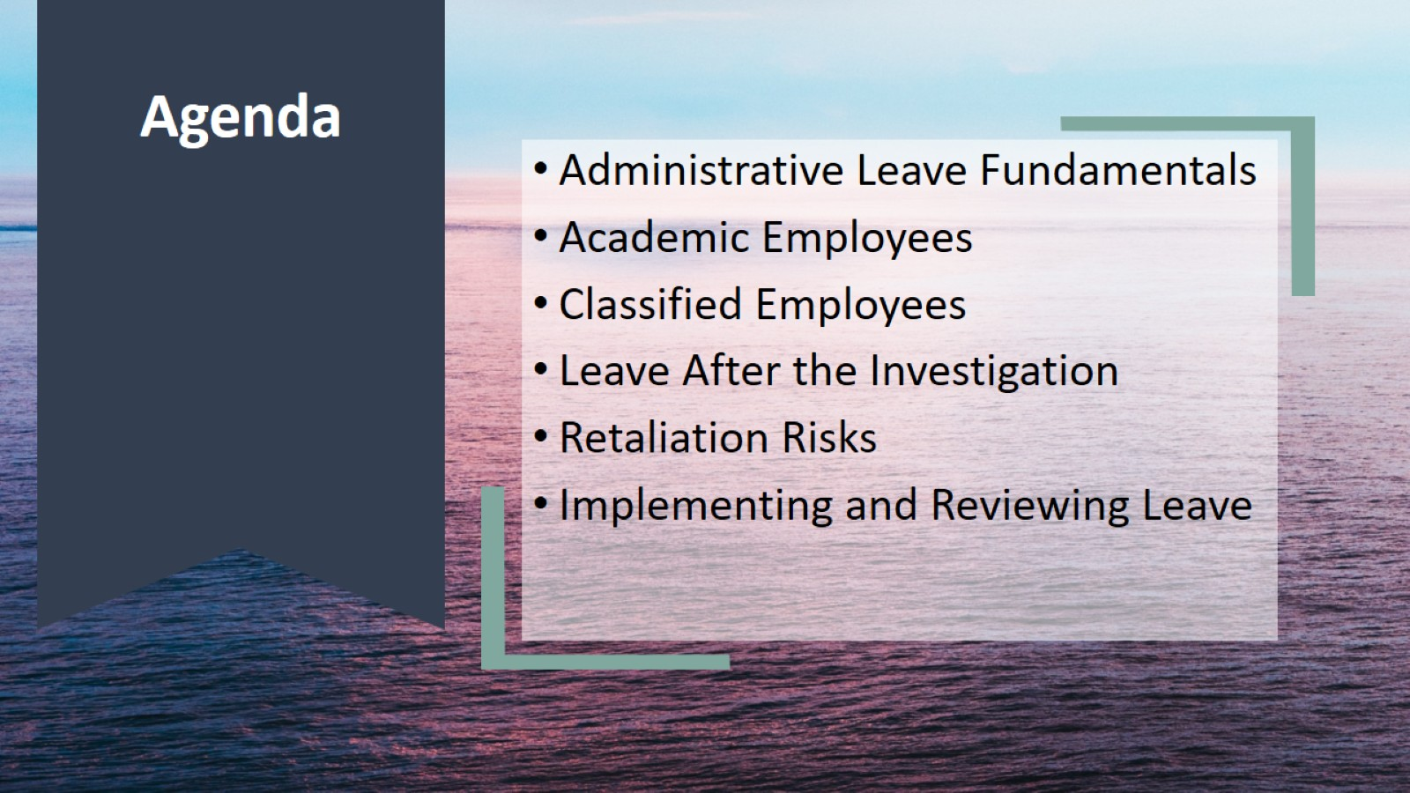
Agenda

Slide 3

Administrative Leave Fundamentals

Slide 4
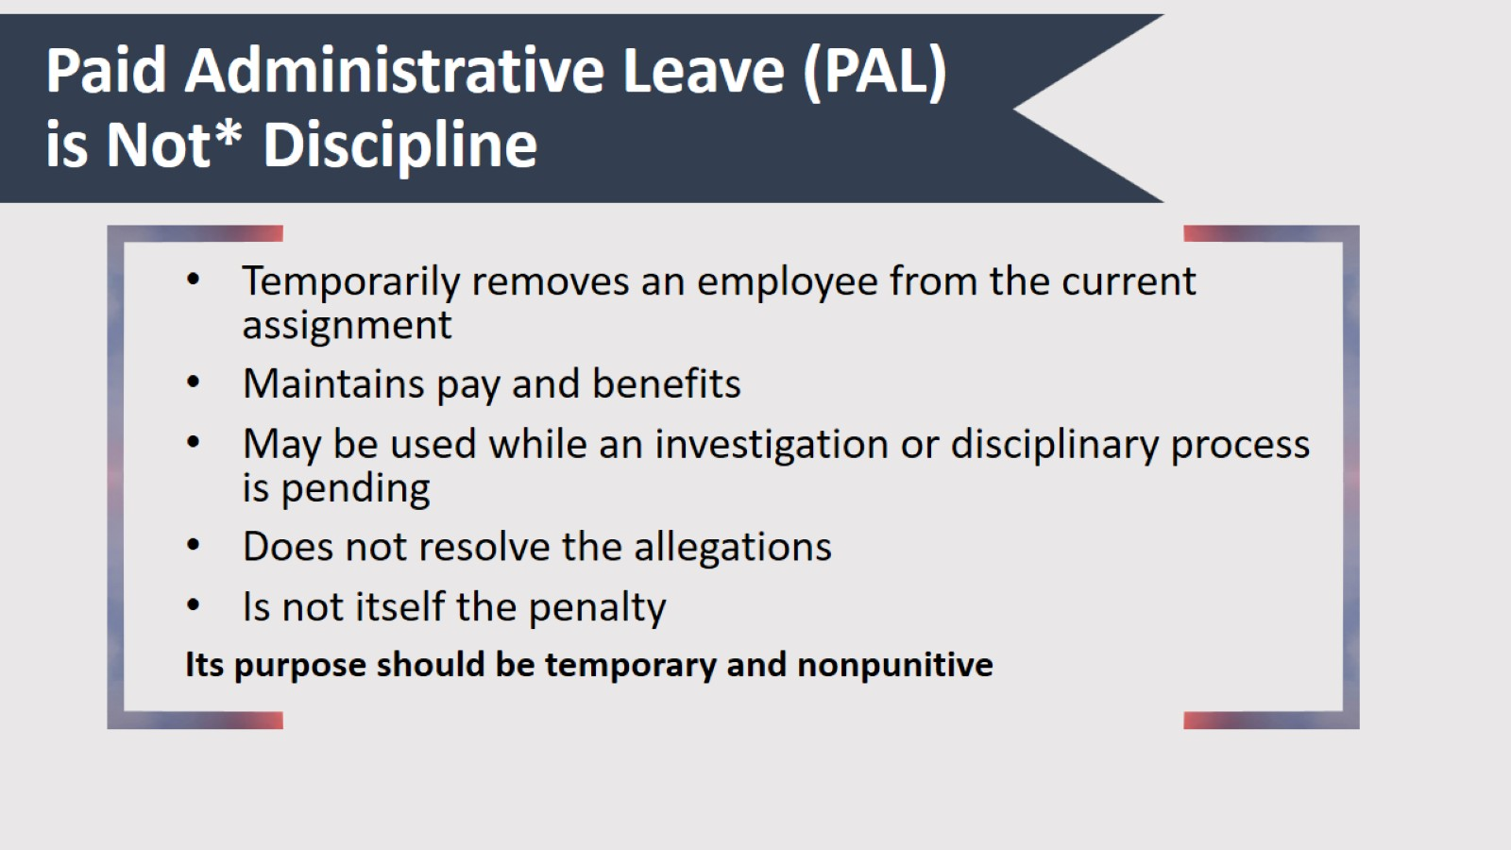
Paid Administrative Leave (PAL) is Not* Discipline

Slide 5
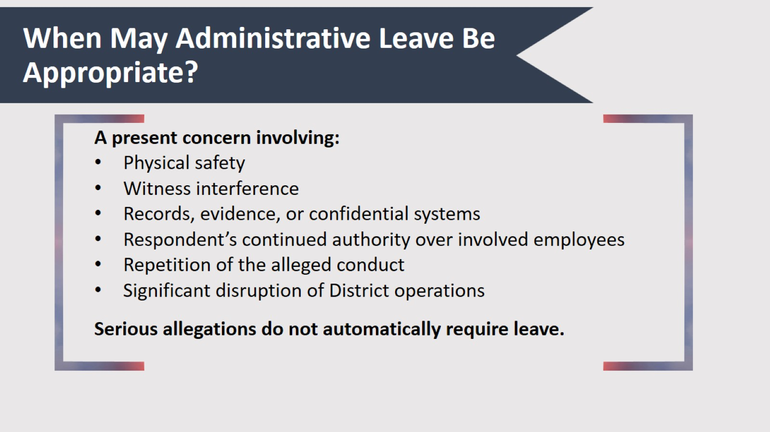
When May Administrative Leave Be Appropriate?

Slide 6
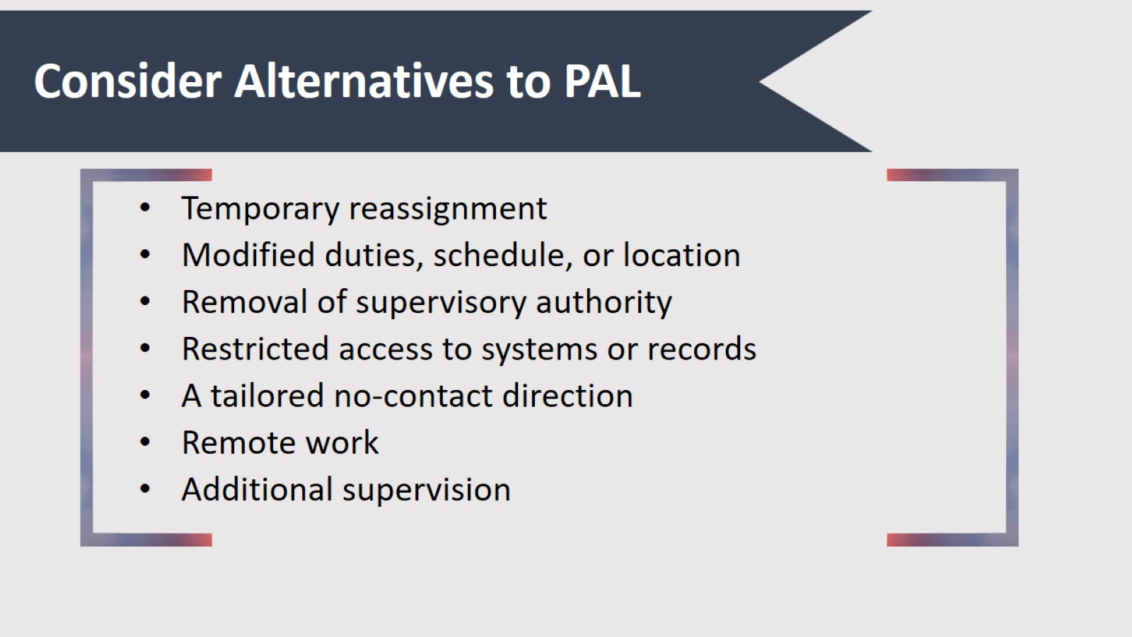
Consider Alternatives to PAL

Slide 7
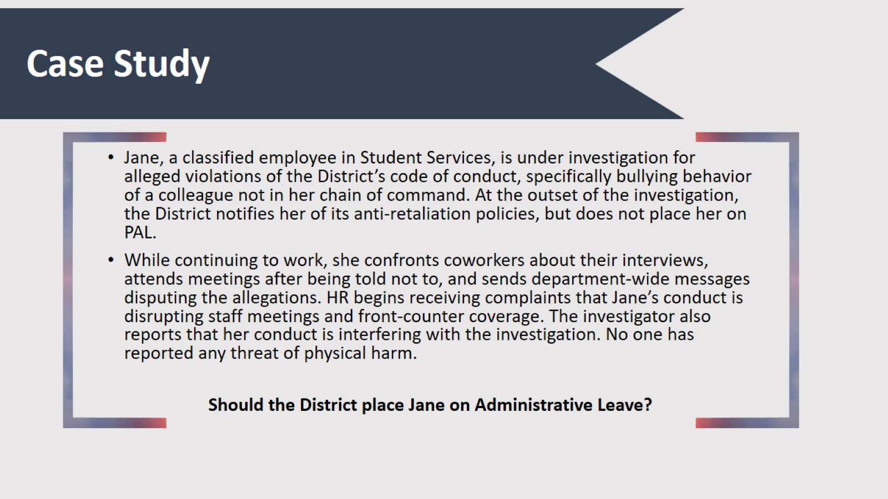
Case Study

Slide 8
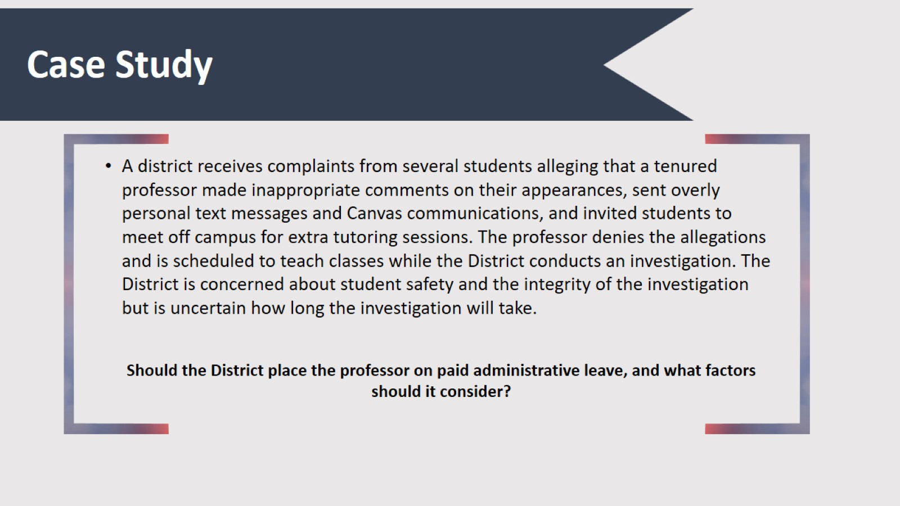
Case Study

Slide 9

Administrative Leave for Academic Employees

Slide 10
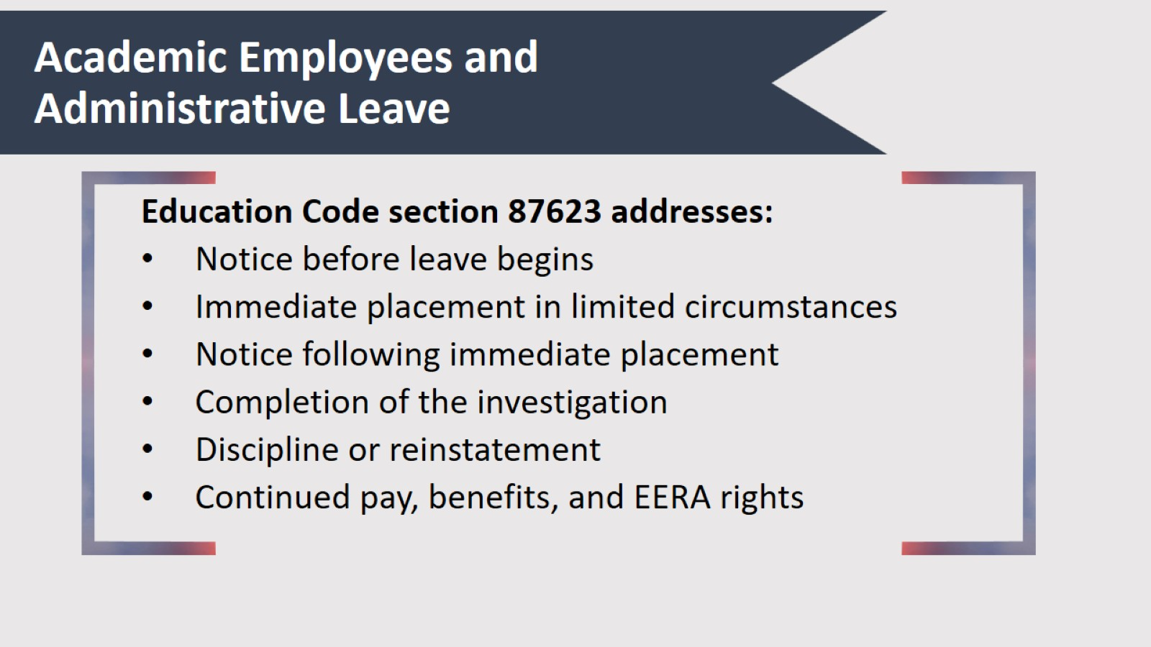
Academic Employees and Administrative Leave

Slide 11
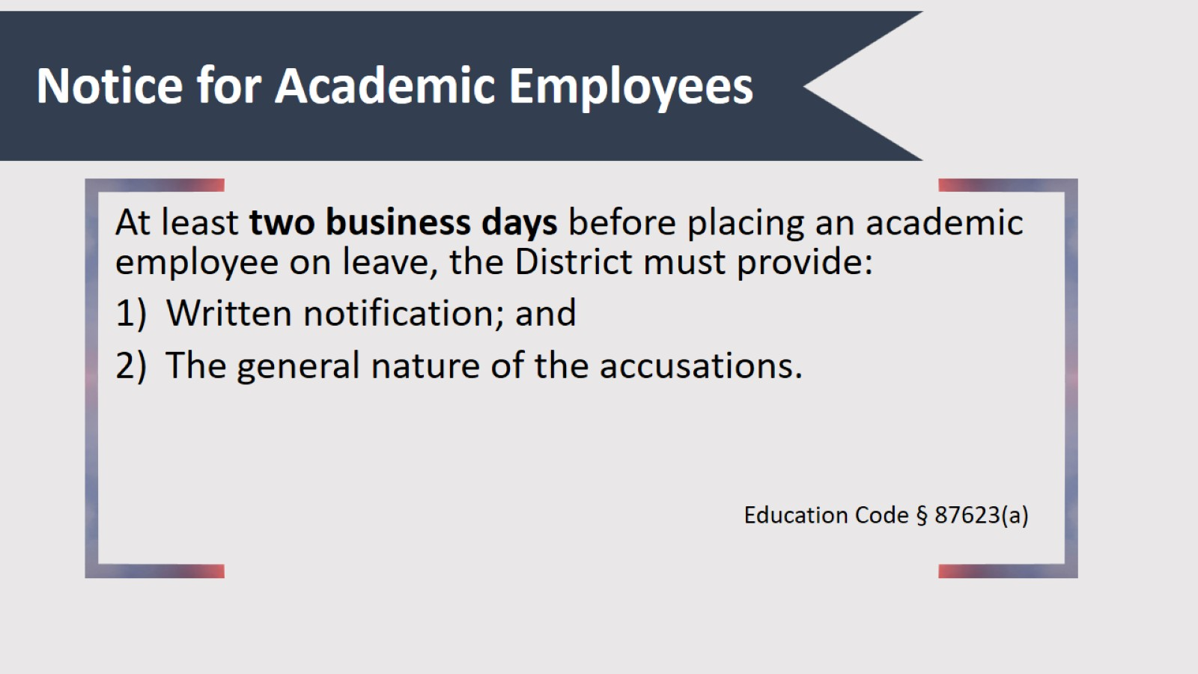
Notice for Academic Employees

Slide 12
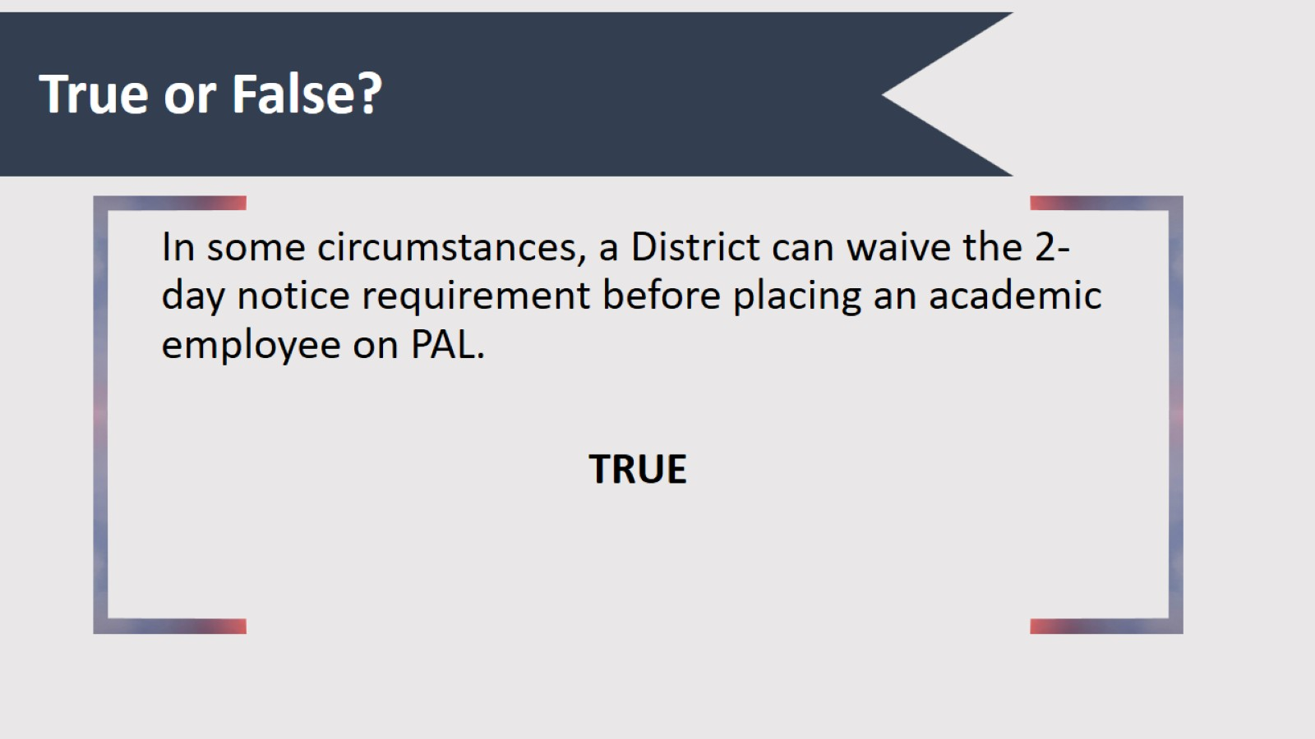
True or False?

Slide 13
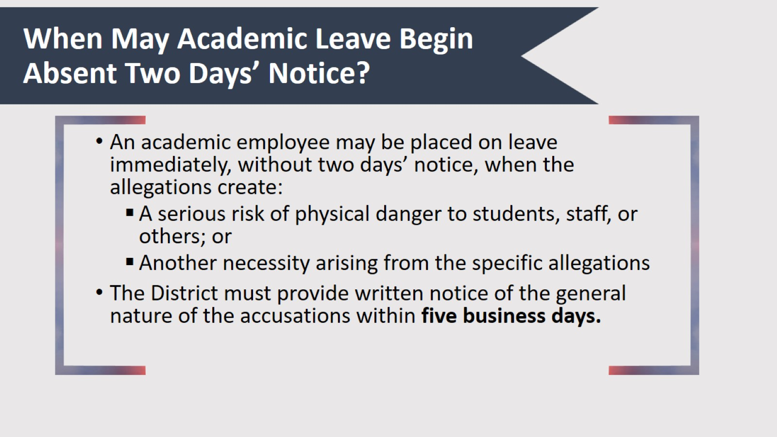
When May Academic Leave Begin Absent Two Days’ Notice?

Slide 14
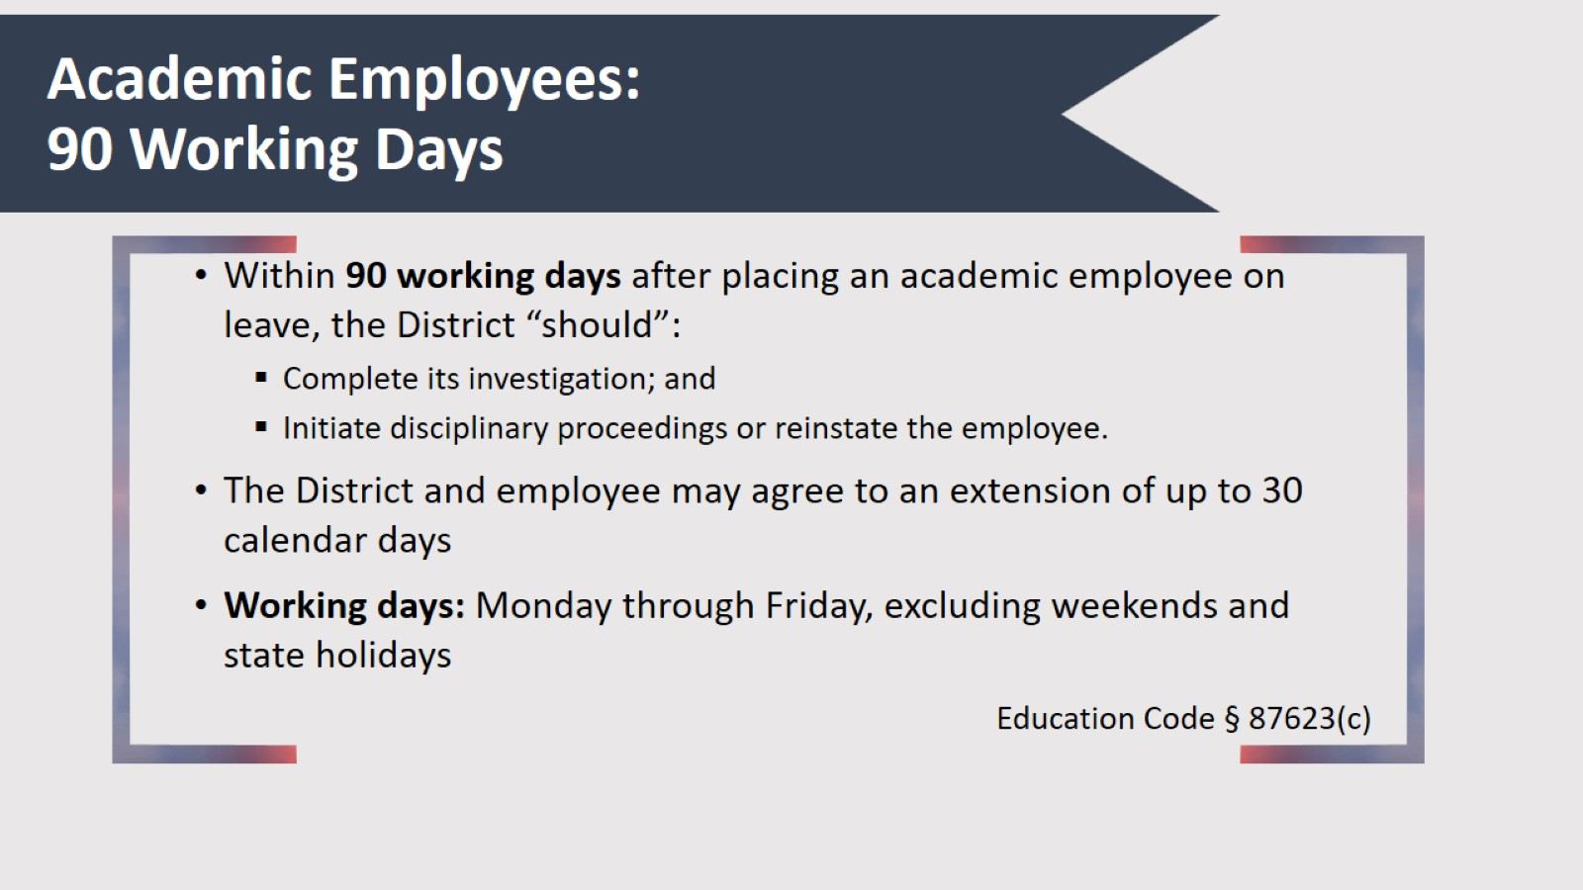
Academic Employees: 90 Working Days

Slide 15
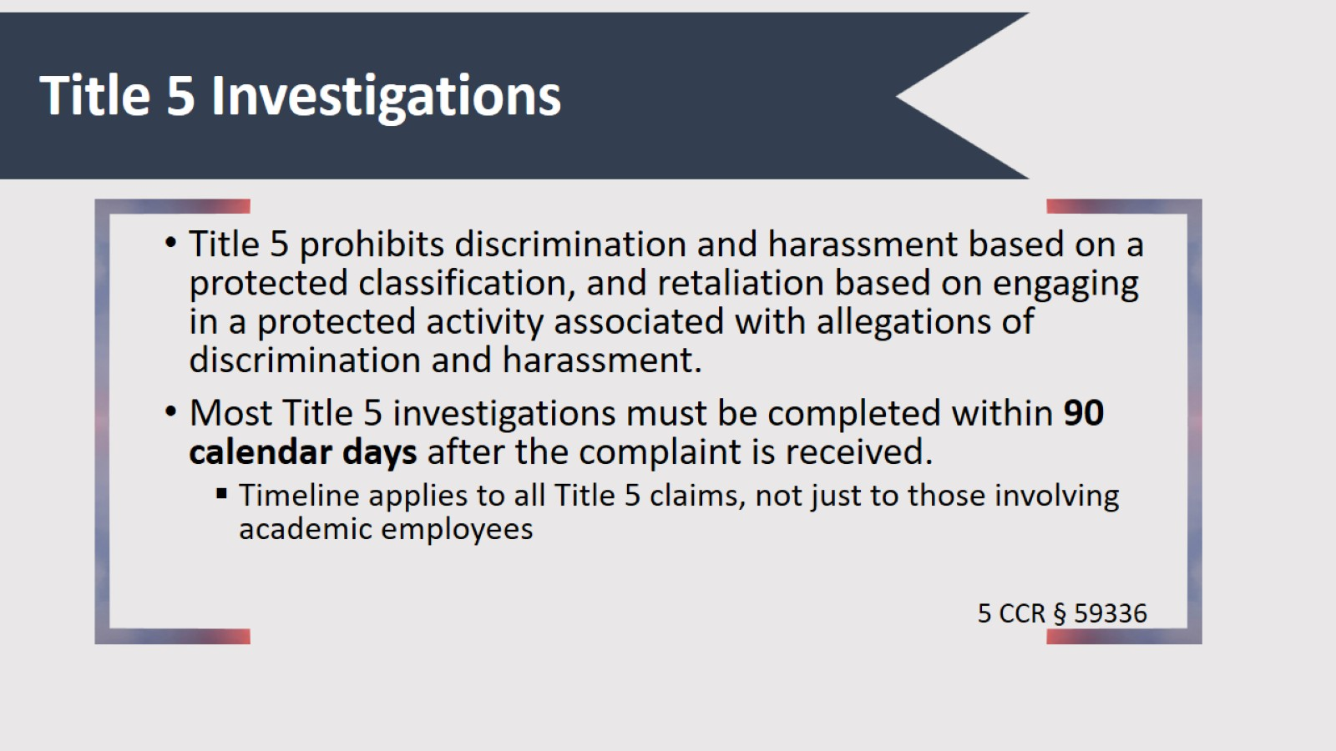
Title 5 Investigations

Slide 16
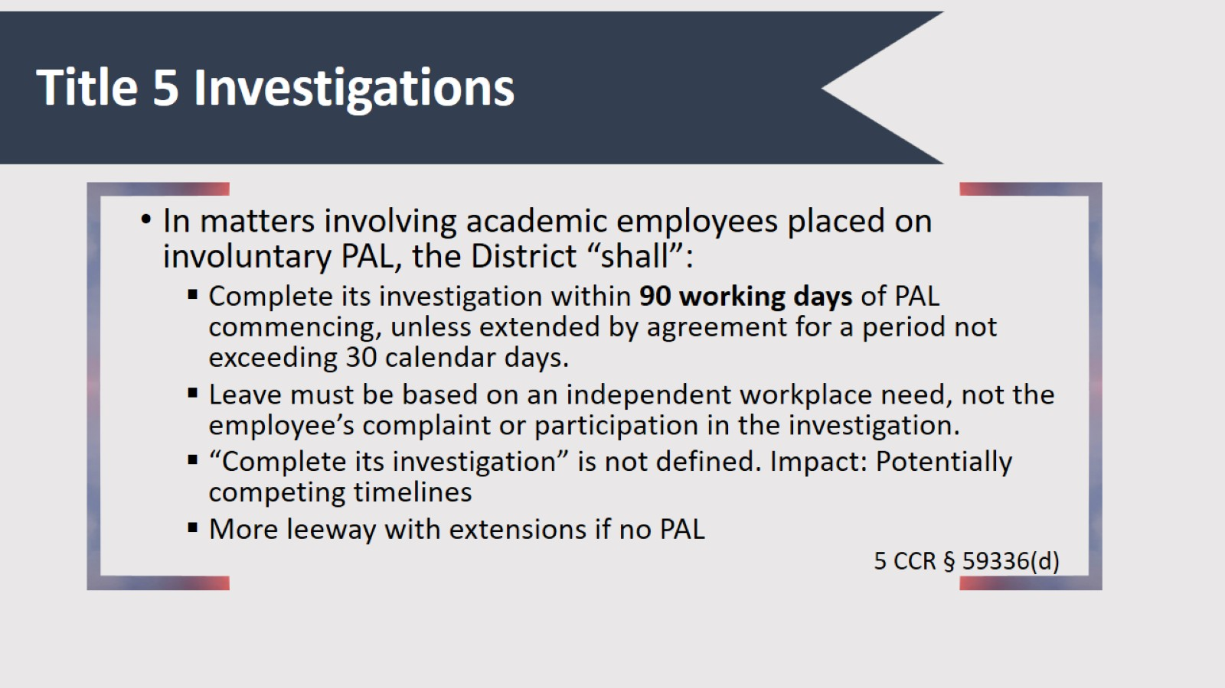
Title 5 Investigations

Slide 17
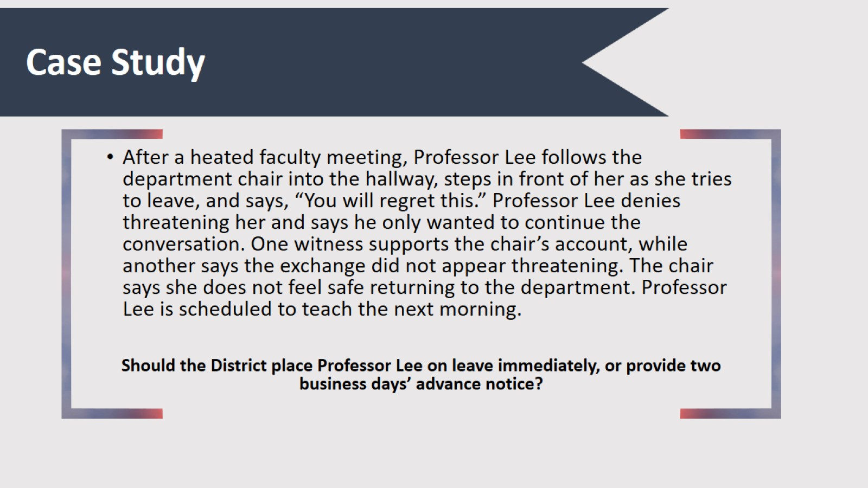
Case Study

Slide 18
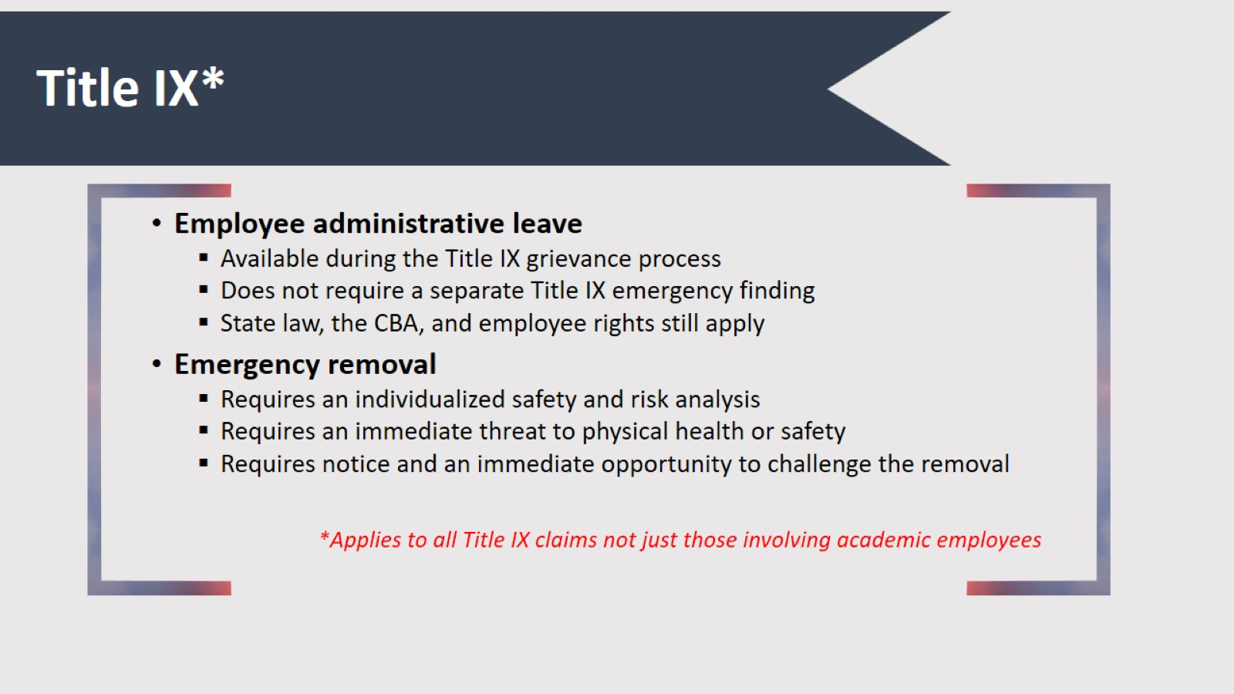
Title IX*

Slide 19
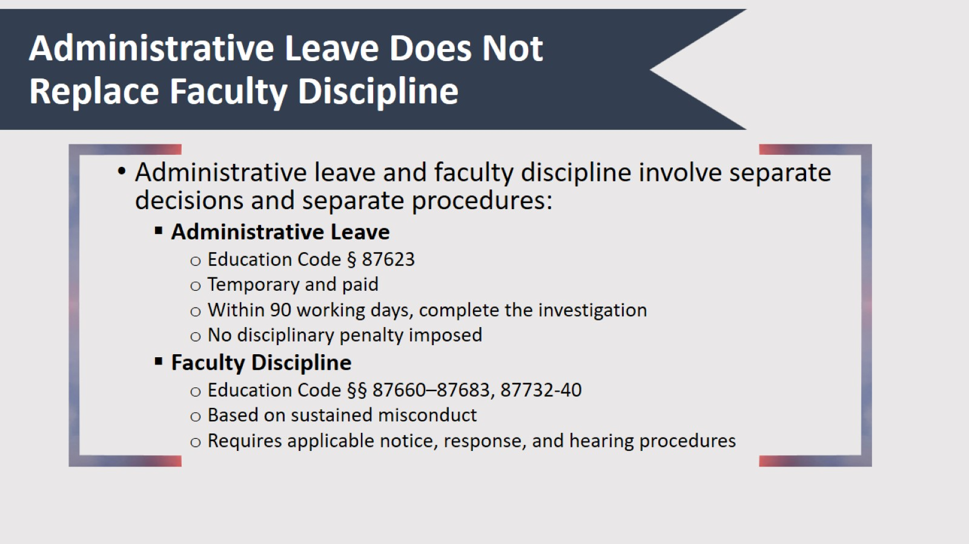
Administrative Leave Does Not Replace Faculty Discipline

Slide 20

Administrative Leave for Classified Employees

Slide 21
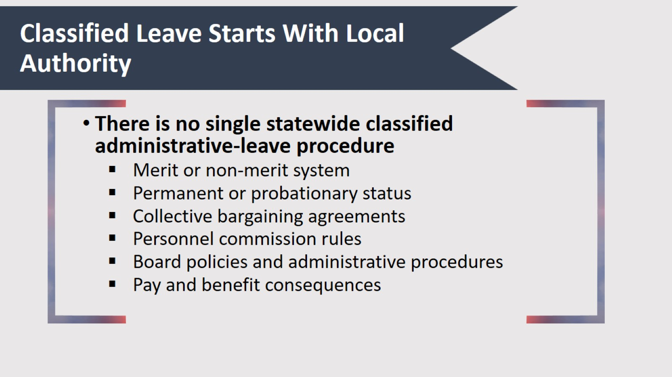
Classified Leave Starts With Local Authority

Slide 22
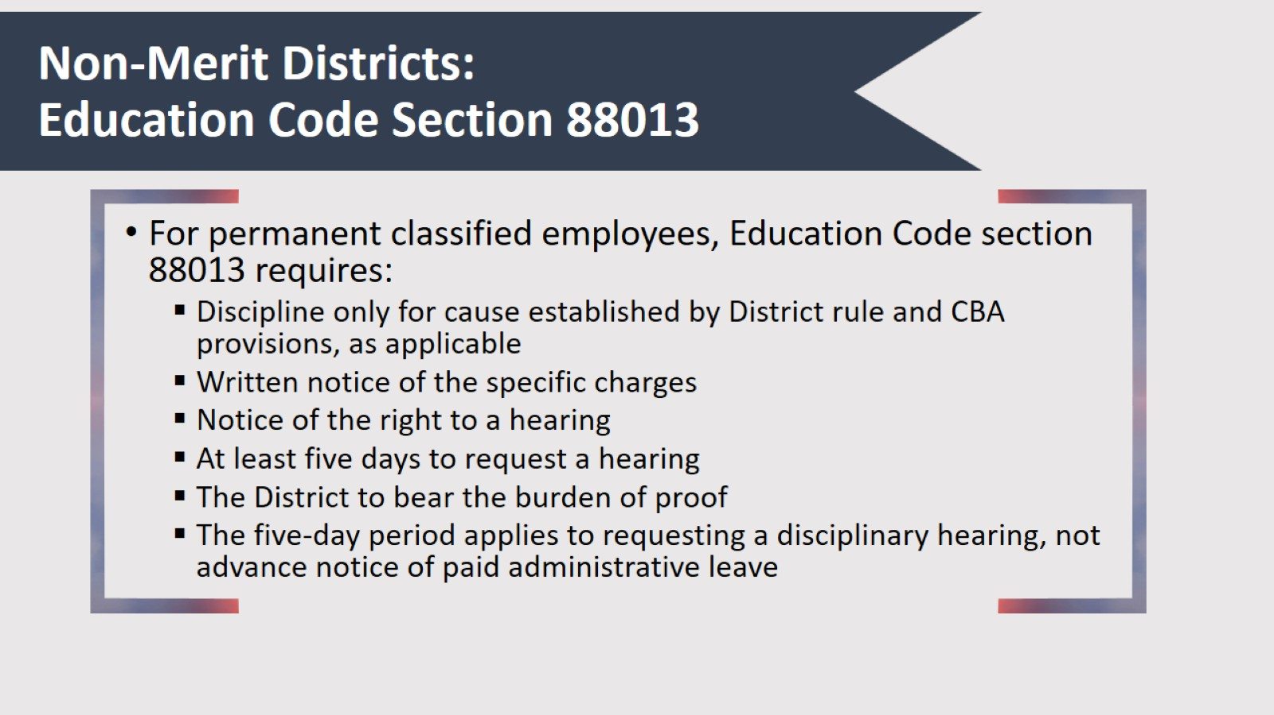
Non-Merit Districts:
Education Code Section 88013

Slide 23
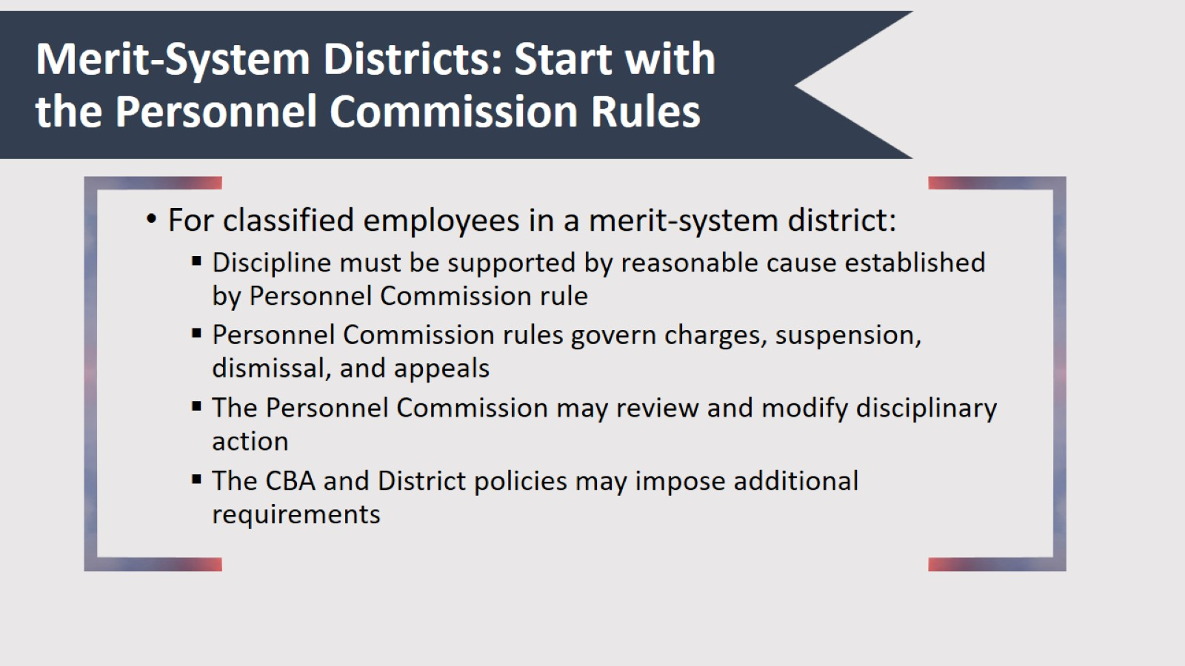
Merit-System Districts: Start with the Personnel Commission Rules

Slide 24

Leave Following Arrest & Criminal Charges

Slide 25
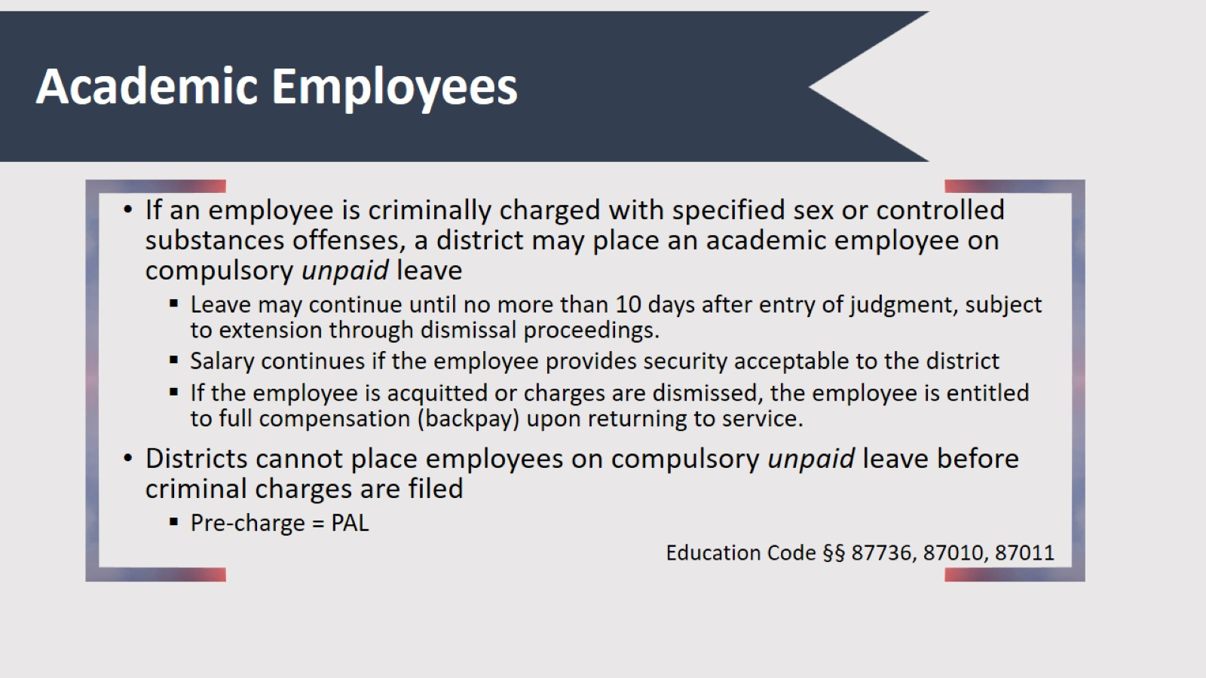
Academic Employees

Slide 26
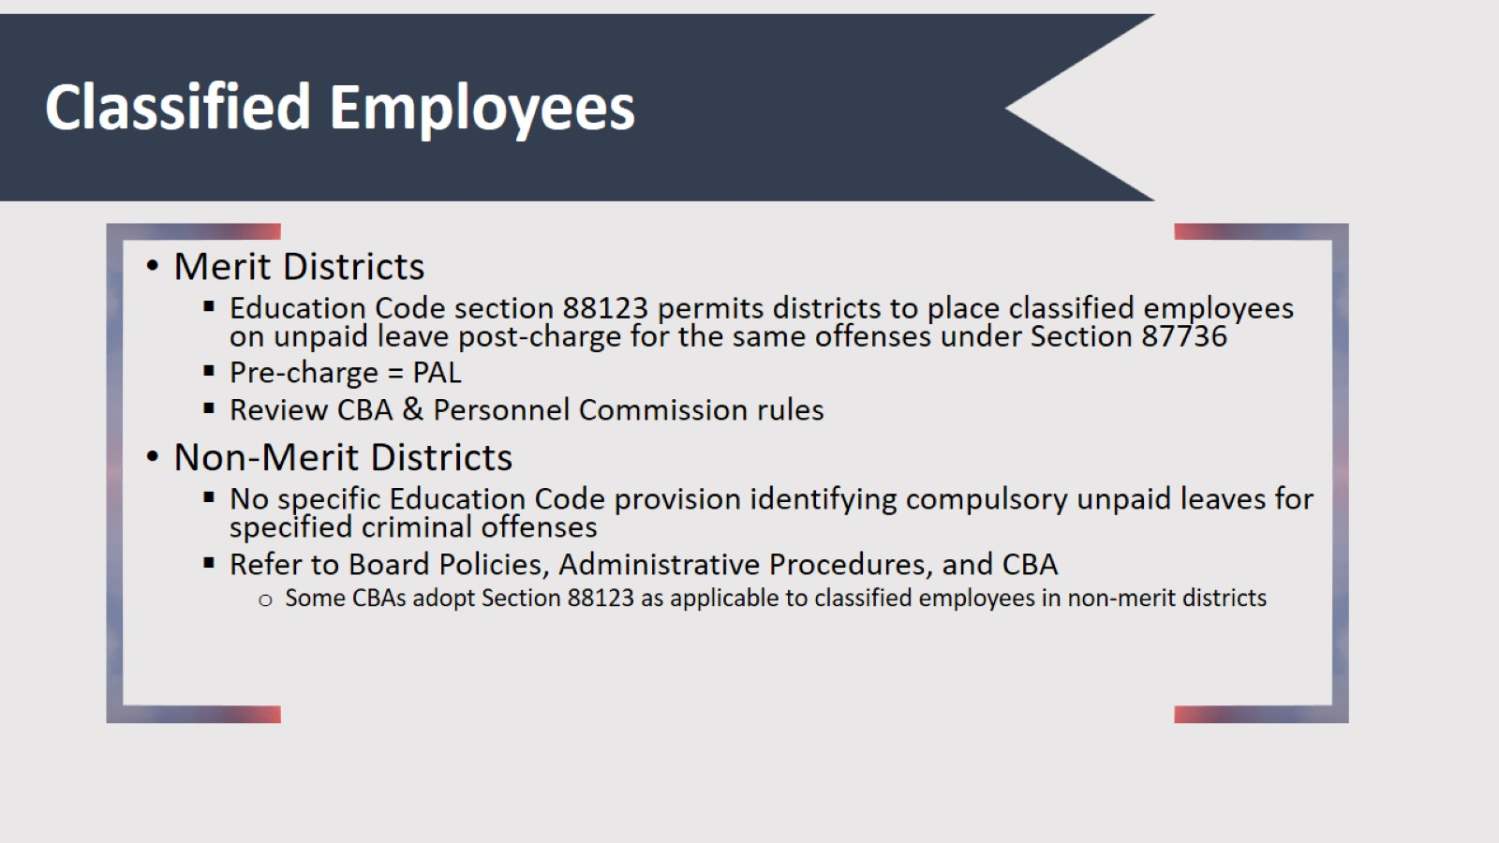
Classified Employees

Slide 27
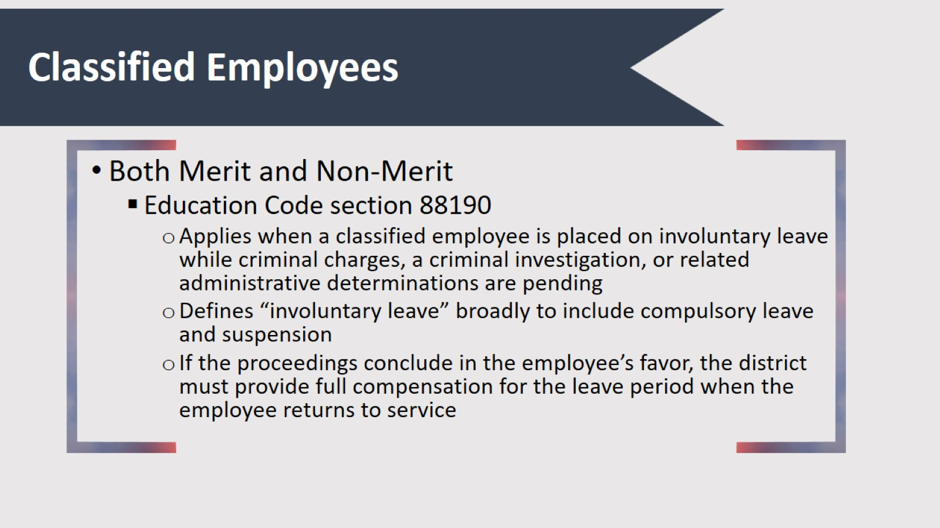
Classified Employees

Slide 28

Leave After the Investigation

Slide 29
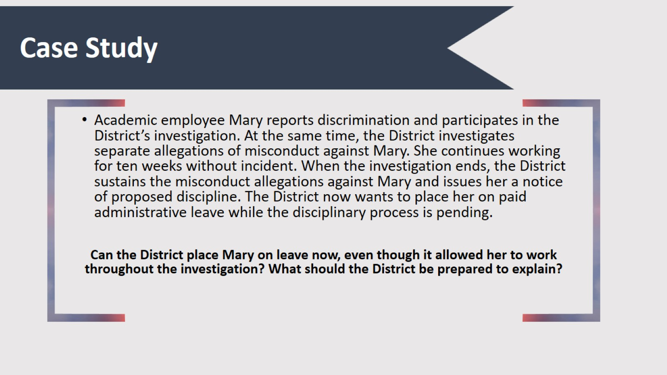
Case Study

Slide 30
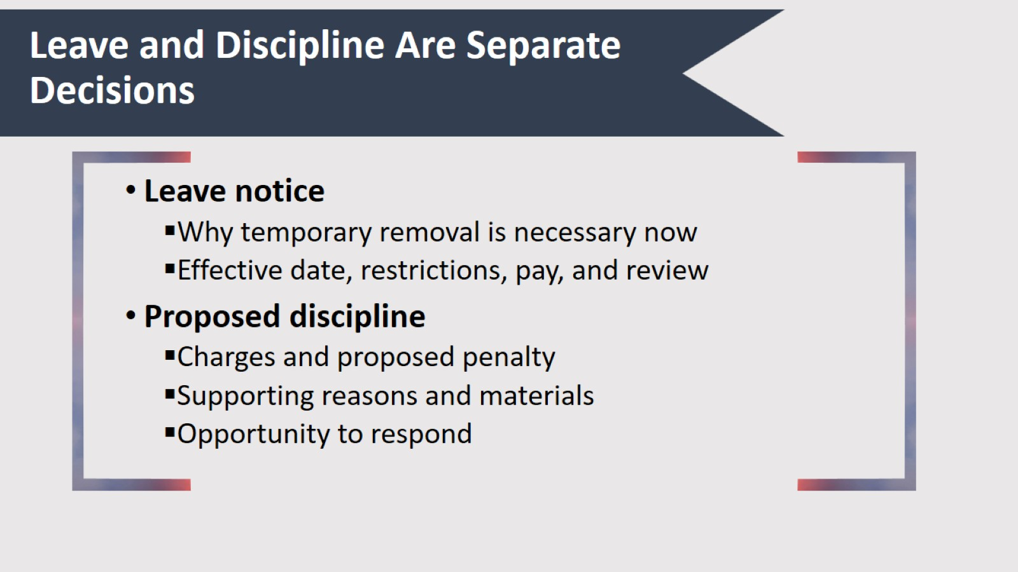
Leave and Discipline Are Separate Decisions

Slide 31

Retaliation and Adverse-Action Risk

Slide 32
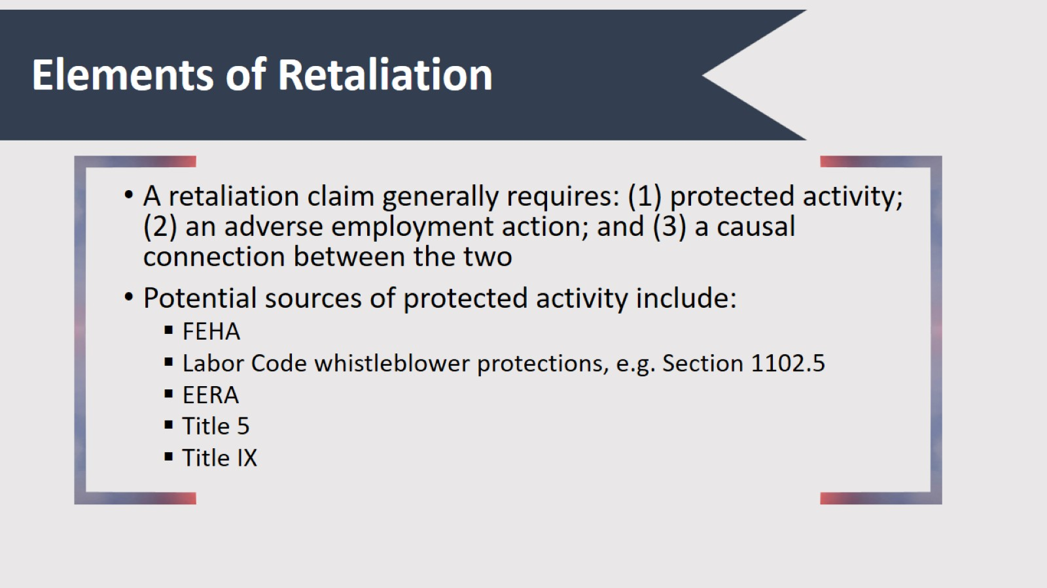
Elements of Retaliation

Slide 33
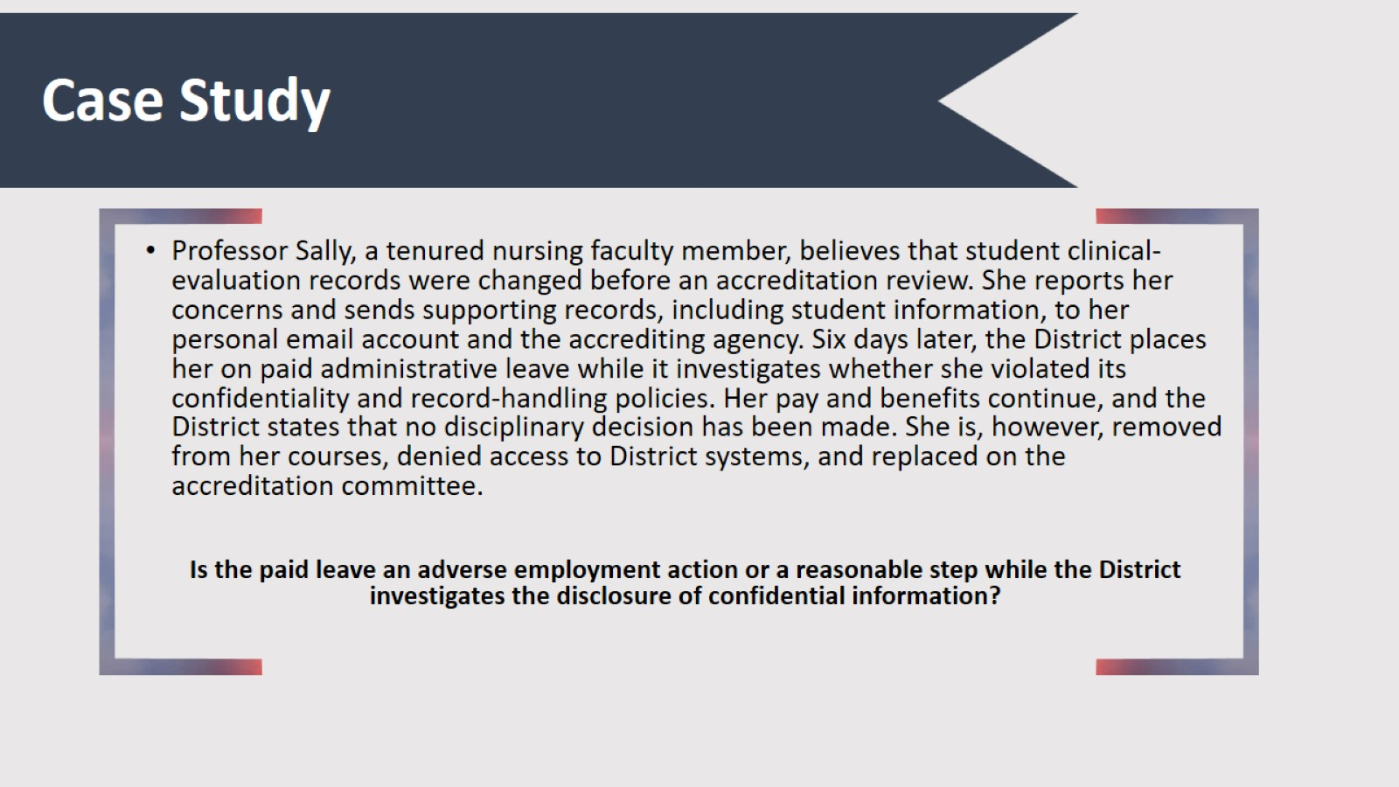
Case Study

Slide 34
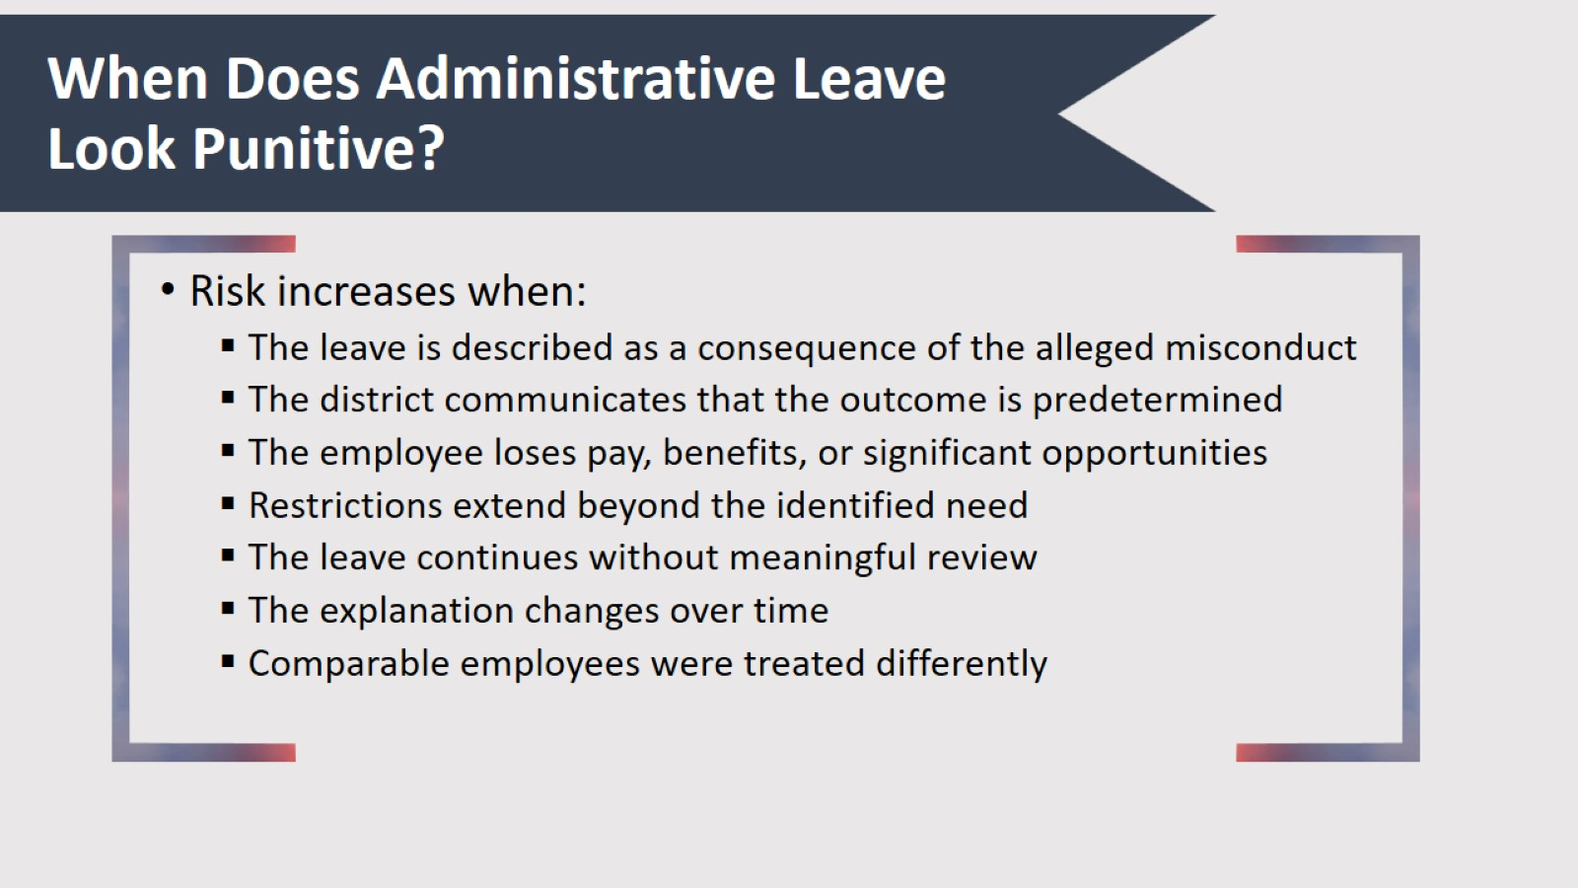
When Does Administrative Leave Look Punitive?

Slide 35
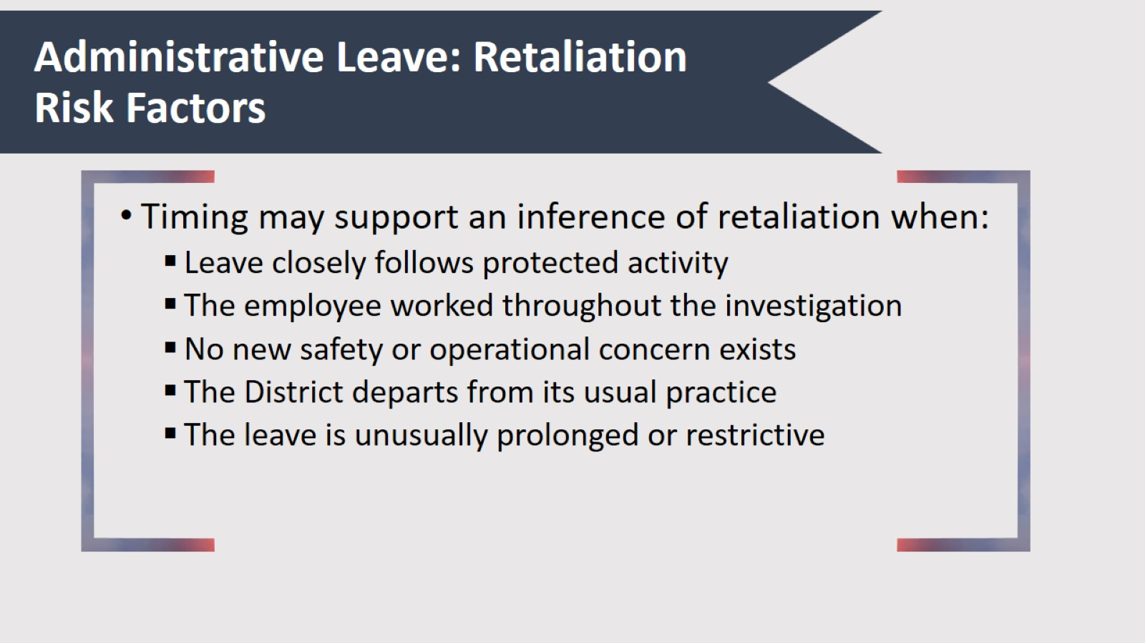
Administrative Leave: Retaliation Risk Factors

Slide 36
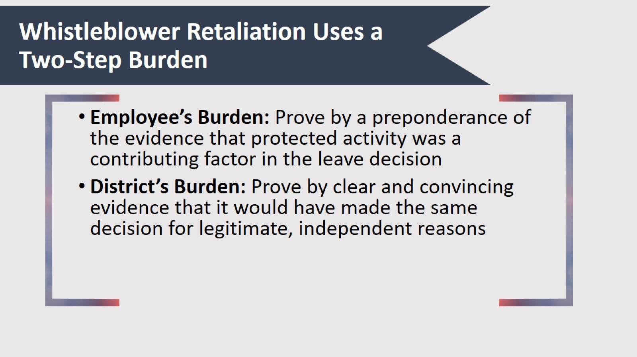
Whistleblower Retaliation Uses a Two-Step Burden

Slide 37
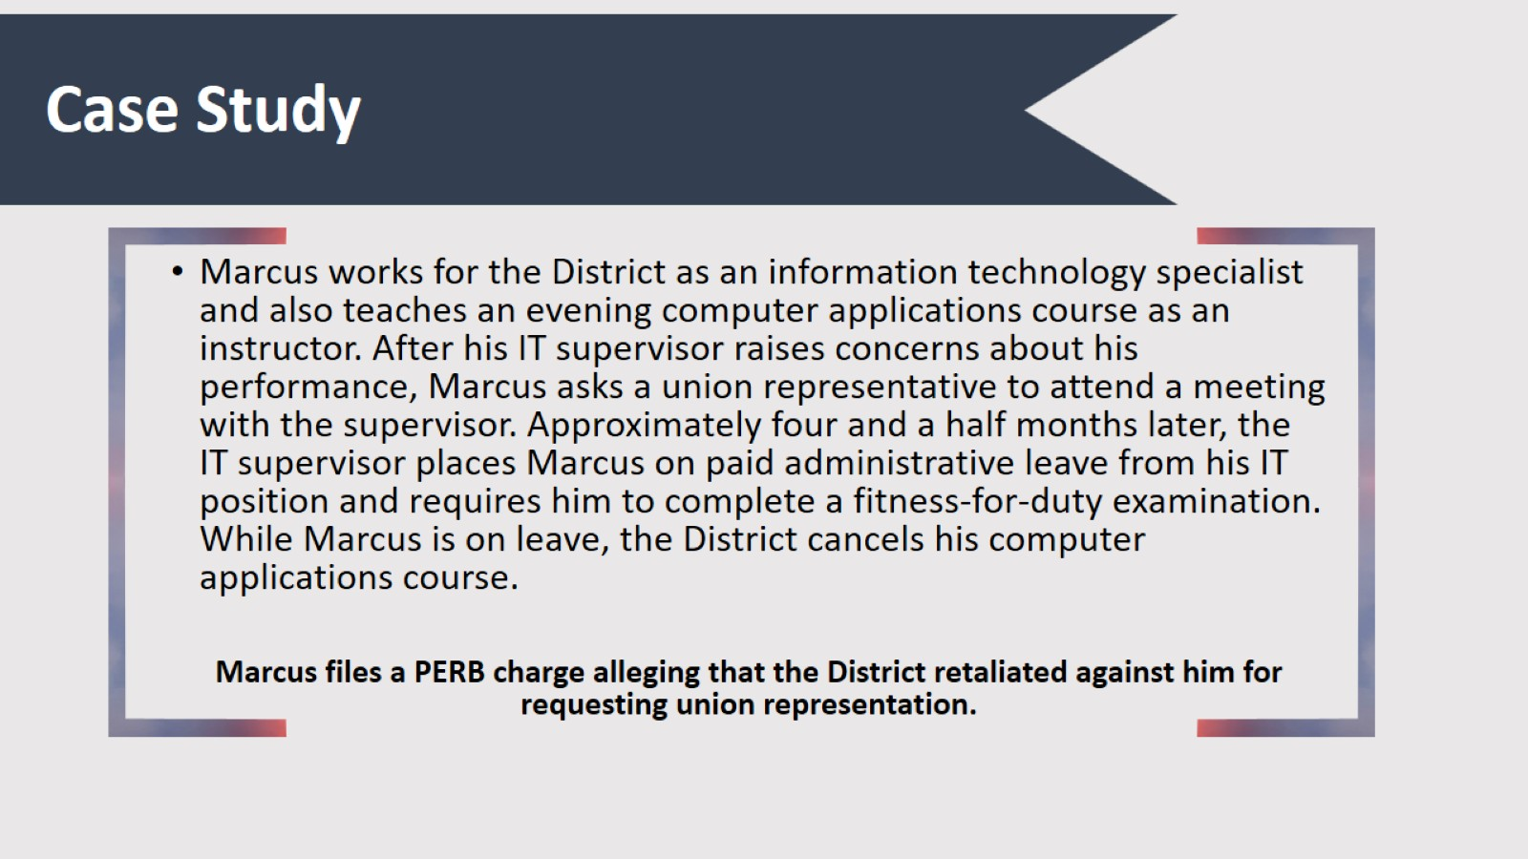
Case Study

Slide 38
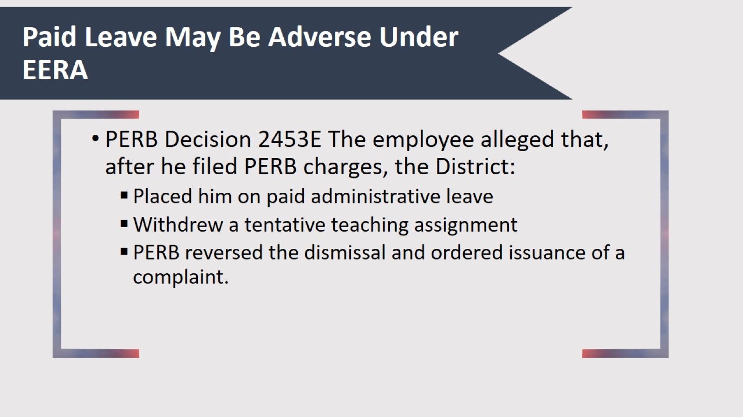
Paid Leave May Be Adverse Under EERA

Slide 39
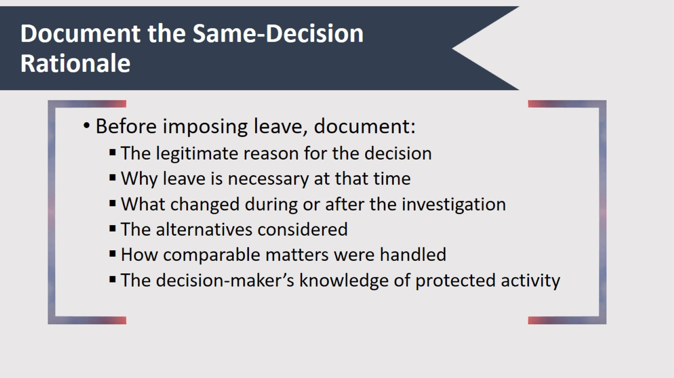
Document the Same-Decision Rationale

Slide 40

Final Considerations

Slide 41
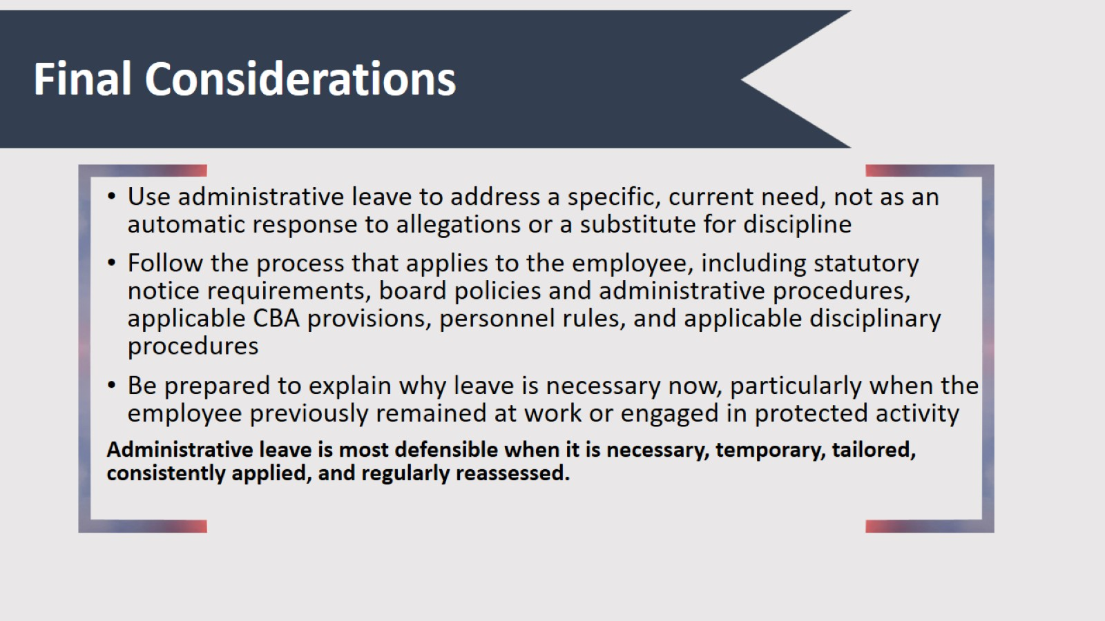
Final Considerations

Slide 42

Questions?

Slide 43
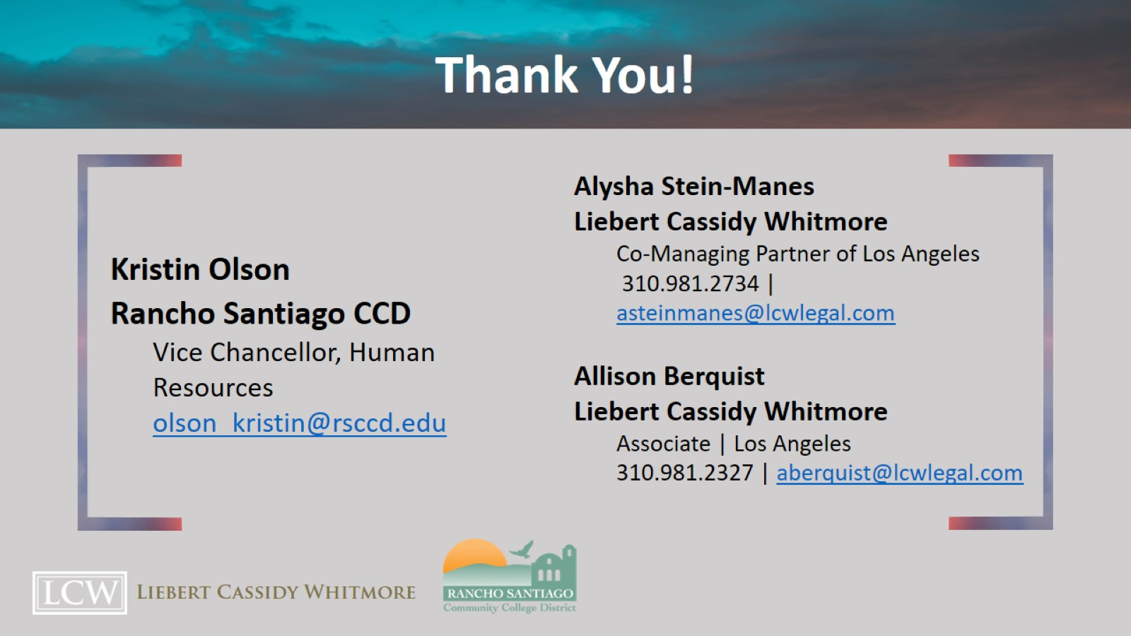
Thank You!

