Slide 1
Navigating the Storm: How to Succeed in Bargaining in Tough Times
A Practical Playbook for School District Labor Relations
Presented by: Michelle L. Cannon, Attorney and Ryan Davis, Vice President Human Resources for Sierra Joint Community College District
ACHRO Fall Institute | September 30, 2026

Slide 2
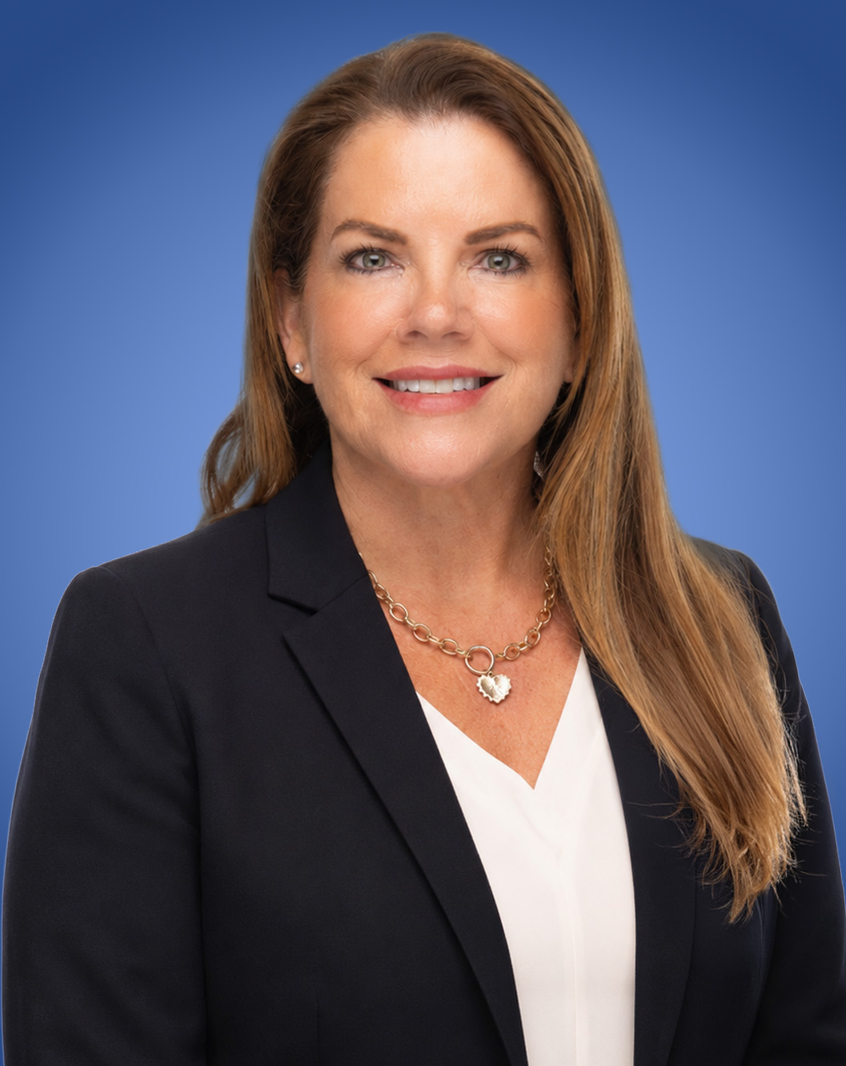
Presenter
Michelle L. Cannon
Michelle L. Cannon is a Partner in Lozano Smith’s Sacramento office. For over 25 years Ms. Cannon has worked closely with a variety of public entities including school districts, community colleges, and special districts. She is an active member in the Labor & Employment, Community Colleges, and Litigation Practice Groups. Ms. Cannon has extensive experience in board governance and training, labor and personnel-related matters, and student discipline. She was named to the Northern California Super Lawyers list each year from 2013 to 2020, and a Top Lawyer in Schools & Education by Sacramento Magazine from 2016 to 2020.
Michelle has worked extensively in the collective bargaining arena in various roles. These roles include, but are not limited to, working as a facilitator in Interest Based Bargaining, acting as lead negotiator in the creation of new contracts, and advising clients through impasse proceedings.
mcannon@lozanosmith.com
916.329.7433

Slide 3
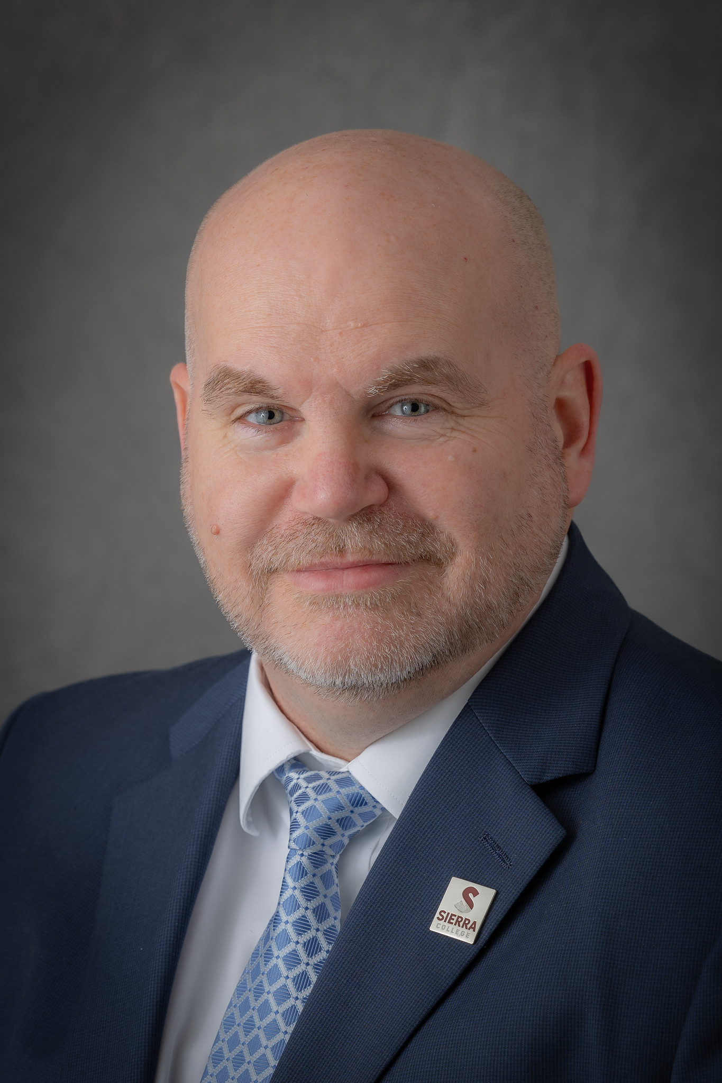
Presenter
Ryan Davis
Ryan Davis has served as Assistant Superintendent/Vice President of Human Resources for the Sierra Joint Community College District for the past eleven years. In this role, he provides strategic leadership in human resources and organizational operations.
Before joining Sierra, Ryan held human resources leadership positions in several K–12 school districts, including Western Placer Unified School District, Tracy Unified School District, and Grant Joint Union High School District. He also practiced education and employment law for a Sacramento-based law firm, where he advised school districts on a range of legal and personnel matters.
Earlier in his career, he worked as a middle school and high school teacher and coach, bringing a broad educational perspective to his leadership service.
rdavis23@sierracollege.edu
916.660.7101

Slide 4
What We'll Cover
Preparing for the Table
Budget Basics
Roles, climate, homework, and your bargaining binder.
The financial fluency every negotiator needs.
Strategy and Technique
Handling Challenges
Interest-based bargaining, BATNA, and reading the room.
Curveballs to expect and conduct to avoid.
Drafting Language
Communications
Writing agreements that hold up later.
Board, community, and the union, done right.
Concerted Activity
Impasse and Fact-Finding
Protected vs. unprotected, at a glance.
The path when the table stalls.

Slide 5
Preparing for the Table
Getting yourself, your team, and your district ready.

Slide 6
Read the Landscape Before You Sit Down
Understand Your Role
Assess the Climate
Audit the Current CBA
Clarify with the Board and superintendent: are you lead, support, or behind the scenes? What’s the relationship with the union today — adversarial, constructive, or fragile?
Is union leadership strong or weak? Is there an influential field rep? A clear read on climate shapes strategy before proposal one is ever exchanged.
Identify problem clauses and outdated language now, so the district has a realistic plan to improve the contract — not just react at the table.
Don’t forget the Board: know what they’ll tolerate, what they want, and how you get direction from them along the way.

Slide 7
Homework, Your Binder and the Sunshine Rule
Pre-bargaining homework
Cost of 1% for the union and for all groups
Scattergrams and salary/benefit comparability
Budget presentations and ending fund balance
Grievance and unfair practice history
Your bargaining binder
Proposal tracker
Sunshine proposals (district and union)
Ground rules and CBA
Bargaining notes and handouts exchanged
The Sunshine Rule
Sunshine proposals must be presented at a public meeting, with an opportunity for public comment.
Sunshine proposals are public records.
Bargaining cannot begin until after the meeting where the district’s sunshine is adopted.
New subjects raised after sunshine — and any vote on them — must be made public within 24 hours.
Government Code § 3547

Slide 8
Strategy and Technique
Two philosophies at the table, and the instincts that serve both.

Slide 9
Interest-Based vs. Traditional Bargaining
Interest-Based Bargaining
Traditional / Positional
Focuses on underlying interests,
not fixed positions.
Joint problem-solving toward mutual gain.
Often facilitated, with agreed ground rules.
Builds relationship capital for
future bargaining.
Parties stake out positions and
trade concessions.
Proposals move through a defined exchange process.
Clear norms for how changes are
identified and dated.
Familiar structure; can entrench
early positions.

Slide 10
Instincts That Serve Every Table
Know Both Wallets
Understand your BATNA — and think hard about theirs. What’s each side's real alternative if this deal falls apart?
Actually Listen
Repeat or paraphrase what you heard. Ask curious questions. Listening is not the same as waiting for your turn to speak.
Keep Your Cool
Emotional discipline at the table is a strategic asset — reactive moments get remembered longer than substantive ones.
Help Them Sell It
Both sides need a deal they can sell to their constituents. Making that easier for the other side isn’t a favor — it's how deals close.

Slide 11
Handling Challenges
Curveballs to expect, and conduct that puts the district at risk.

Slide 12
Expect the Curveball — And Know the Line
Challenges to Anticipate
Conduct to Avoid
A sudden change in law mid-negotiation.
Changed circumstances requiring unilateral action.
A team member who goes off-message.
Personal attacks aimed at your team.
The union walking out of a session.
Direct dealing with unit members.
Bad-faith bargaining of any kind.
Unfair labor practices.
Contract violations that trigger grievances.
Slow-walking requests for information.
Compelling business necessity can justify unilateral action, but only where it’s the unavoidable result of a sudden change beyond the district’s control, with notice and a chance to bargain.

Slide 13
At the Table: What Would You Do?
Two scenarios worth talking through as a group before they happen to you.
The Personal Attack
You’re discussing a safety proposal when the bargaining chair spends ten minutes describing how a recent safety issue was mishandled. Then turns and repeatedly calls a member of your team incompetent and uncaring, by name, in front of both committees.
DISCUSS: What do you do in the room, and in the next 24 hours?
The Walkout
Your team presents its salary proposal. The union team is visibly angry, and the entire bargaining committee gets up and walks out of the session without another word.
DISCUSS: What do you do in the room, and in the next 24 hours?

Slide 14
Drafting Language
Writing agreements that mean the same thing to both sides — later.

Slide 15
Words Matter More Than They Seem
“A contract must be interpreted to give effect to the mutual intention of the parties at the time of contracting — reading the whole agreement together, so each clause helps interpret the other.”
Civil Code §§ 1635–1645
Read the Whole Contract
Understand how the new language interacts with everything already in the CBA before you agree to it.
Clarify Ambiguity Now
Resolve inconsistent terms and undefined language at the table — not after it's signed and disputed.
Don’t Rush, Don't Be Intimidated
Time pressure is a tactic. Take the time the language deserves.
Confirm the Understanding
Ask yourself (and others) ‘is this the agreement as you understood it?’ before it's final.
PRACTICAL TIPS FOR DRAFTING DURING NEGOTIATIONS

Slide 16
The Ship Called Peerless
“When I use a word,” Humpty Dumpty said, in rather a scornful tone, “it means just what I choose it to mean. Neither more nor less.”
An 1864 English case still taught today: a merchant agreed to buy cotton arriving in Liverpool “on the ship Peerless.” Neither party knew it, but two ships named Peerless were sailing from Bombay that year. One in October, one in December.
The buyer meant the October ship. The seller delivered from the December ship. The court found there was no true meeting of the minds, each side had a different, equally reasonable ship in mind, and held there was no enforceable contract at all.
The Lesson for the Table
You and the union may both be reasonable, sincere, and still mean two different things by the same clause. The only fix is confirming shared meaning in writing, at the table. Not assuming it.
Raffles v. Wichelhaus (1864) — a foundational contract interpretation case

Slide 17
Communications
Board, community, and union messaging that holds up.

Slide 18
Own the Narrative — Within the Rules
Board Authority
The Board and its negotiating team can communicate progress to employees via newsletters, mail, or the website — but it must stay factual, non-threatening, and never bypass the union to deal directly with employees.
Brown Act Exemption
EERA exempts negotiations discussions from the Brown Act: bargaining sessions, mediation, fact-finding, and closed session strategy talks are all shielded from open-meeting rules.
Community Messaging
Release factual budget data before rumors spread. Use plain language and simple visuals — let the community see the math, not just the headline number.
Stay De-Escalated
Maintain a calm, respectful tone even if public statements from the other side turn aggressive. Frame everything around impact to students and services.

Slide 19
Where the Line Sits
PERMITTED — District Free Speech
PROHIBITED — Interference
Share factual information with employees
and the public.
Respond to union communications with
the district’s view.
Establish regular, predictable
negotiation updates.
State a lawful opinion about the process
or its pace.
Negotiating directly with unit members,
bypassing the union.
Undermining the union’s leadership
or standing.
Coercing support through threats or
promised benefits.
Publicizing a proposal before it’s passed
at the table.
PERB draws the line by looking at surrounding circumstances, and not just the words used. Even a true statement can be found coercive if the timing, tone, or context suggests a threat or a promised benefit.

Slide 20
At the Table: What Would You Do?
The Newsletter Snapshot
Can the district include a snapshot of its current proposal in the monthly newsletter
to staff?
PERB’S LENS: Only after it’s been presented to the union at the table — and it should inform, not encourage employees to act.
The Firm Public Statement
The union is publicly criticizing the district’s pace. Can the district respond firmly in the local paper?
PERB’S LENS: Possibly — PERB looks at the district’s own good-faith conduct and the surrounding circumstances, not just the words used.

Slide 21
Concerted Activity
Protected vs. unprotected, and the District’s realistic options.

Slide 22
The Two-Part Test
An activity is protected only when it’s lawful under the EERA and pursued in a proper manner. Improper means strip protection — even for a legitimate goal.
Protected
Unprotected
Strikes after completing impasse procedures.
Peaceable, non-blocking informational picketing.
Work-to-rule on truly voluntary duties.
Member communication via email, bulletin boards.
Attending and speaking at board meetings.
Strikes before impasse procedures are exhausted.
Sickouts, intermittent, or surprise strikes.
Wildcat strikes not authorized by the union.
Blocking access to district property.
Refusing mandatory duties as a bargaining tactic.

Slide 23
Work-to-Rule: The Likeliest Test You’ll Face
Work-to-rule doesn’t require impasse to be protected; which is exactly why it’s the concerted activity districts encounter most often, and often earliest.
Mandatory Duties
Discretionary Duties
Voluntary Duties
Required by law, job description, or the CBA. Refusal is NOT protected and may support discipline.
e.g., normally assigned adjunct duties
Manner of performance is left to the employee’s judgment. Refusal for bargaining leverage is
NOT protected.
e.g., whether to give a final exam
Duties an employee is genuinely free to do or not do. Refusal IS protected — case-by-case, weighted heavily on past practice.
e.g., attendance at voluntary event

Slide 24
Work-to-Rule: The Likeliest Test You’ll Face
Hypothetical: The district and union have jointly declared impasse with two issues left on the table: salary and distance learning. The district has offered 5%; the union hasn’t moved off 8.5%. Current contract language guarantees distance learning assignments by seniority. The district wants discretion to deny distance learning assignments when it’s “in the best interests of the district.” The union has told its members the district is trying to erode their rights across the board.
TALK IT THROUGH — 5 MINUTES:
Sequencing
The Board
The Narrative
Which issue do you put in front of the mediator first, and why?
What do you tell your Board before you walk into that first session?
What, if anything, do you communicate to staff before mediation begins?

Slide 25
Same Podium, Different Outcomes
PERB draws a fine line on employer statements during bargaining. Two illustrative outcomes, side by side:
Found Lawful
Found Unlawful
A district explained that a proposed raise “was based on the outcome of negotiations,” and that a stalled item “could be resolved if the union agreed to the district’s offer.”
PERB found these statements accurate and made only in response to employee questions during ongoing talks — not coercive.
A superintendent told employees he disliked the state labor law, referenced “outside influences,” and suggested one group got a raise the other didn’t because of union “activities.”
PERB found this created a threatening, coercive climate. Implying a benefit for avoiding union activity.

Slide 26
Impasse and Fact-Finding
The path forward when the table stalls

Slide 27
Every Road Leads Back to the Table
1. Negotiations
Parties bargain; if talks stall, either side may declare impasse, or it’s declared jointly.
2. Meditation
PERB appoints a mediator. Confidential sessions aim to close the gap within about 15 days.
3. Fact-Finding
If mediation fails, a neutral panel reviews both positions and issues written recommendations.
4. Last, Best and Final
Parties reach the end of their authority to move. The terms the district may ultimately implement.
Even after a strike and district implementation of its last, best and final offer, the parties are still headed back to negotiations for the next agreement. Impasse is a detour, not an exit.

Slide 28
Practical Notes for Mediation
It’s Confidential
What happens in mediation stays there. Label any movement made as a ‘mediation proposal’ and confirm with the mediator whether you’re on or off the record.
Prepare Every Audience
Brief your bargaining team, your administration, and your Board, and get clear parameters before you walk in.
Know Your Authority
Understand exactly what you’re authorized to move on before mediation starts, not while you’re in the room.
Stay Creative
Mediators shuttle between rooms to find paths neither side saw alone. Come ready to problem-solve, not just restate positions.

Slide 29
Key Takeaways
Protected ≠ Unlimited
Manner, timing, and means matter. Improper execution strips legal protection from even a legitimate goal.
Know Your Duties
Communicate Strategically
Districts have free speech rights too. Use them carefully, and never in a way that reads as bad-faith bargaining.
Impasse Is a Trigger
Most work stoppages become lawful only after impasse procedures are exhausted. Premature action invites a bad-faith claim.
Consult Counsel Early
The mandatory-vs-voluntary line is the heart of most work-to-rule disputes. Analyze each duty separately.
Document Everything
Keep confidential records of threats, preparation, and union communications, but don’t act on them without counsel.
PERB decisions are highly fact-specific. Loop in legal counsel before disciplining or filing a charge.

Slide 30
We’re glad to talk through how this applies to your district’s table.

Slide 33
SB 848: New Screening, Reporting, and Training Requirements for Educational Agencies

