Slide 1
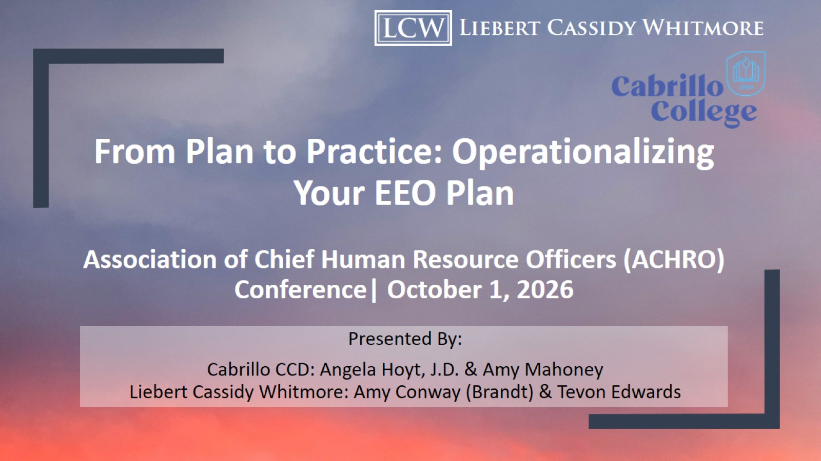
From Plan to Practice: Operationalizing Your EEO Plan
Association of Chief Human Resource Officers (ACHRO) Conference| October 1, 2026

Slide 2
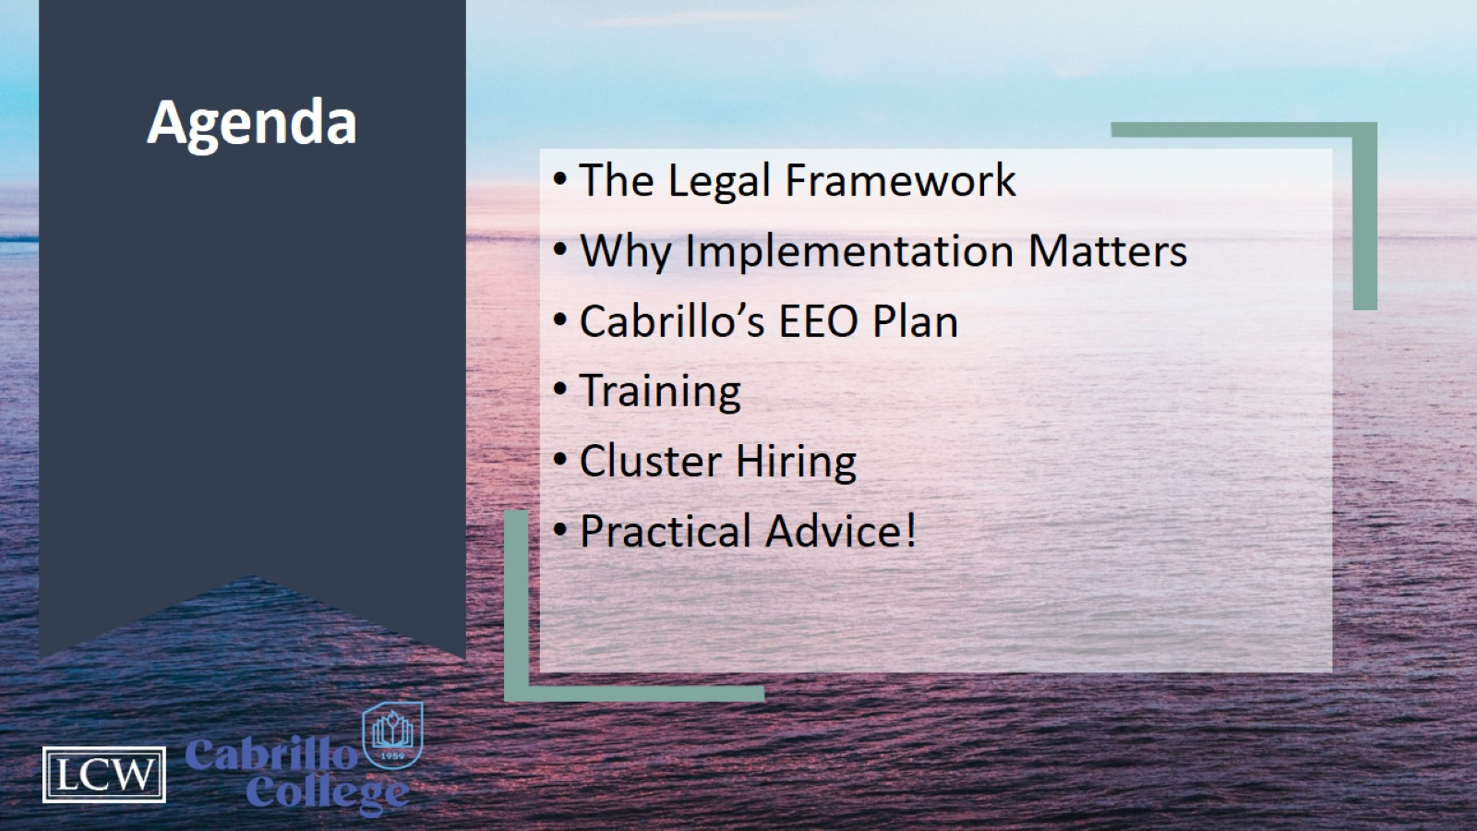
Agenda

Slide 3
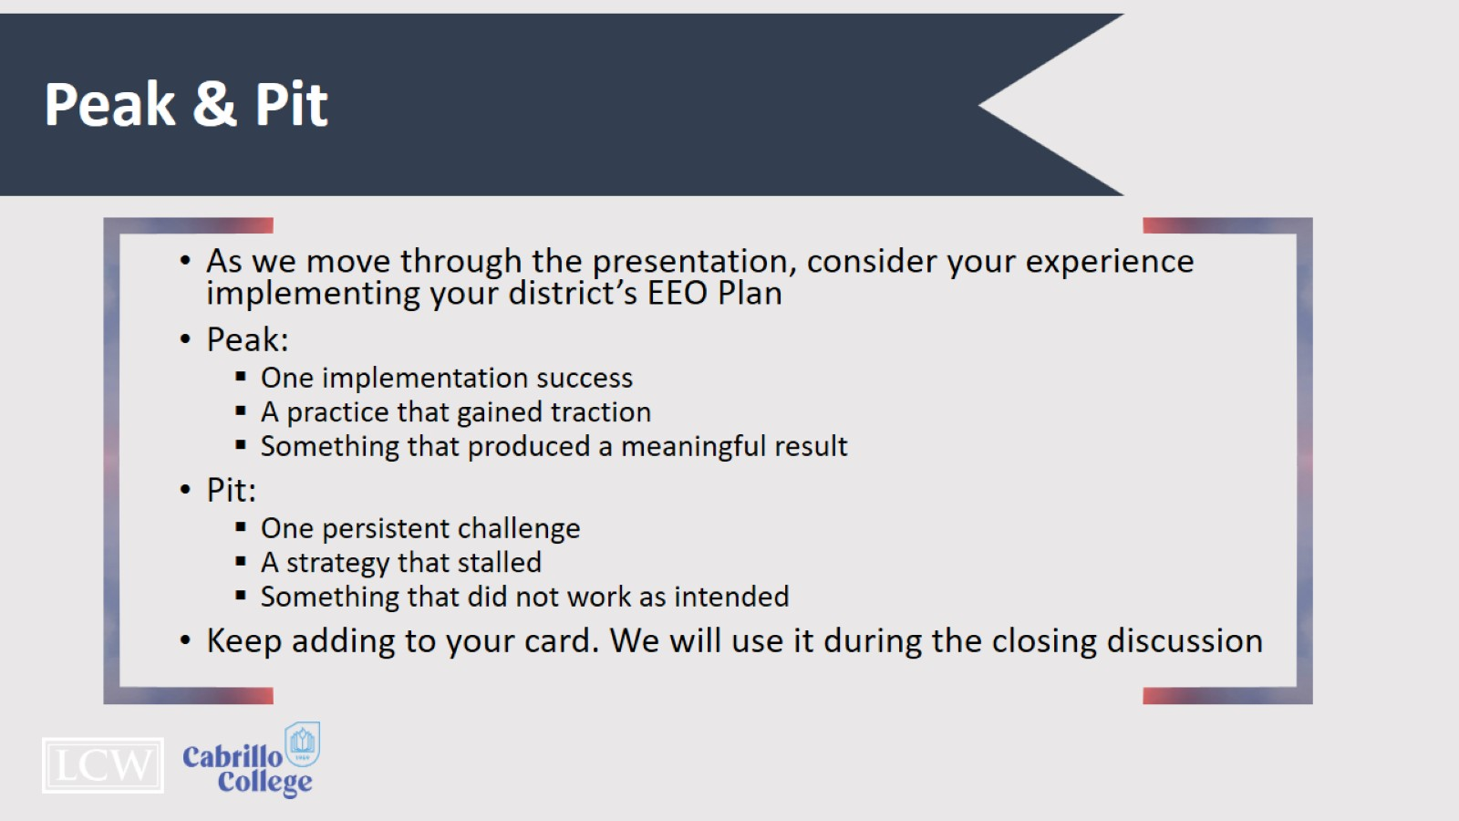
Peak & Pit

Slide 4

The Legal Framework

Slide 5
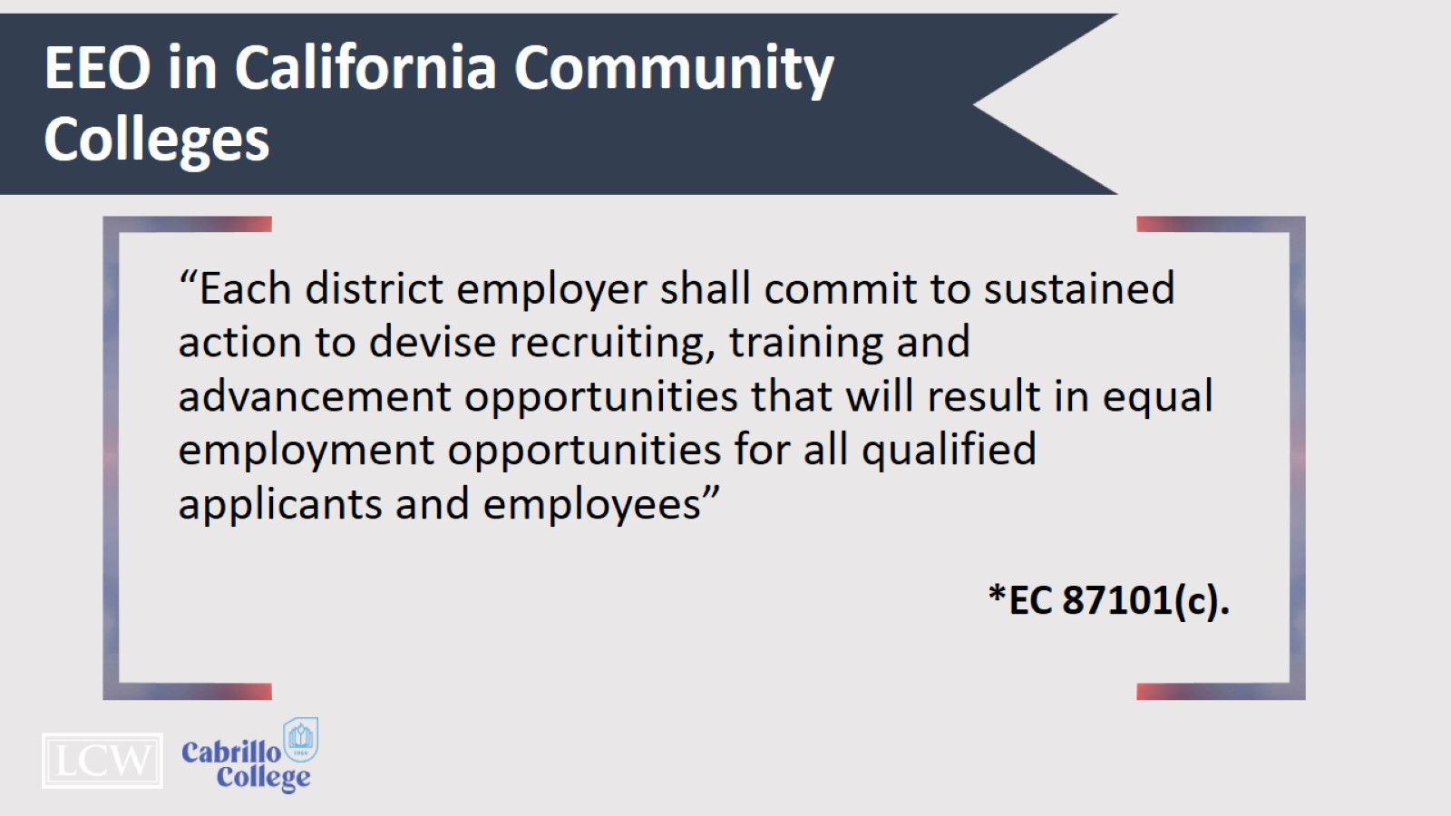
EEO in California Community Colleges

Slide 6
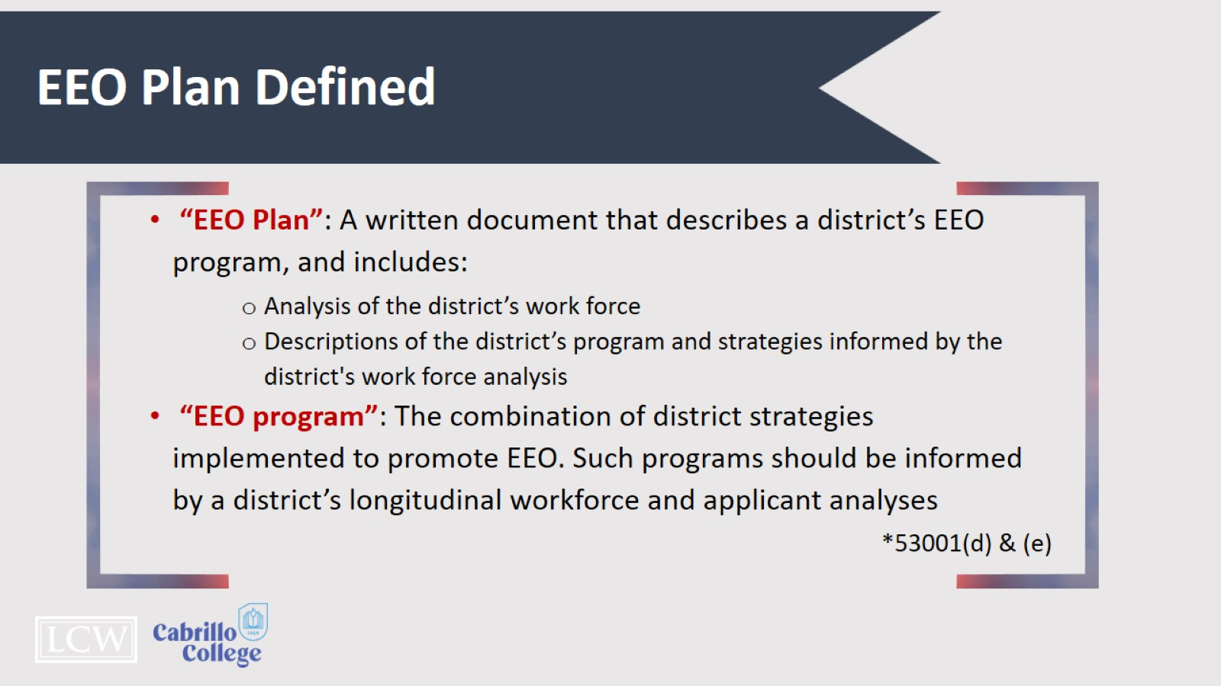
EEO Plan Defined

Slide 7
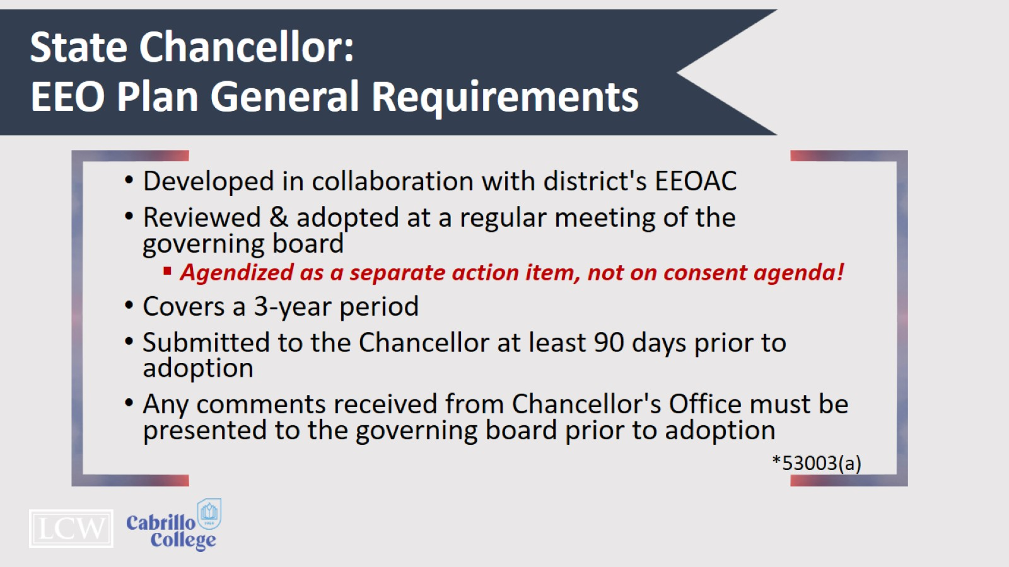
State Chancellor:
EEO Plan General Requirements

Slide 8
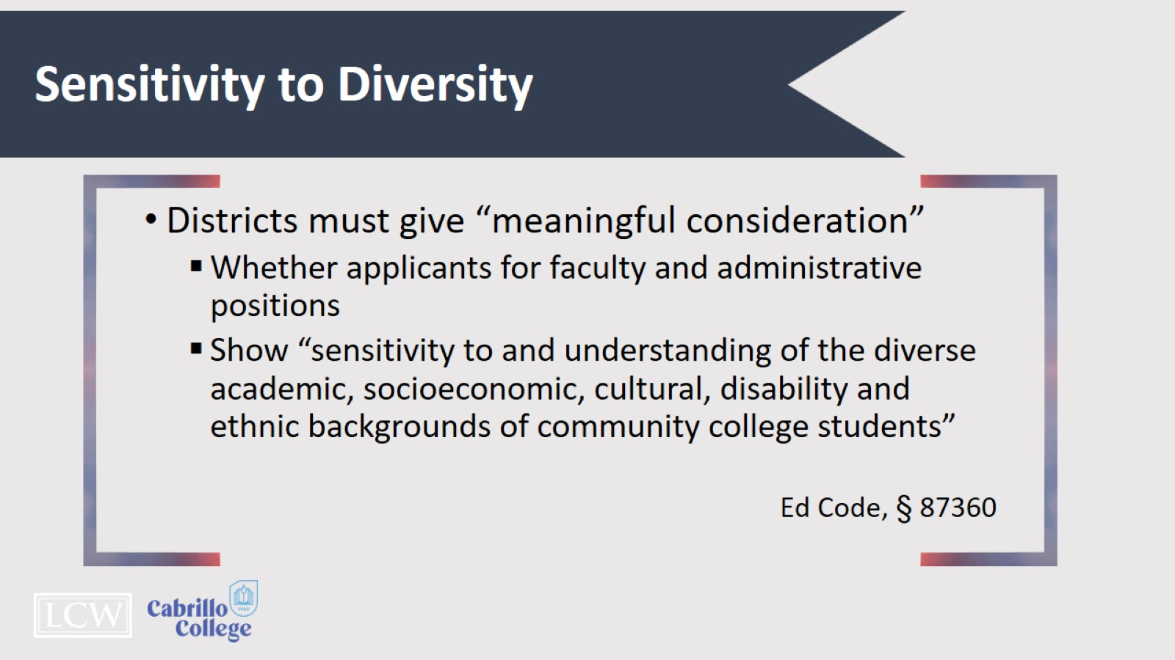
Sensitivity to Diversity

Slide 9
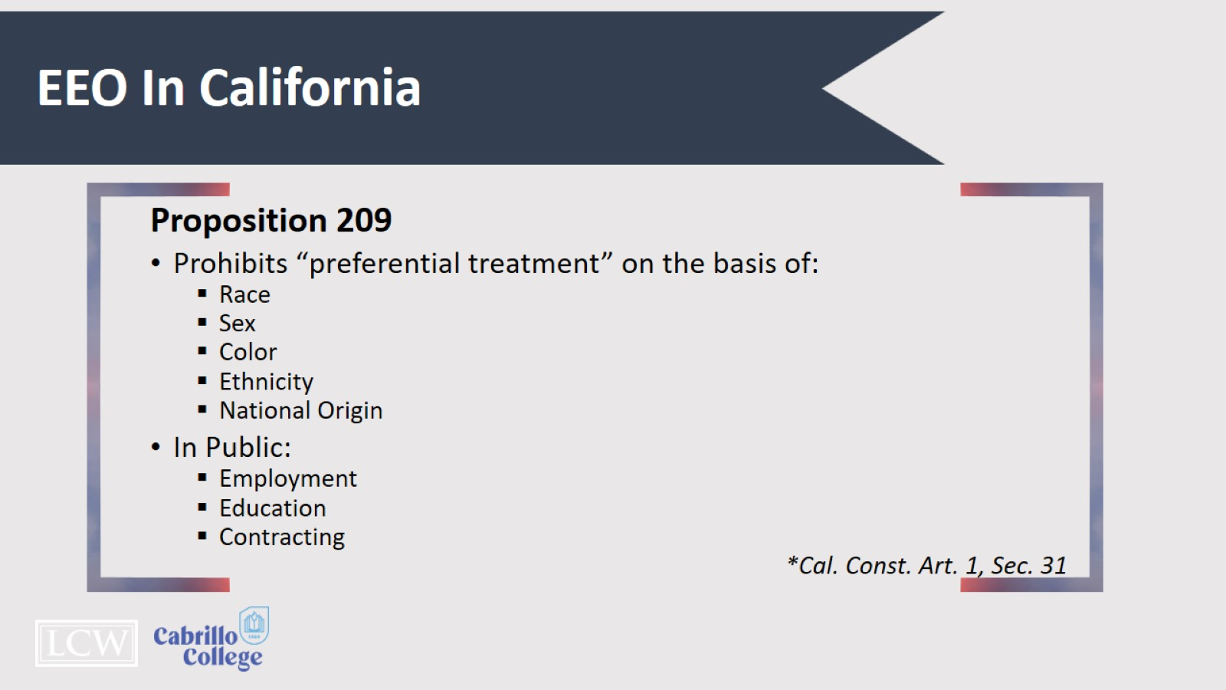
EEO In California

Slide 10
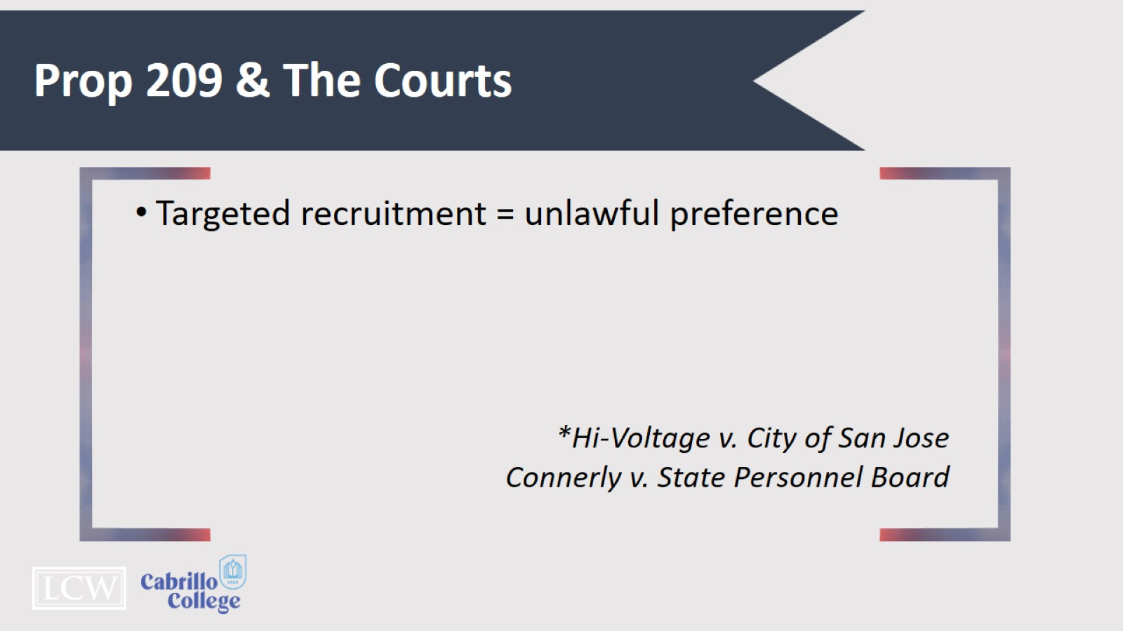
Prop 209 & The Courts

Slide 11
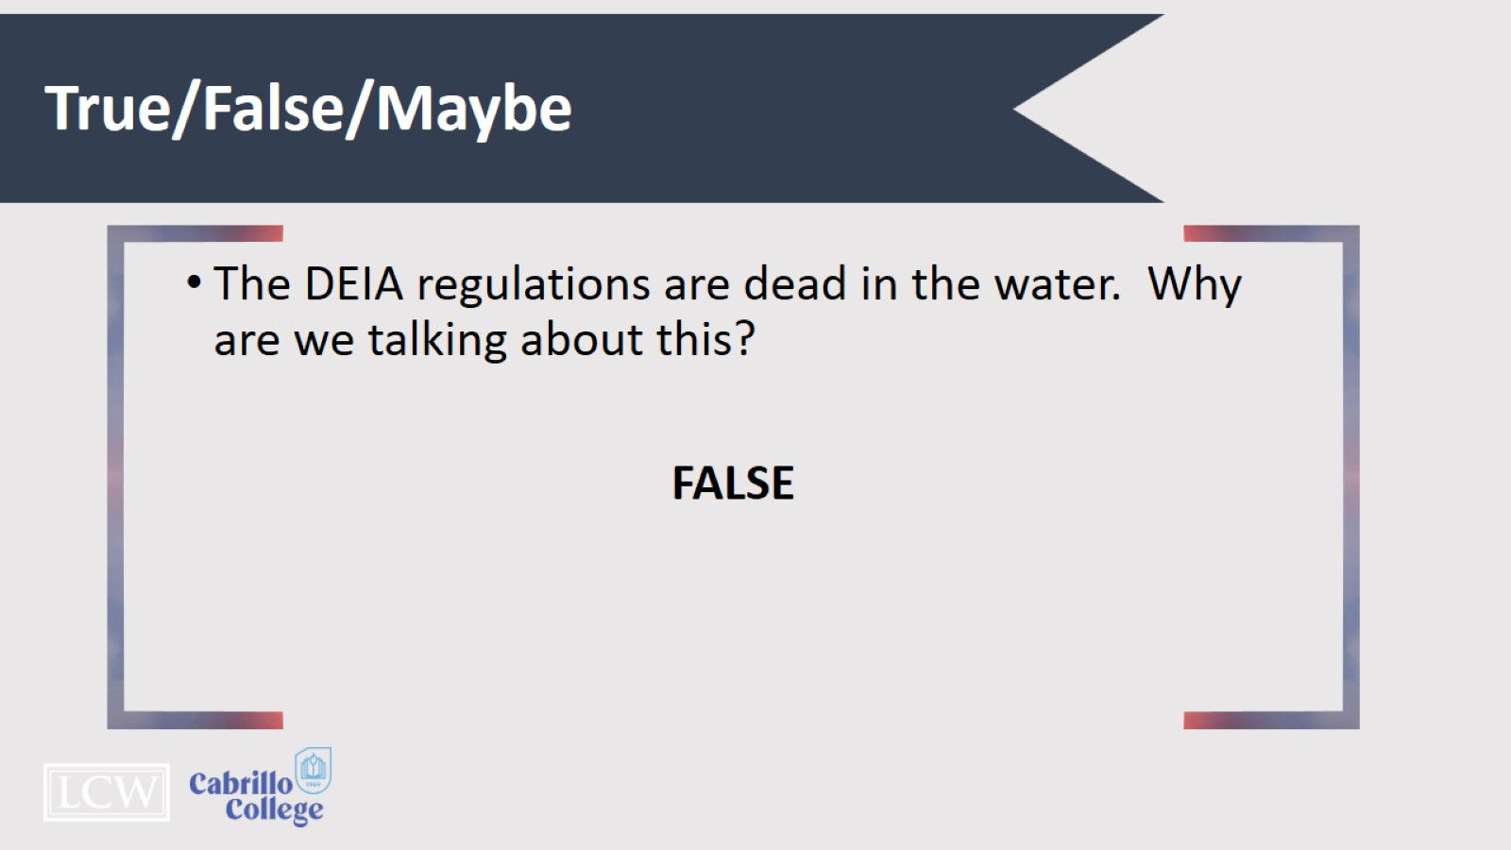
True/False/Maybe

Slide 12

Why Implementation Matters

Slide 13
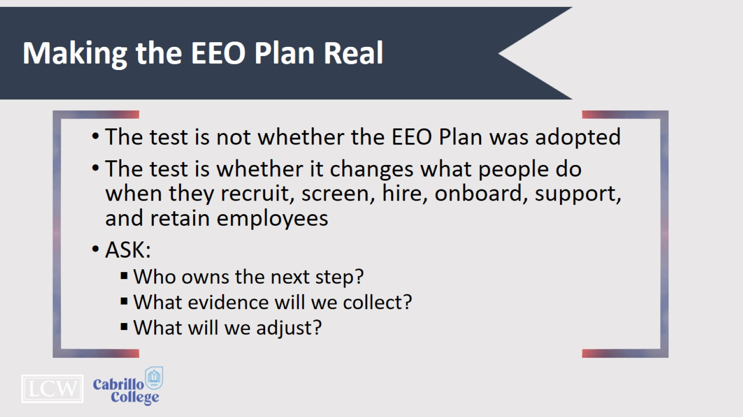
Making the EEO Plan Real

Slide 14
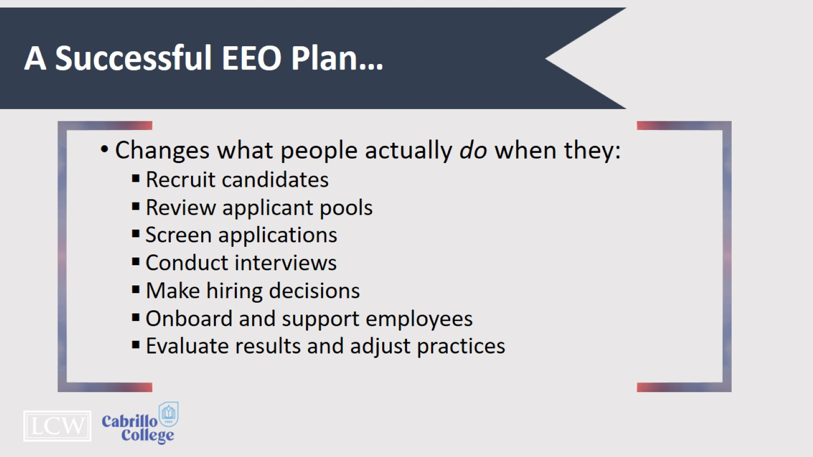
A Successful EEO Plan…

Slide 15
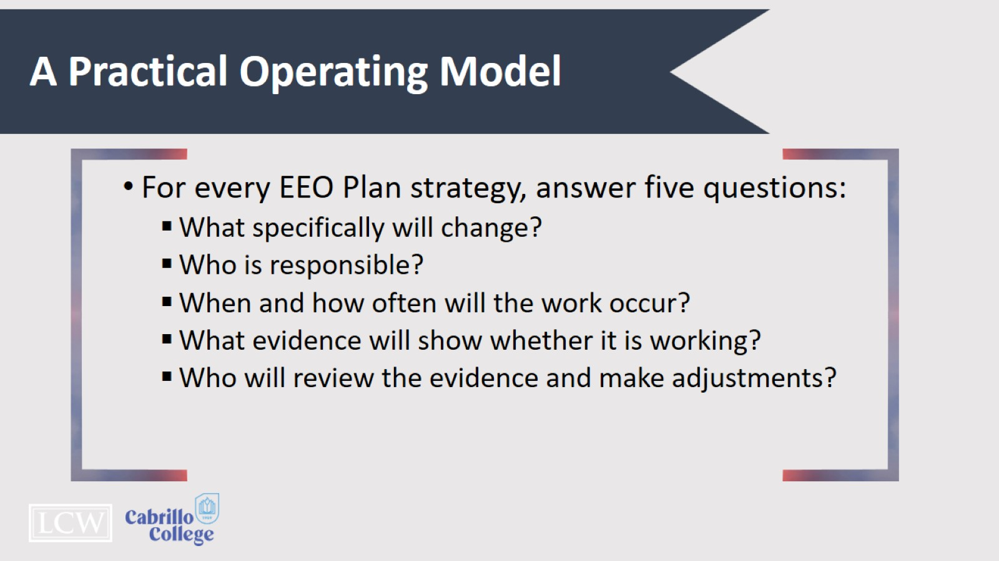
A Practical Operating Model

Slide 16
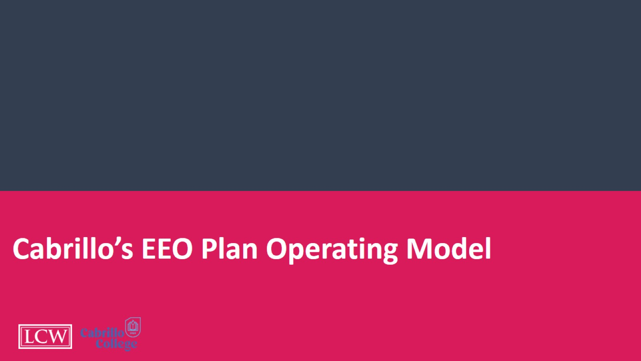
Cabrillo’s EEO Plan Operating Model

Slide 17
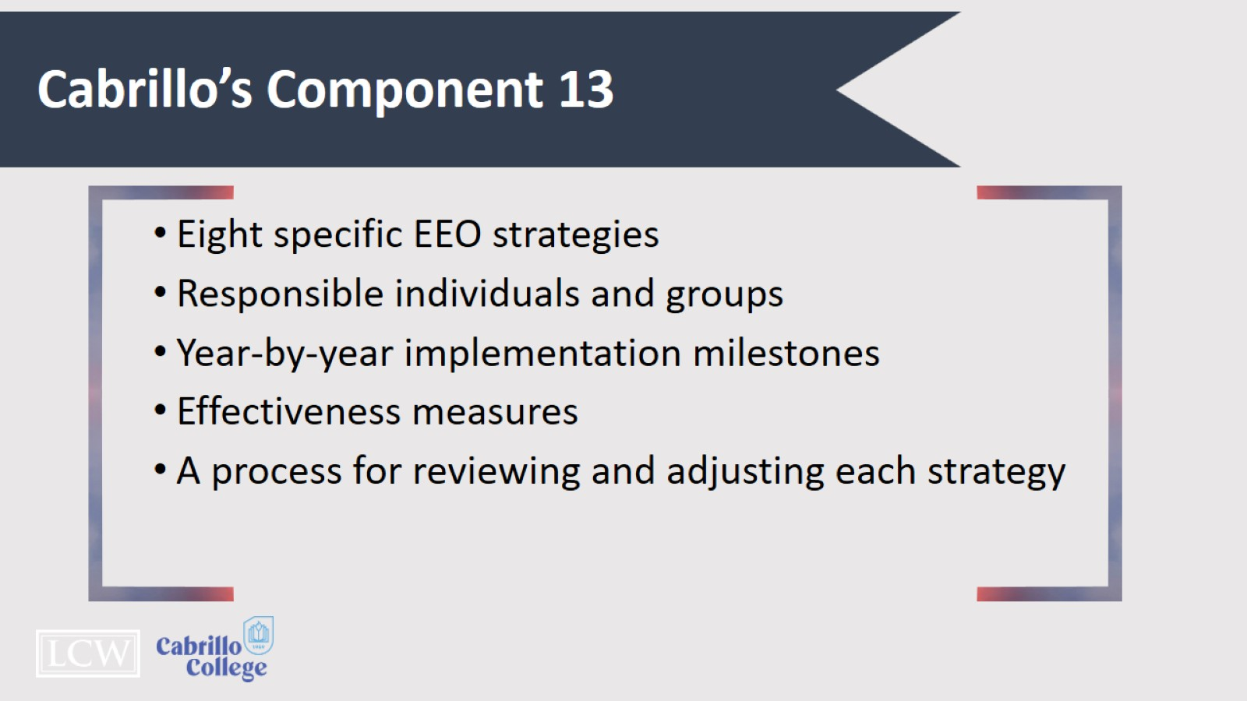
Cabrillo’s Component 13

Slide 18
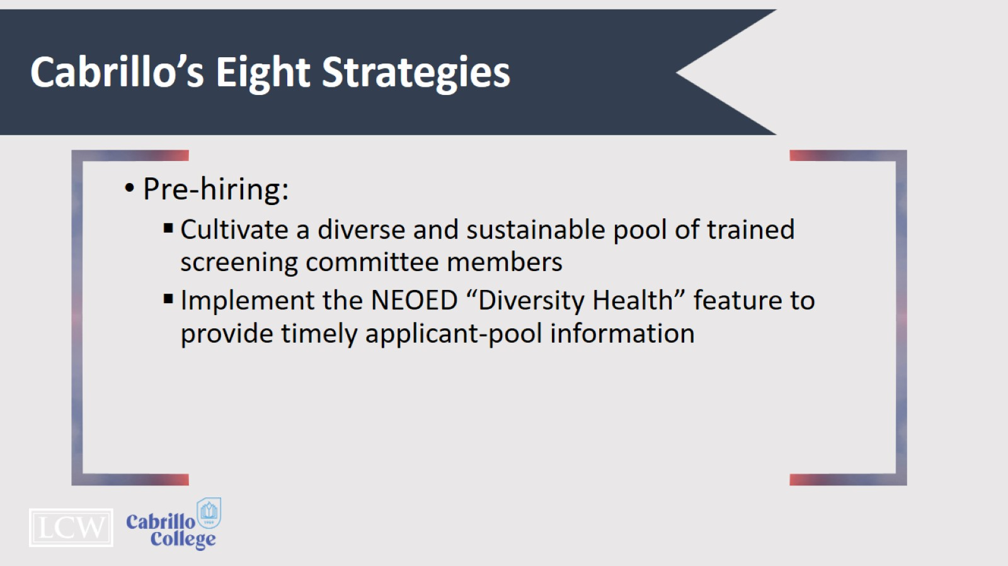
Cabrillo’s Eight Strategies

Slide 19

Cabrillo’s Eight Strategies

Slide 20
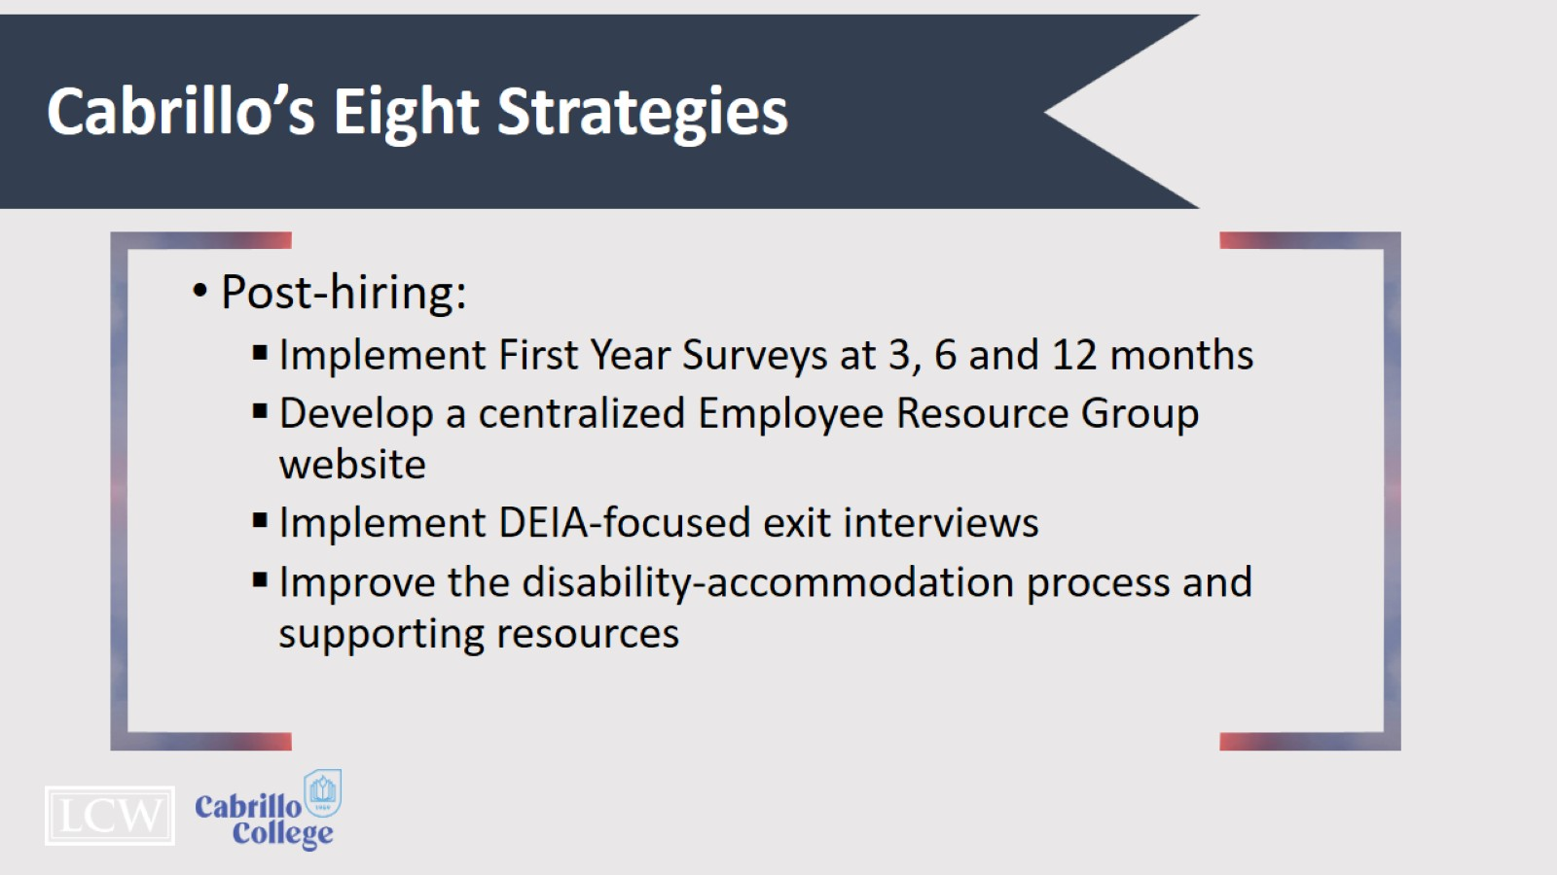
Cabrillo’s Eight Strategies

Slide 21
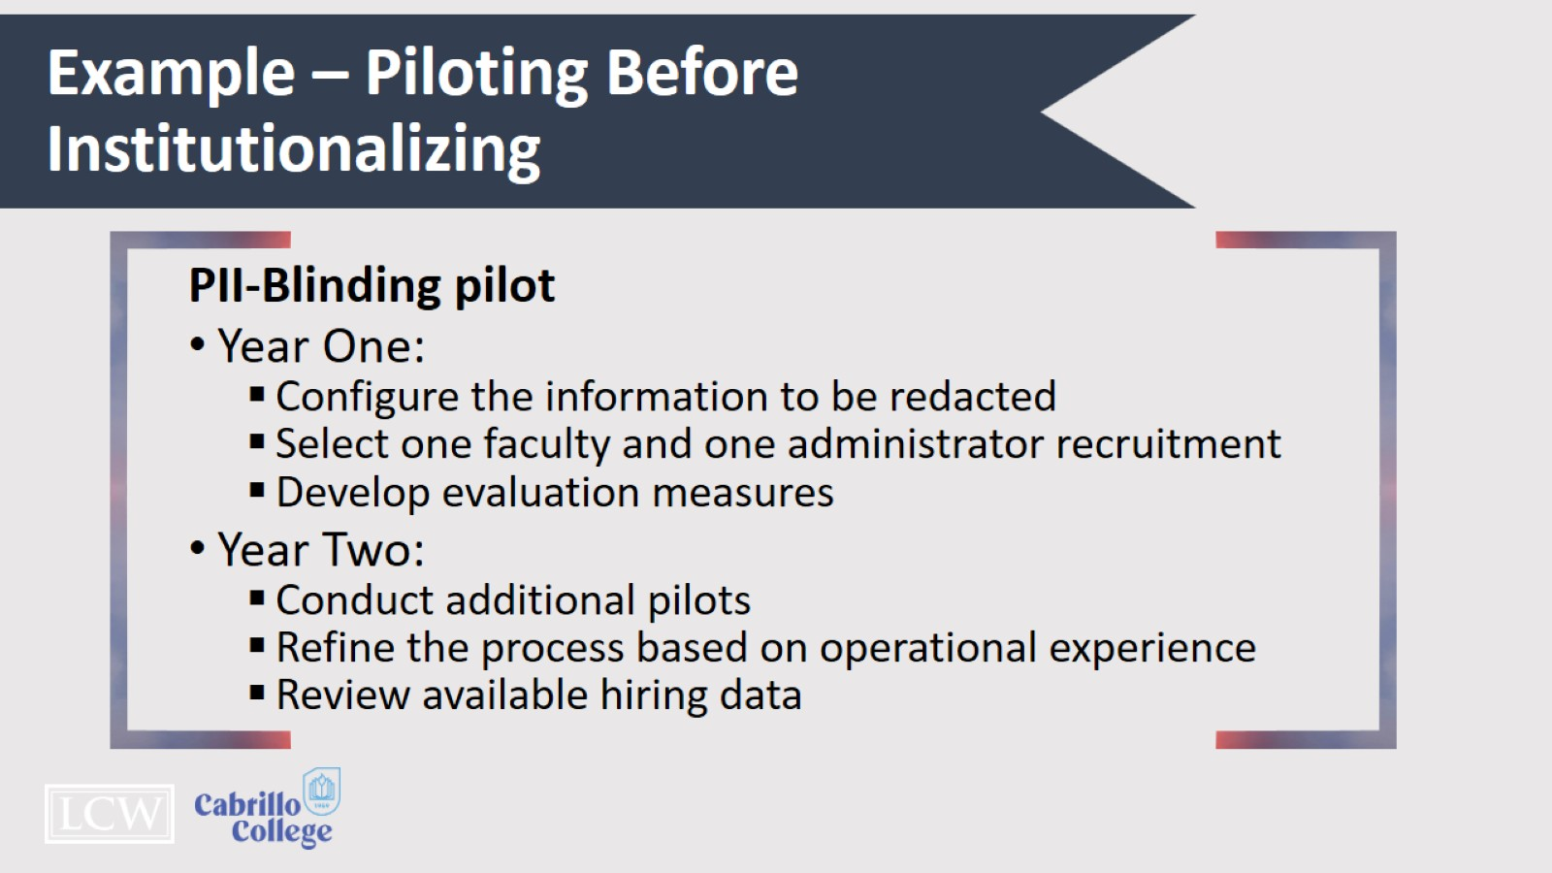
Example – Piloting Before Institutionalizing

Slide 22
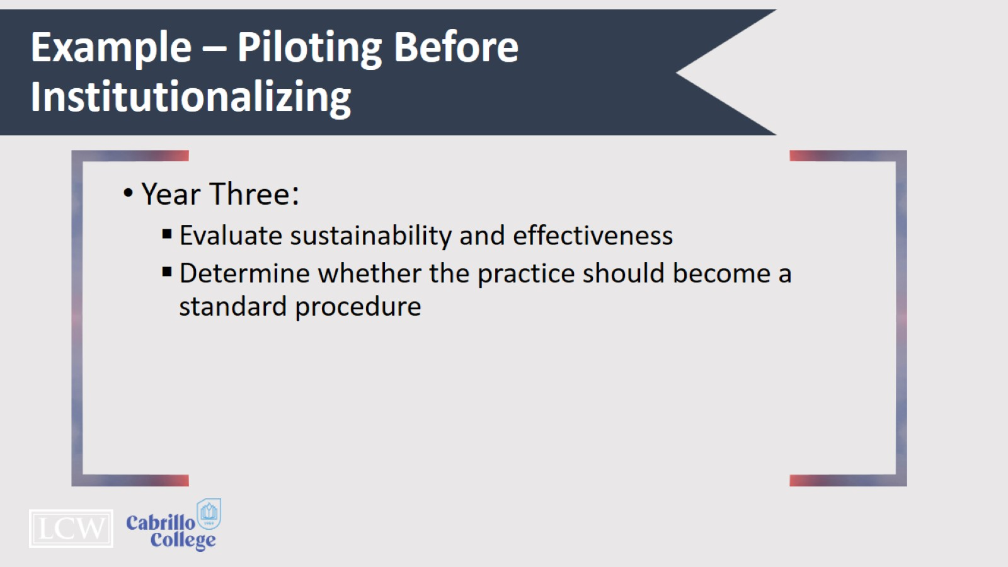
Example – Piloting Before Institutionalizing

Slide 23
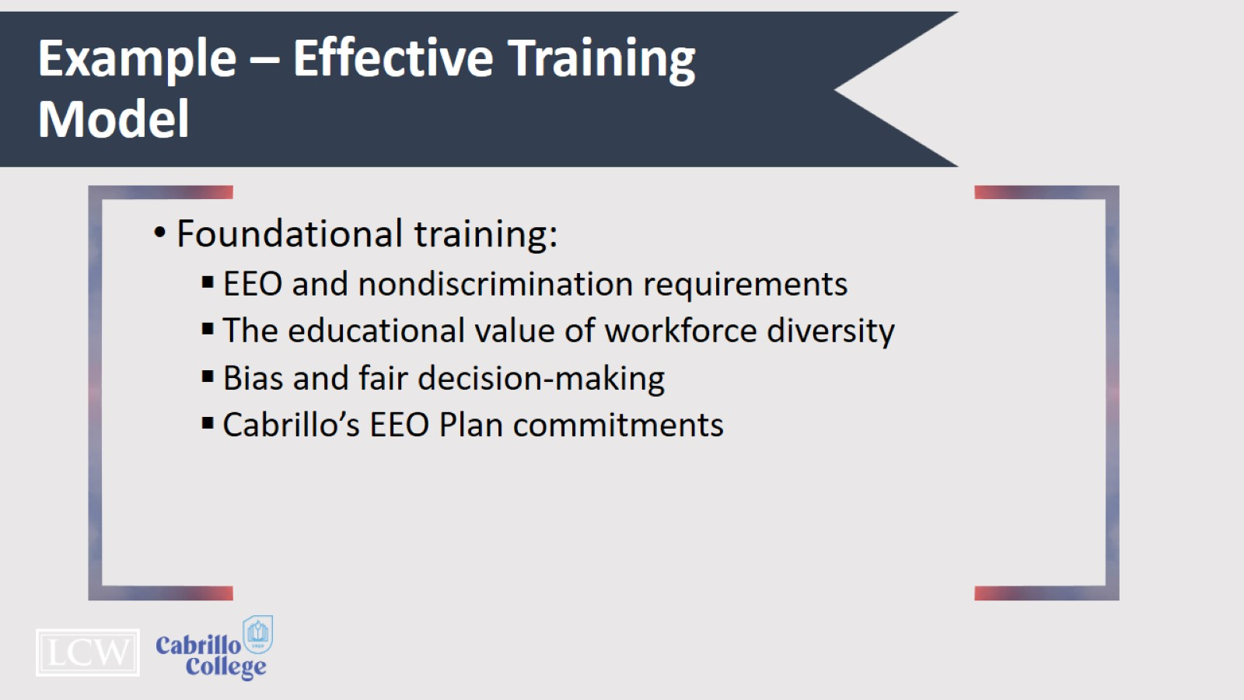
Example – Effective Training Model

Slide 24
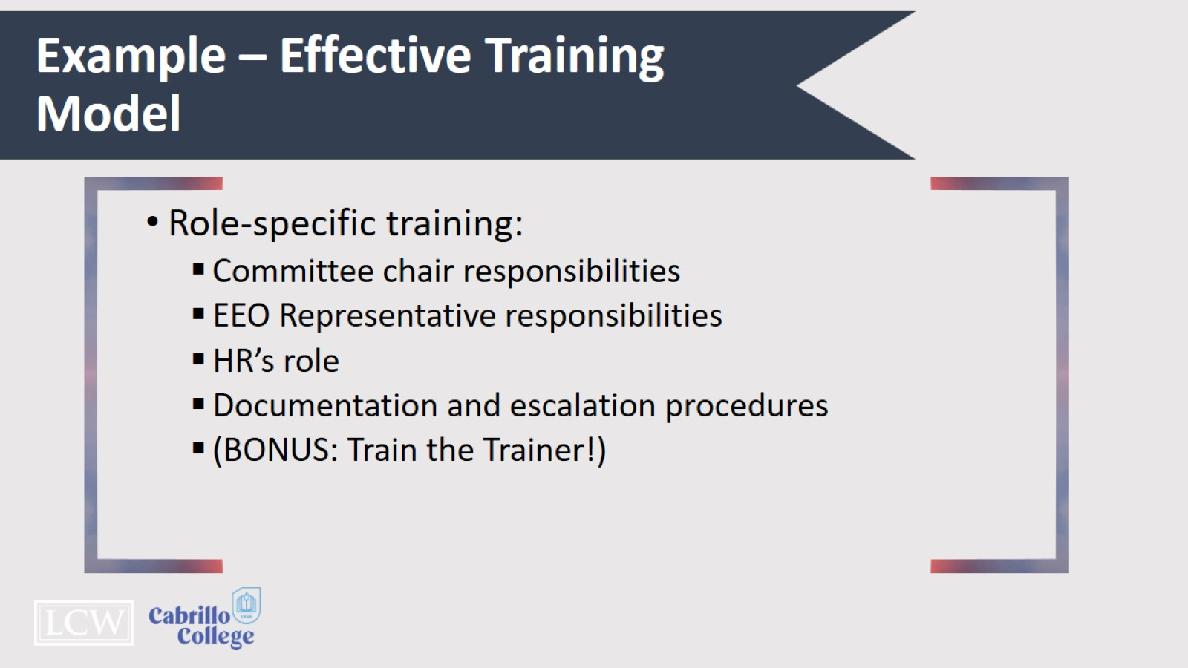
Example – Effective Training Model

Slide 25
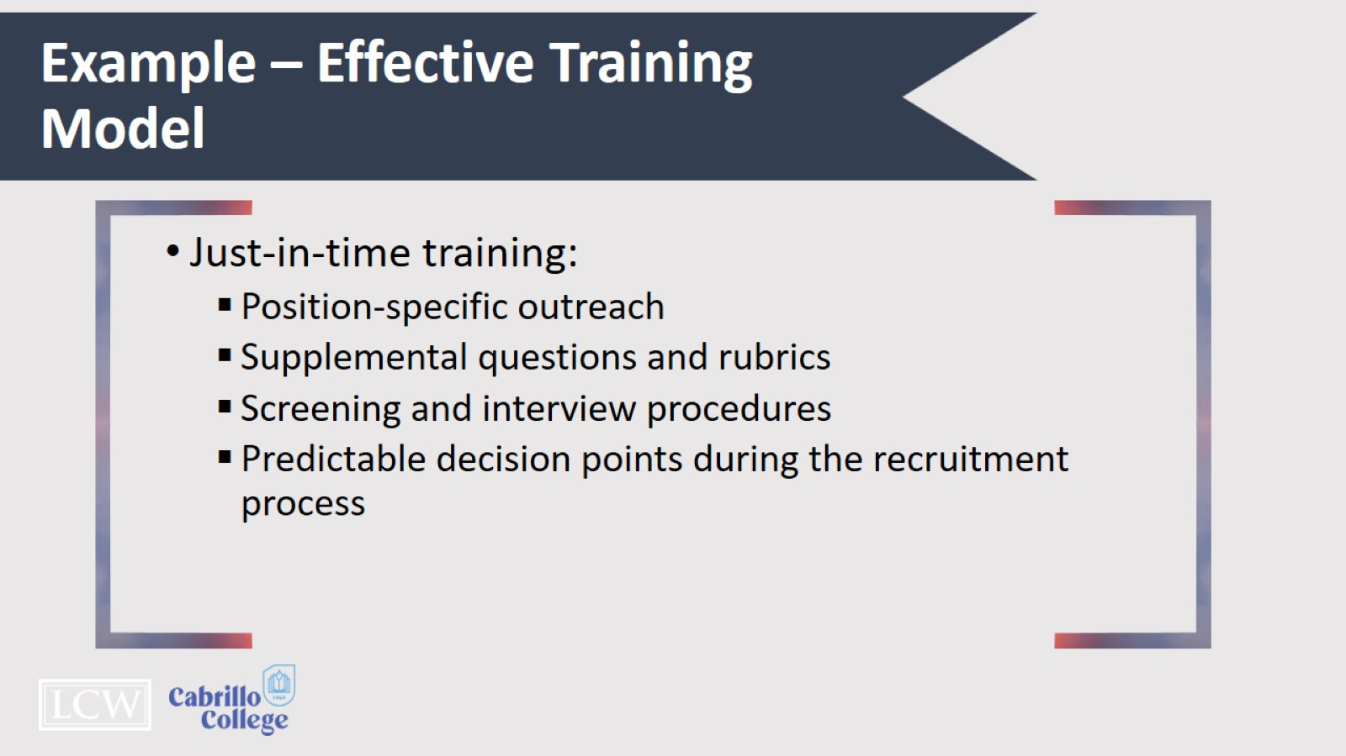
Example – Effective Training Model

Slide 26

Cluster Hiring

Slide 27
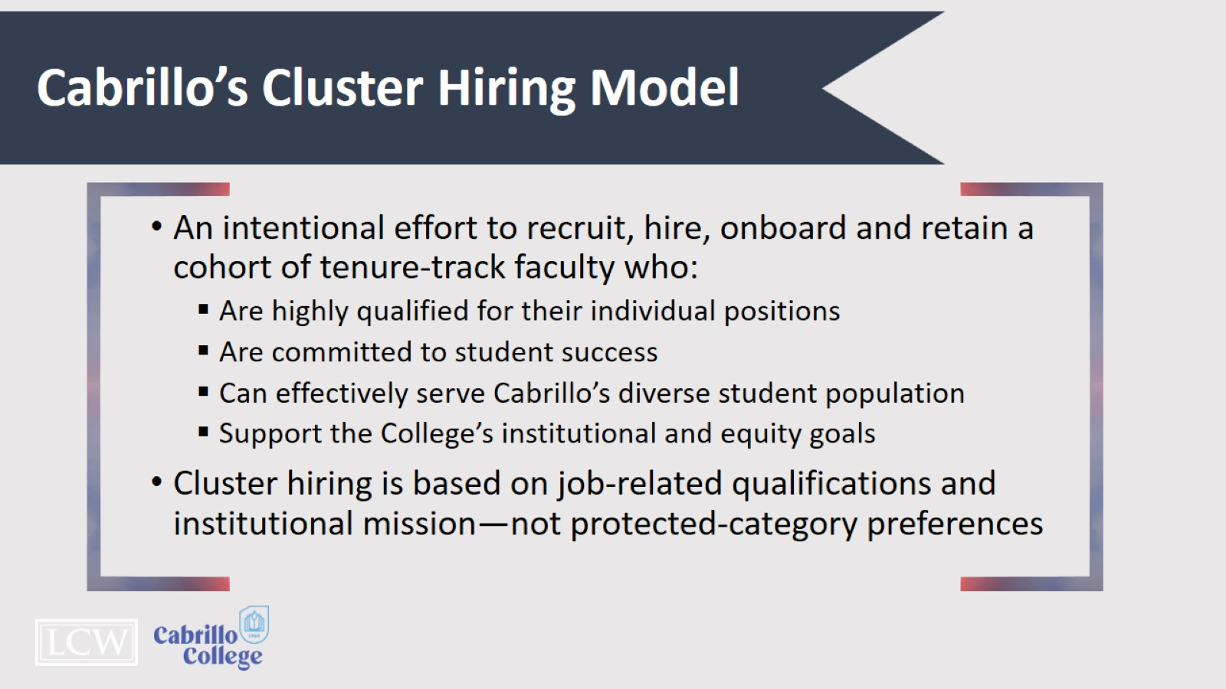
Cabrillo’s Cluster Hiring Model

Slide 28
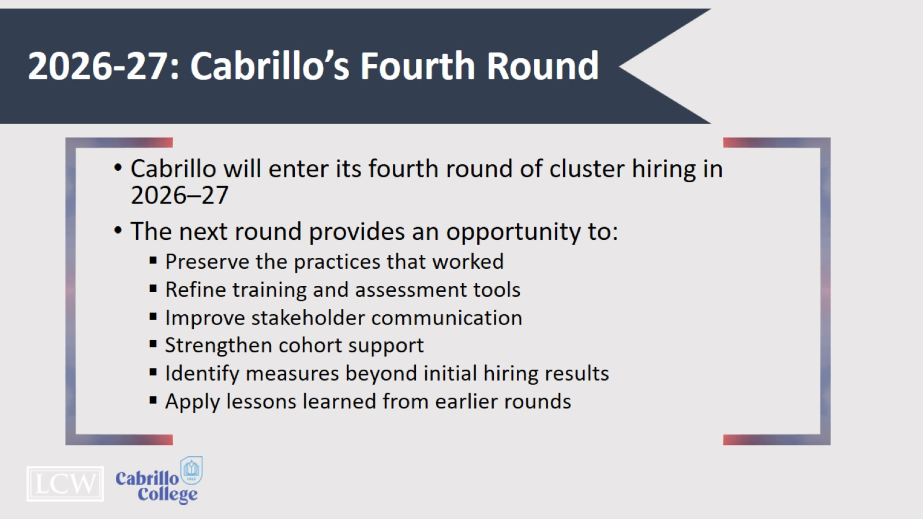
2026-27: Cabrillo’s Fourth Round

Slide 29
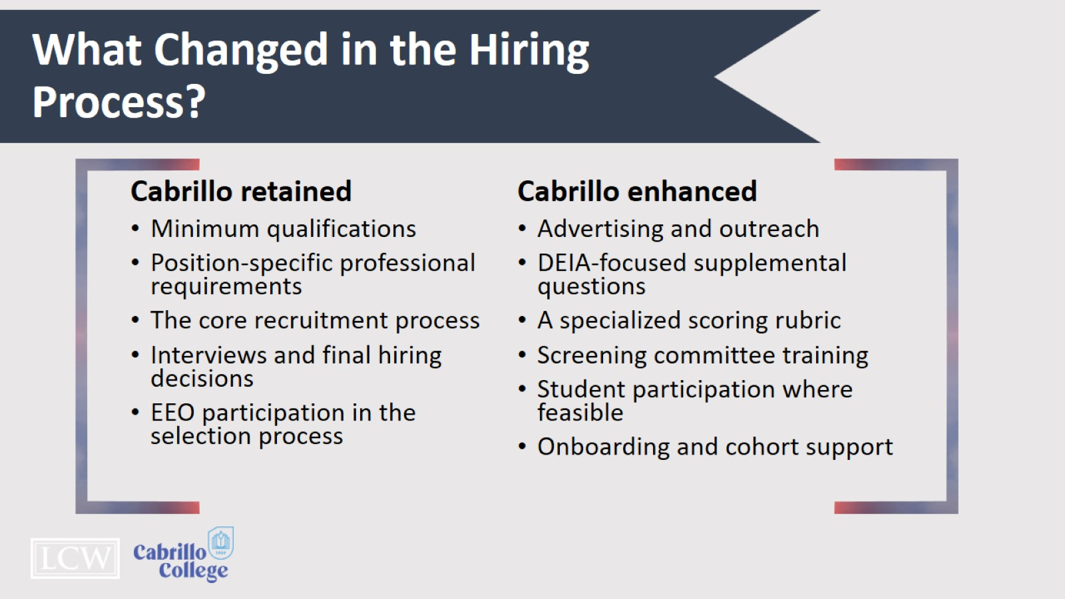
What Changed in the Hiring Process?

Slide 30
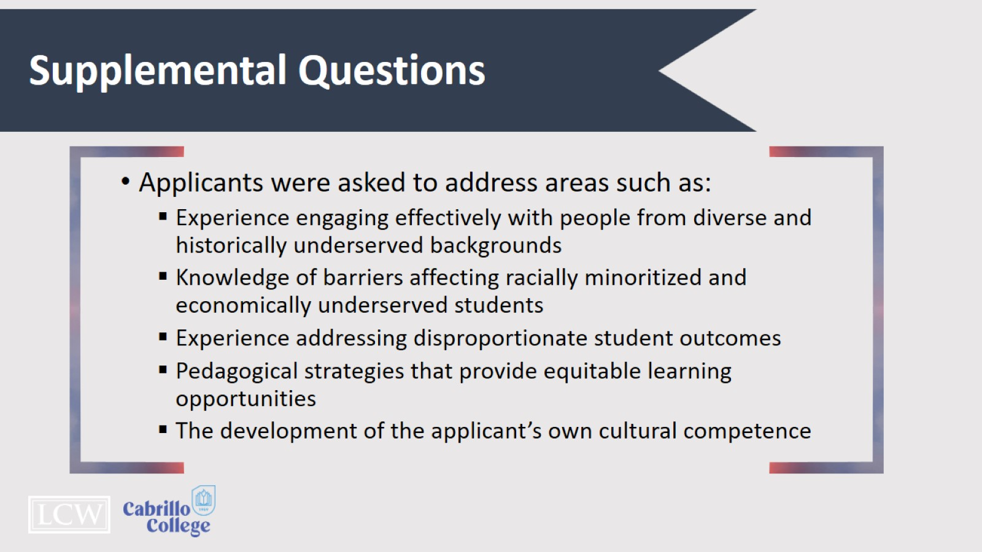
Supplemental Questions

Slide 31
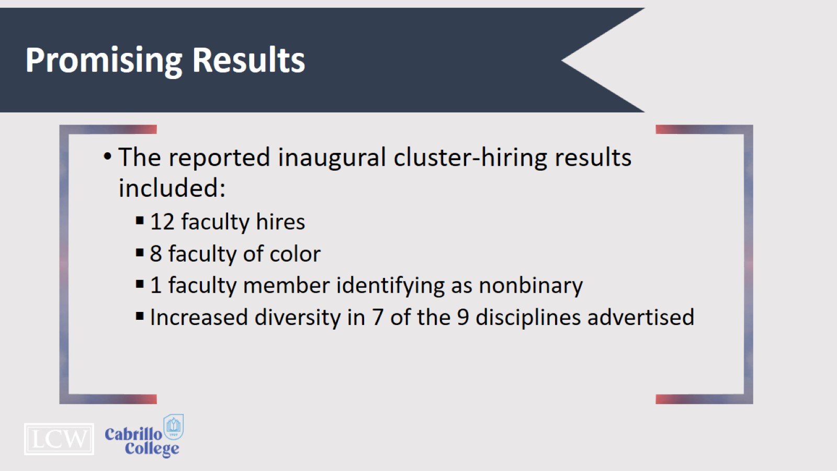
Promising Results

Slide 32
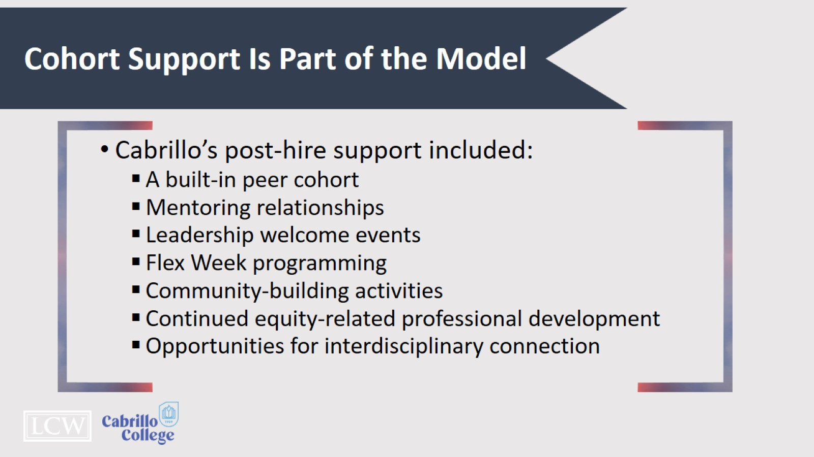
Cohort Support Is Part of the Model

Slide 33

Practical Implementation & Discussion

Slide 34
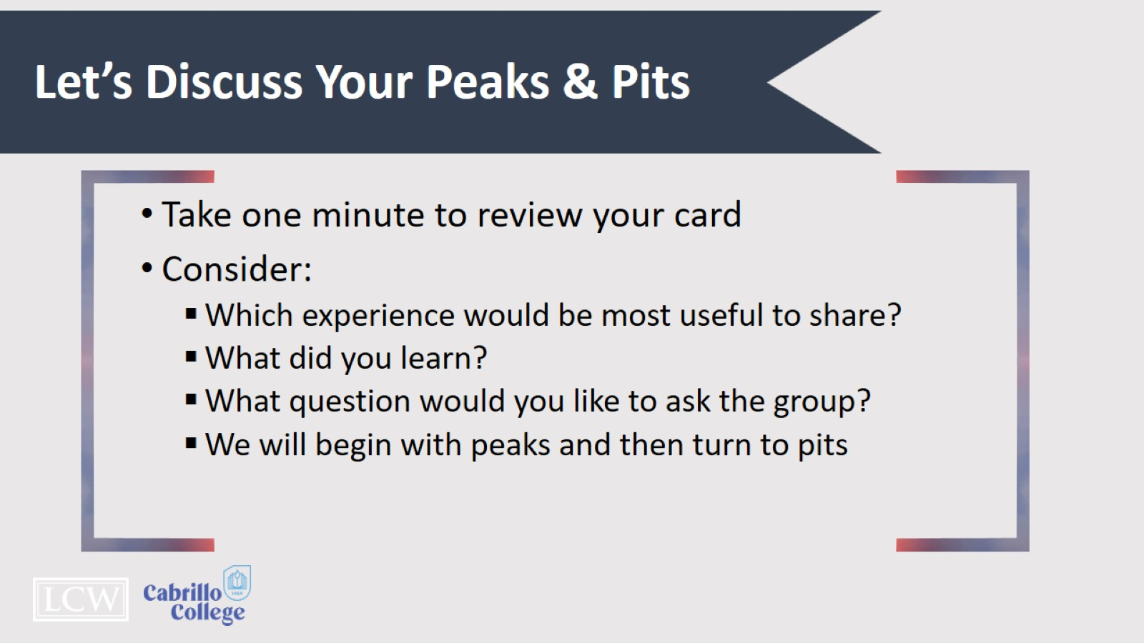
Let’s Discuss Your Peaks & Pits

Slide 35
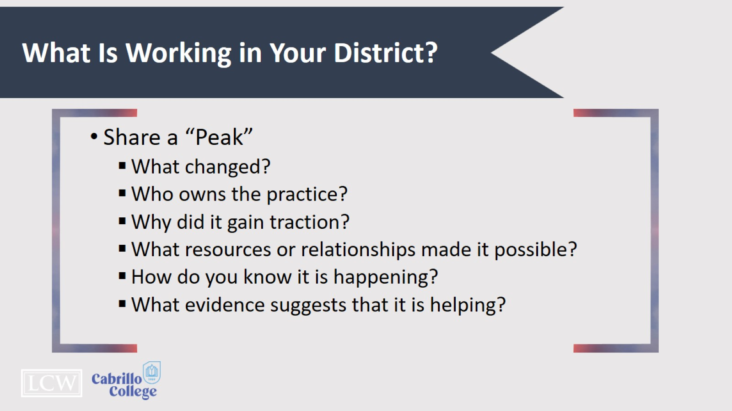
What Is Working in Your District?

Slide 36
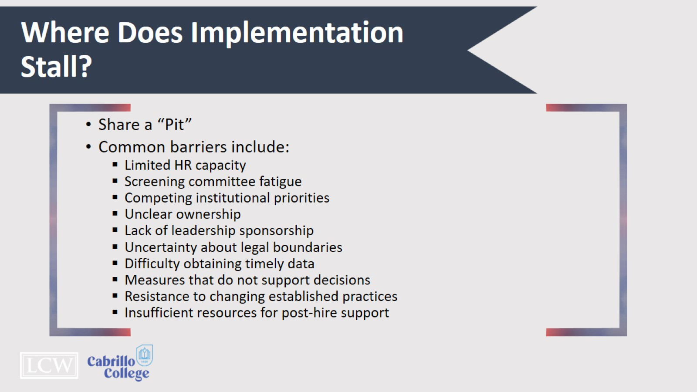
Where Does Implementation Stall?

Slide 37
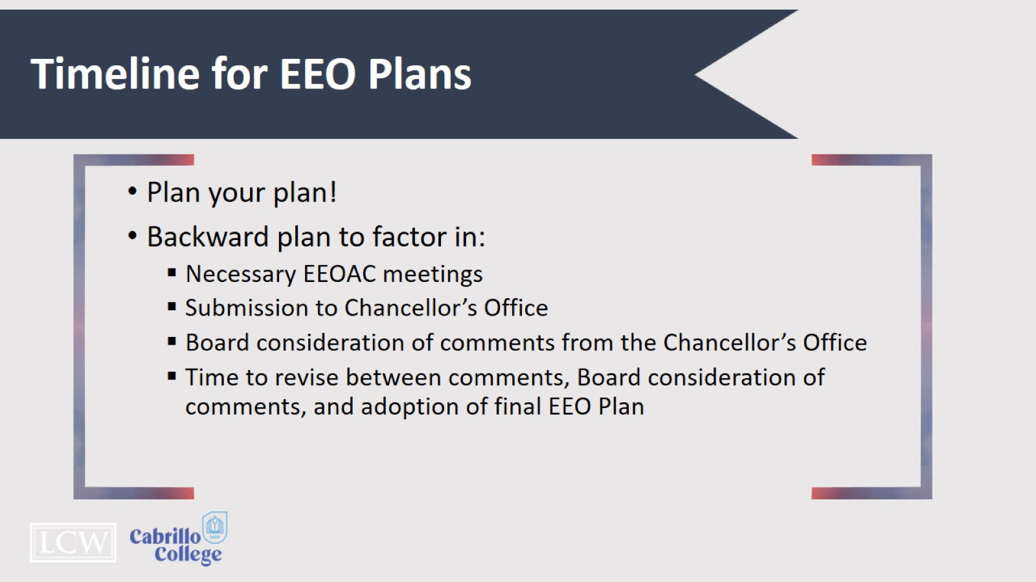
Timeline for EEO Plans

Slide 38
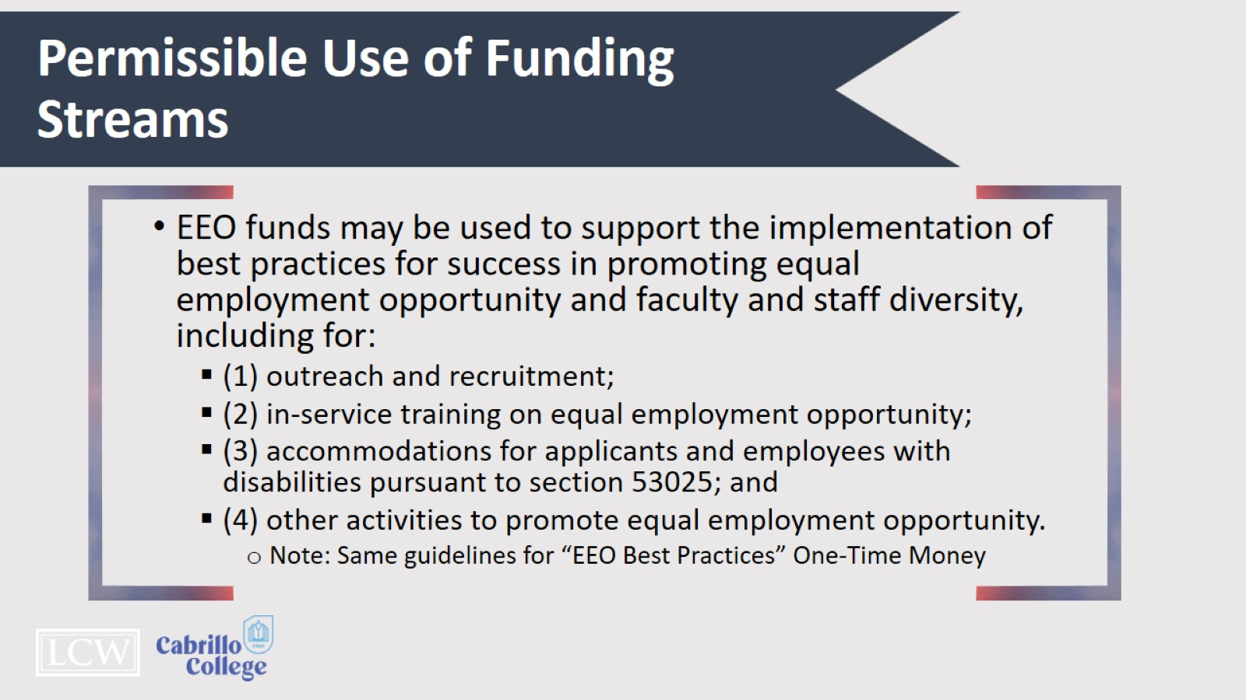
Permissible Use of Funding Streams

Slide 39
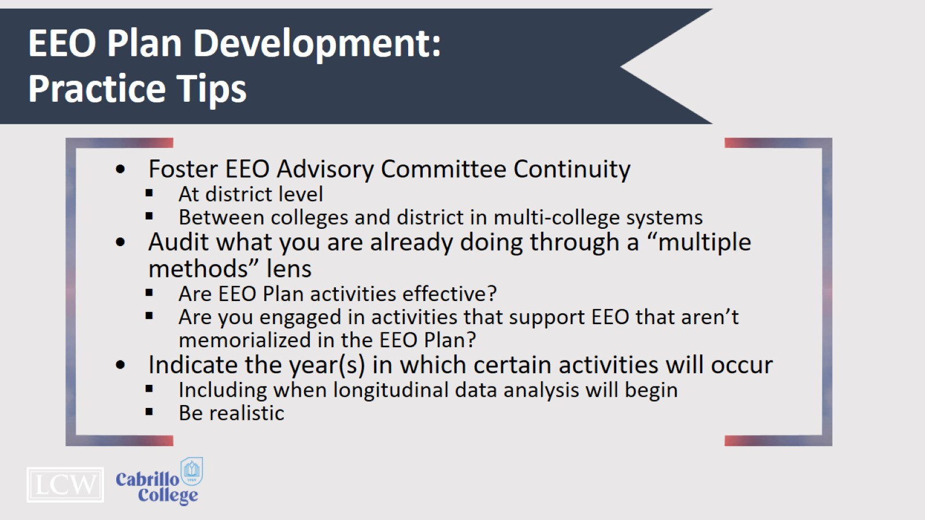
Eeo Plan Development:
Practice Tips

Slide 40
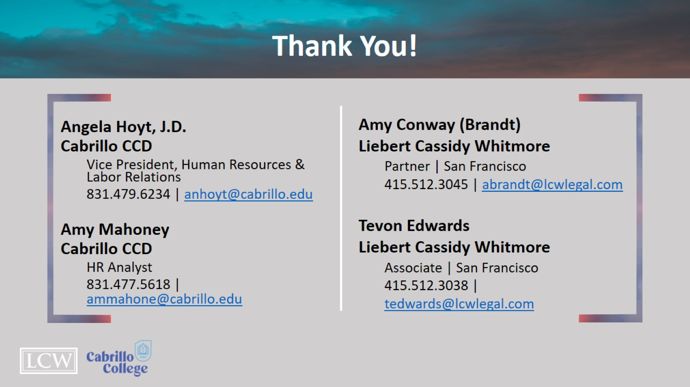
Thank You!

