Slide 1



Preparing for Negotiations
Presented for the 2026 ACHRO/EEO Conference
Presented by:
Rex Randall Erickson, Principal
www.McDougalLawFirm.com | (619) 440-4444

Slide 2
Disclaimer
This presentation is designed to be a general guide and should NOT be considered legal advice. For questions about specific situations, please consult an attorney.
As a reminder, although we will be covering specific fact situations (and even though one or more of those situations may be provided by an audience member), and although opinions may be given regarding those facts, this seminar is presented for information and entertainment purposes only, and does not constitute legal advice.
Similarly, your raising of a question or seeking an opinion does not constitute engaging the services of any speakers during these seminars. Therefore, you should not act upon any information from these seminars or in these materials without seeking professional counsel.
Blah, blah blah blah blah

Slide 3

Presentation Overview
Introduction
Understanding the Basics
  Understand the Law
  Subjects of Bargaining
Negotiations Preparation
  Building Your Negotiations Team
  Preparing the Sunshine Proposal
  Preparing Proposals
Negotiation Strategies at the Table

Slide 4
Jay Heinrichs
Thank You for Arguing
Everyone lusts after something. If you can suss out the desire, exploit the lust, dangle the carrot, then you can bridge the gap.

Slide 5

Understand the law
Understanding the basics of California labor law in the educational setting

Slide 6
Educational Employment Relations Act
Passed in 1978
The EERA created a process for groups of public school employees sharing a "community of interest" to organize and be represented in an exclusive bargaining unit
The EERA also defines the ground rules and processes by which school districts and bargaining agents negotiate, arbitrate, and grieve disputes

Slide 7
Educational Employment Relations Act
Persons Covered by the EERA
Persons Not Covered by the EERA
Authority of the Public Employment Relations Board (“PERB”)
Limitations of PERB

Slide 8

Subjects of Bargaining
Anticipating what will be at issue

Slide 9
Scope of Representation
Prohibited* Subjects
Reemployment Period/Priority
Layoffs
Permissive Subjects
Sabbatical
Intellectual Property
Mandatory Subjects
Hours
Benefits
Evaluation
Union security
Management Rights
Leave Banking
Recruiting
Waivers
Assignments
Binding Arbitration
*Non-Enumerated Subjects
*Past Practices
Wages
* Prohibited Subjects are “illegal” in the sense that they are not enforceable:
United Teachers of Los Angeles v. Los Angeles Unified School District (2012) 54 Cal. 4th 504: Collective bargaining provisions which annul, replace, set aside, or “directly conflicts with” provisions of the Education Code cannot be enforced.

Slide 10

Preparing for Negotiations
PRACTICE PROPER PREPARATION

Slide 11
Advice From a Chief Negotiator
The single most important ingredient for ensuring that proposals and ideas are adequately explained at the bargaining table is advance preparation.
Without advance preparation it is unlikely that ready responses and explanation can be expected at the bargaining table

Slide 12

Playing the Position
Building Your Negotiation Team

Slide 13
ESTABLISH ROLES IN NEGOTIATION
Determine who will be at the Table:
Who will take notes?
Will you bring in an Outside Negotiator?
How will the two teams communicate?
Who can participate at the Table?
Establish ground rules for negotiating?

Slide 14
WHO’S ON THE BARGAINING TEAM?
Determine the Needs and Subject Matter Expertise:
Human Resources: Generally involved in all aspects
Economic Issues: Typically include CBO/Fiscal
Academic Issues: Typically include Instruction and Student Services
M&O and Support: Typically include classified supervisor
Police: Generally include Chief or Senior Admin Officers

Slide 15
Include Legal Counsel?
  Legal Counsel’s (unbiased) Point of View
    Collective bargaining agreements are legally binding documents.
    CBAs govern the working relationship between management and the employees, as well as establishing each other’s respective rights.
    CBAs impact 85% (or more) of the District budget.
    Fees and Expenses may be a reimbursable Mandated Cost.

Slide 16
Legal/Chief Negotiator
Draft proposal language.
Review/compare union proposal language.
Don’t rely on union proposals – always check against prior CBA and prior proposals.

Slide 17
Get Ready to Get Ready
Sunshining and preparing to prepare for negotiations

Slide 18
Anticipate Demands
Both locally and at neighboring Districts:
What has the union demanded?
What speeches/statements have come from the union or the negotiator?
Has there been a new stance taken at a statewide conference?
Have there been grievances? Over what?

Slide 19
Legal Review
Conduct a legal review of the CBA:
  Legal changes to CBA Terms:
      Leave policies comply with changes in law
      Release time for union officers
      Discipline and arbitration procedures
      Right of assignment
      Adjunct reemployment rights
  Recapture management rights and identify existing provisions which are permissive (but not mandatory) subjects of bargaining
  Identify existing provisions which are illegal subjects of bargaining

Slide 20
Review Bargaining Agreement
Conduct a critical review of the CBA:
What is unclear?
Has there been any part impacted by new laws or recent Court decisions?
Have there been grievances?
What is not working for the District?

Slide 21
HR Perspective
Conduct a critical review of the CBA:
  Identify any grievances that might need clean-up language
  Are there areas that HR consistently deals with where the contract lacks clarity?
  Any patterns of performance issues that require revised language to the Discipline Article?

Slide 22
Business Office Perspective
Partner with the Chief Negotiator:
        Get Board parameters up front
        Be realistic
        Communicate State and local budget forecasts with Budget Committee
        Know your pinch points and impacts
        Cost all scenarios from both sides – be accurate!

Slide 23

Collect Financial Data
At a minimum, find out:
What is the cost of salary and benefits?
What is changing in hidden costs? (PERS/STRS?)
What are the ongoing costs? (Step/Column)
Are there avoidable costs? (OT?)
What will 1% cost the District?
Where is the District in comparison to others?

Slide 24
Develop Initial Proposals
What would you change about the CBA?
Revising outdated terms/procedures
Ensure agreement is lawful and enforceable
Economic posture of the District
What are the District goals in next 3-years?
What is the local/state outlook for next 3-years?

Slide 25
Sunshine Initial Proposals
“Initial Proposal” – A set of proposed terms of employment, brought forth by a public school employer or a public school employee organization, as a first effort to negotiate a collective bargaining agreement.
“Sunshining” – A process required by law in which a public school employer and a public school employee organization present, in a public meeting, their initial proposals for collective bargaining.

Slide 26
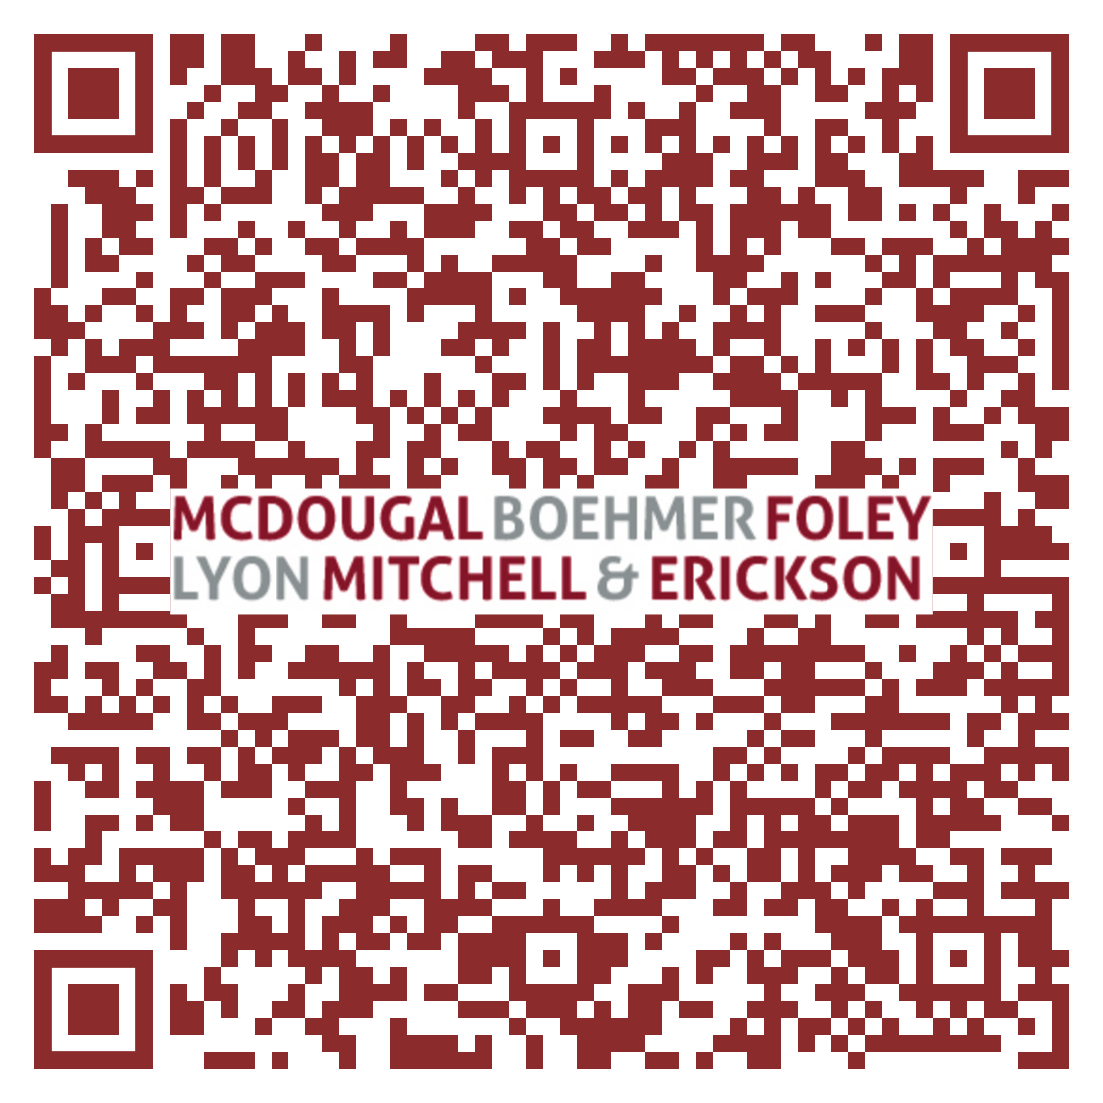
Sunshine Example

Slide 27
Drafting Proposals
It is important that the Parties can easily track what the other is changing.
It is important to have a consistent method of tracking changes.
Format Key:
Unchanged existing language
Deleted proposal language
Added proposed language
Accepted deletion
Accepted addition
TermsLanguage that may be agreedacceptable, but with questions.
Undeleted existing language (i.e., one party deleted it and the other put it back)
[Notes]
**See Attached example proposal.

Slide 28
Exchanging Proposals
A Note on [Notes]
  When making substantive contract proposals, it is important to be clear about why certain language is necessary or preferred.
  Negotiation requires good faith and that the Parties clearly communicate their proposals, in this case their interests and justifications.
  [Notes] permit the negotiator to sell your position to the District, or to sell the District position to the membership.

Slide 29
Proposal Example

Slide 30

Negotiation Strategies
Form follows function follows form follows function
Form follows function follows form follows function
Form follows function follows form follows function
Form follows function follows form follows function
Form follows function follows form follows function

Slide 31
Subjects =/= Style
The EERA still applies, and PERB retains jurisdiction, despite the form of negotiation used.
The style of negotiation defines the process.
The style of negotiation does not relieve the parties of the duty to bargain in good faith or change the subjects.

Slide 32

Positional Bargaining
Traditional
Adversarial
One party clearly wins
Each party is entrenched
Chief negotiator acts as gatekeeper
Parties try to persuade others out of their entrenched positions
Concessions may breed resentment, threaten future labor peace

Slide 33
Positional Bargaining PROCESS
Propose Article
Reject most
Propose
Reject part
Propose
TA
[repeat]
Formulaic
Each proposal moves parties fractionally closer to objective
Tedious
Requires meticulous tracking of changes
Time consuming
Interests may only become clear through repeated proposals

Slide 34

Interest-Based Bargaining
“Big picture”
Introspective
“Problem-solving” approach
Time consuming
Can be tedious

Slide 35
IBB Process
Agree on Topic
Tell the Story
Identify Issues
Questions
Potential
Stakeholders
Identify
Interests
Develop Options
Rank Options
Straw Design
Action Plan

Slide 36
Hybrid Process
Exchange Proposals
Identify Commonality
Problem Solving
Identify Interests
Discuss Solutions
Narrow Issues
Parking Lot?
MOU/TA
Identify Conflict
Agreement
Objectives
First Proposal

Slide 37
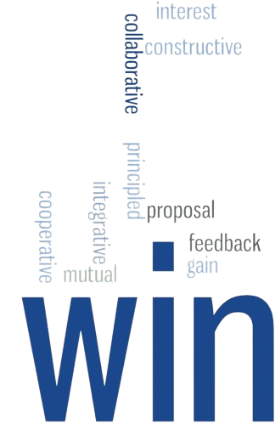
Hybrid Approach
Borrows from both Positional and IBB models.
Parties present proposals to outline initial position.
Parties evaluate commonality and conflict.
Parties adopt a problem-solving approach.
Parties identify interests and potential solutions.
Parties cooperate to find positions that are mutually beneficial.

Slide 38
Timing is Everything
Both sides must feel they have been through the process or they will not value the bargain
Extract concessions first
The later the offer, the more it is worth
Unless truly the last offer, undermines credibility

Slide 39
Package or Piecemeal
Isolation of proposals results in giving more
  You soon run out of "gives" without achieving an agreement
  Better to deal in "packages" and trades
  Get something for every concession

Slide 40
Beware “Quick” Agreements
Agreement is not a function of the # of meetings
Do not raise form over substance
Timing and frequency of meetings is very important
Too frequent meetings indicate a lack of firmness

Slide 41
NO
Saying “NO” takes practice
During the initial stages of bargaining, you may wish to accept proposals of little consequence to establish some good faith.
Rarely should you accept language absent making modifications that represent your interests.

Slide 42
NO
Saying “NO” is not automatically bad faith
“Hard bargaining” =/= bad faith
If the District determines that it can not or will not yield to a specific union demand, the District may lawfully maintain an adamant position on any issue.
(Oakland Unified School District (1983) PERB Decision No. 275;
NLRB v. Herman Sausage (1960) 275 F.2d 229 .)

Slide 43
A union will only settle either when it gets everything that it is asking for or is convinced that it can get no more.

Slide 44
2025 ACHRO Handbook and
Comprehensive Negotiation Checklist

Slide 45

QUESTIONS?
THANKS!

