Slide 1

Seamless Integration of AI and Automation for HR Functions
September 30, 2026
ACHRO/EEO Annual Conference
Presented by:
Mercedes Gutierrez
Cerritos Community College District
&
Angelique A. Cramer

Slide 2

Disclaimer:
The following information is designed to be a general guide and should NOT be considered legal advice. For questions about specific situations, please consult an attorney.
"Court Gavel - Judge's Gavel - Courtroom" by weiss_paarz_photos is licensed under CC BY-SA 2.0.

Slide 3

Overview
Introduction to AI Tools
Best Practices for Incorporating AI and Improving Results
Using AI or Automation in:
  a. Recruitment
  Employee Self-Service
  Employee Development
  Labor Relations
Concerns about AI Use for HR
Notes:
Learning Objectives
By the end of the presentation, you will be able to:
Identify at least three HR tasks that can appropriately be assisted by AI.
Write a useful AI prompt for a common HR task.
Recognize situations in which AI use presents elevated legal, privacy, equity, or employee-relations risks.
Develop practical skills to move toward responsible AI adoption within your HR department.

Slide 4

“AI is the new electricity.”
Notes:
Quote is by Andrew Ng, who was cofounder and head of Google Brain.

Slide 5
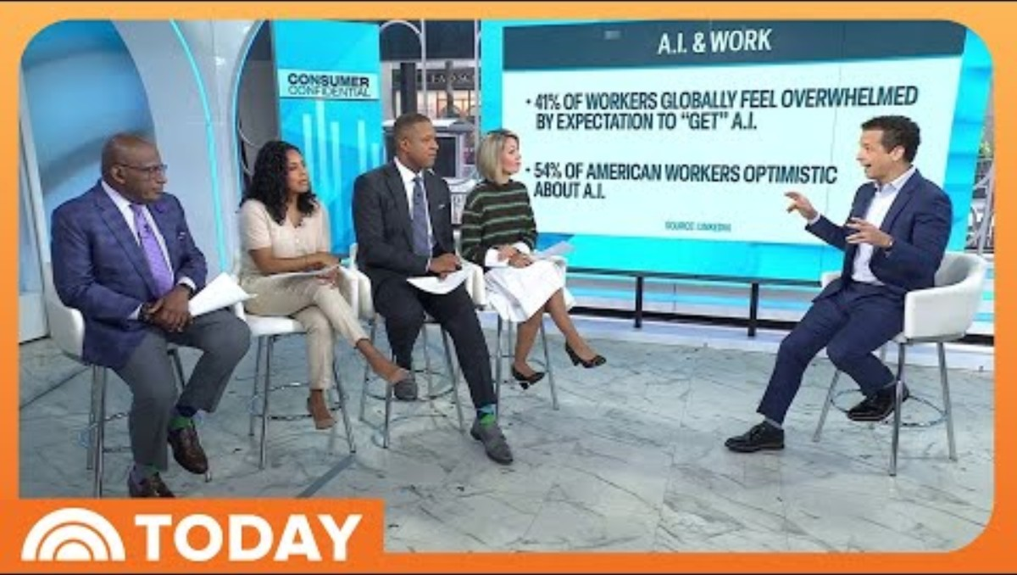

Slide 6
What is Artificial Intelligence?
Simulation of human intelligence in machines that can be programmed to suppose like human beings. Algorithms that train themselves to simulate human behavior and to re-imagine workers’ experience.
Using the computer to solve problems or make automatic decisions for tasks that, when done by humans, typically require intelligence.
Notes:
AI term was first coined by John McCarthy in in 1956, when he held an academic conference on the subject.
AI Is Not One Thing:
1. Generative AI: Creates or transforms content.
Examples:
Drafting an email
Summarizing a document
Creating interview questions
Developing a training outline
2. Predictive/Analytical AI: Uses data to identify patterns or make predictions.
Examples:
Forecasting turnover
Identifying trends
Analyzing survey responses
3. Agentic AI: Can perform multiple steps or take actions with limited human intervention.
Examples:
Searching information
Creating a report
Updating systems
Sending communications
Triggering workflows
Automation: trigger event initiates defined protocol.

Slide 7
Main AI Approaches
Logic and rules-based approach
Common, non-HR example: Tax preparation software
Pattern-Based Approach (Machine Learning)
Common, non-HR example: translation software
An example that can help in HR, is an Email Spam Filter
We’re emailing about your car warranty!
Notes:
Email Spam Filter: System detects patterns in email that are likely markers of spam.
For example, emails with “car warranty” in them are more likely to be spam.
Employee who deletes the car warranty emails that do make it into the email box, allows the filter to “figure out” through the use of patterns how to delete more car warranty spam emails in the future.

Slide 8
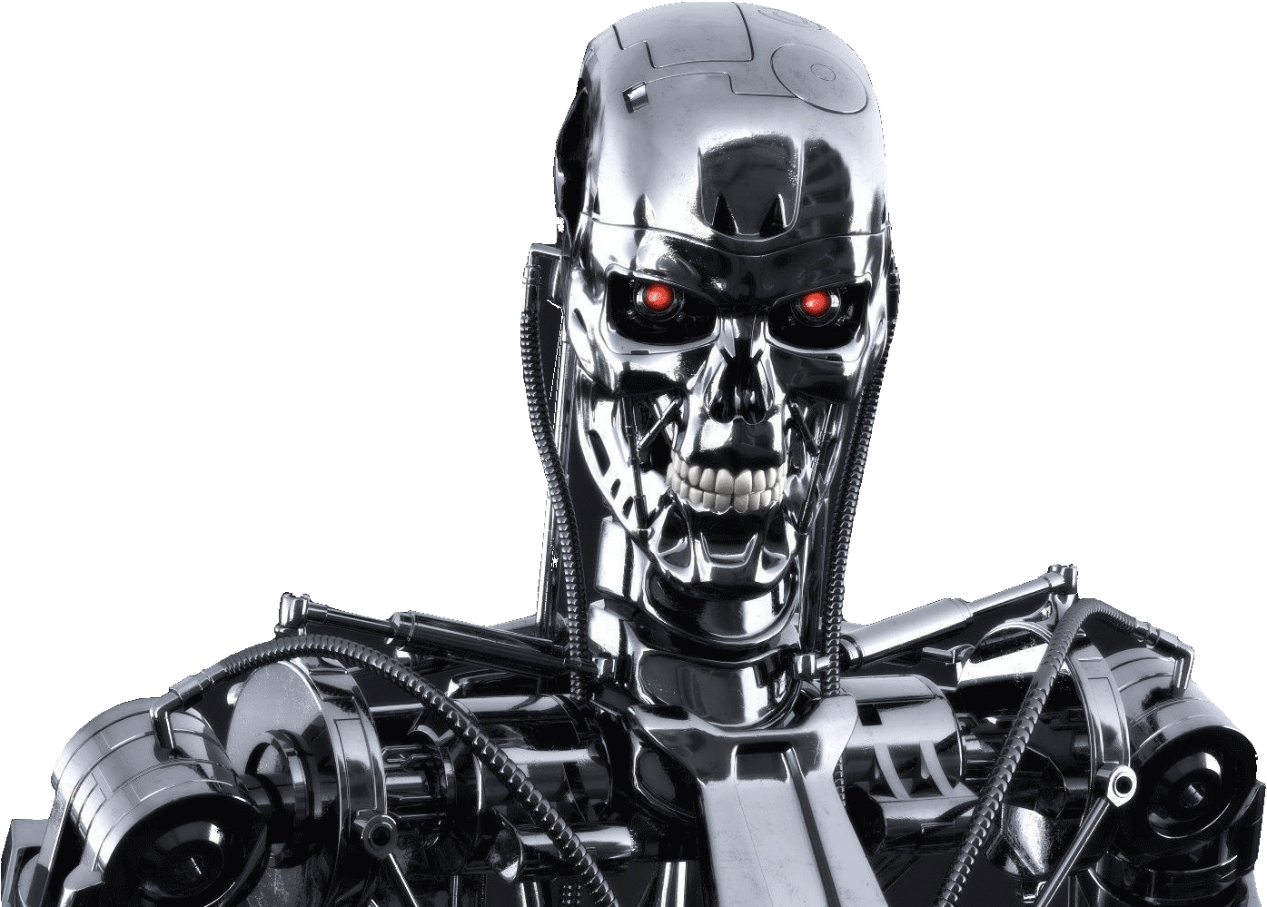
AI Best Practices
I’ve got this. Trust me!
Notes:
Best way to use artificial intelligence: augmented human with machines (the chess lesson). The chess lesson shows that when a human chess player focuses on the strategic planning and the computer takes care of the calculations, best results. It is the ability to coordinate and effectively coach the computers that defeats a great chess player and a good PC—and allows even a novice chess player to win. Humans plus computers are better than humans or computers alone.
If AI could safely eliminate one repetitive HR task from your workload tomorrow, what would you choose?
EXAMPLES:
Drafting routine communications
Summarizing meetings
Creating job descriptions
Responding to repetitive questions
Reviewing policies
Preparing reports
Creating training materials
Scheduling/interview preparation
Creating FAQs

Slide 9
AI Benefits & Uses
AI can help HR Professionals:
  Reduce administrative workload
  Improve consistency
  Accelerate drafting and research
  Make information easier to access
  Create employee self-service resources
  Evaluate options
  Develop training
  Improve communication
  Audit workflows
  Manage priorities and scheduling
AI is particularly useful for:
    Drafting
    Editing
    Summarizing
    Brainstorming
    Organizing
    Creating outlines
    Generating alternatives
    Converting information into FAQs
    Creating first drafts
    Identifying questions that require human follow-up
Notes:
AI Is Becoming Part of the HR Workplace
AI can help:
Create → Organize → Summarize → Analyze → Suggest

Slide 10
AI Limitations
AI also introduces potential risks related to:
  Accuracy
  Privacy
  Confidentiality
  Bias
  Accessibility
  Security
  Employment discrimination
  Accountability
  Hallucinations
AI is less reliable at:
  Making determinations when it does not have facts
  Exercising judgment
  Interpreting ambiguous situations
  Making nuanced decisions
  Applying institutional or personal context when not provided
  Adapting to recent changes or remaining current
  Generating legally accurate content
Notes:
HR must retain responsibility:
Verify → Interpret → Decide → Communicate → Document
AI Can Sound Right and Be Wrong. AI may:
Invent citations
Misstate a policy
Create nonexistent requirements
Misinterpret exceptions
Combine unrelated rules
Use outdated information
Present speculation as fact
The solution is not:
"Don't use AI."
The solution is:
Use AI with verification.
STOP. REVIEW. VERIFY.

Slide 11
AI Implementation Guidelines
The Chancellor's Office HUMANS framework emphasizes human agency and accountability, transparency, privacy/data protection, bias mitigation, accessibility, and vendor/partner evaluation:
    Human-centered Approach
    Universal Support
    Managed Privacy Controls
    Algorithmic Discrimination Protections
    Notice and Explanation
    Safety Security
Notes:
The California Community Colleges Chancellor’s Office describes its systemwide approach as human-centered, equity-focused, transparent, accountable, and privacy-conscious. Its AI Council and guidance are intended to support responsible AI adoption across the system. The Chancellor's Office describes AI as a tool intended to support—not replace—human expertise, relationships, and judgment.
Human-centered Approach
Include humans in design and testing so AI supports equitable access, minimize bias, and improve outcomes.
Universal Support
People can opt out of AI enabled experiences and reach a human to correct errors or resolve issues.
Managed Privacy Controls
People maintain agency over how personal data is collected and used.
Algorithmic Discrimination Protections
Systems are designed to prevent discrimination and inequitable outcomes.
Notice and Explanation
Clear notice is provided for AI use including how it effects users and how it related to decisions or outcomes.
Safety Security
AI tools are monitored and managed to prevent unsafe, unreliable, or ineffective use with protective safeguards.
AI Drafts. HR Decides.

Slide 12
Practical AI Protocol Considerations
1. Approved Tools: Maintain a list of AI tools approved for institutional use.
2. Prohibited Data: Define what may not be entered into unapproved systems.
3. Human Review: Identify decisions requiring human review.
4. High-Risk Use Review: Require additional approval for employment decision systems.
5. Vendor Review: Evaluate privacy, security, accessibility, bias, and contractual terms.
6. Documentation: Maintain a basic inventory of AI use categories.
7. Training: Teach employees how to use AI responsibly.
Notes:
Treat output as a draft, never a decision
AI output is a first draft, not legal advice and not a final determination.
Verify every legal and contractual reference against the current CBA, Education Code, Title 5, and your Board Policies/Administrative Procedures. Models can cite outdated or invented provisions.
Loop in legal counsel for dismissal, layoff, arbitration, threats to safety, and ADA/FEHA accommodation decisions.
Watch for bias — especially in any screening or selection content. AI must never screen or rank real candidates for you.
Keep a human in the loop and document your own reasoning; you remain accountable for the decision.
Do not input:
Names, employee or student IDs, Social Security numbers, home addresses, or other direct identifiers.
Medical information, disability details, leave diagnoses, or anything resembling a medical record.
Specifics of an open investigation, discipline, or negotiation that could identify a person.
Anything covered by attorney-client privilege or that your IT/security and AI-use policies prohibit.
Individual task review:
Task
What do I repeatedly do?
Frequency
How often?
Time
How much time does it take?
Information
What information does it require?
Risk
What could go wrong?
AI Opportunity
Could AI:
Draft it?
Summarize it?
Organize it?
Analyze it?
Create a first version?
Human Review
What must a person verify?

Slide 13

Crafting a Prompt
  ROLE: sets the expertise or point of view
  - Who should the AI act as?
  TASK: describe the deliverable to be generated
  - What do you want it to do?
  CONTEXT: supplies the facts, conditions, or source text to rely on
  - What does it need to know?
  OUTPUT: sets the structure, tone, and length of the product
  - What format should it produce?
  CONSTRAINTS/GUARDRAILS: sets limits on behavior and generated product
  - What must it not change or assume?
  REVIEW: notes items to be checked or verified.
  - What should it flag for human attention?
Notes:
A Better Prompt = Better Output
Ask AI to explain its reasoning and flag items for human review
Weak Prompt
"Write an email about our new leave policy."
Better Prompt
"Act as an HR communications specialist. Draft a concise employee email announcing the attached leave-policy update. Use a professional, approachable tone. Explain what is changing, when it takes effect, and where employees can obtain additional information. Do not add requirements, deadlines, eligibility rules, or interpretations that are not contained in the source document. Flag any information that appears ambiguous or missing. Keep the email under 300 words."
Best practice
Tell AI what it must not invent.
Ask: "What would you still verify before finalizing this?"

Slide 14
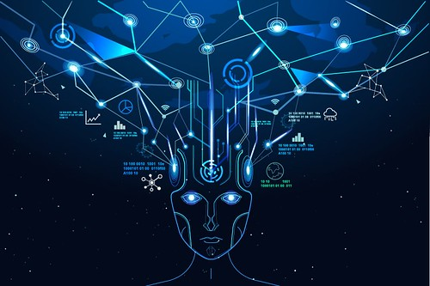
Using AI in Recruitment

Slide 15

Benchmarking
AI can generate:
  Criteria for selecting comparators
  Comparisons of policies and practices across Districts
  Tools to structure data collection for compensation and position comparison
  Translate data into options
  Draft methodology for comparisons
Notes:
Generated content does not replace authoritative sources — use CCCCO DataMart, the State Chancellor’s Office, CalHR, EDD, and comparison districts’ CBAs and salary schedules to verify actual numbers.
Generative AI does not have live access to current salary schedules. Use it to design the study and present the findings — input source material or pull the actual figures from authoritative, current sources.

Slide 16
Job Descriptions
Generate custom job descriptions and audit to identify potential biases.
Pressure test job description language to attract more diverse applicants.
Refocus descriptions on key skills and clarify to match existing workflows.
Notes:
Heavy review needed before finalizing.

Slide 17

AI in Application Processes
Utilize a chatbot to help someone complete the lengthy application process
Smart Digital Forms—so applicants do not have to reenter the same information from their resume over multiple steps of the application process
  Use information to automatically generate new hire forms.
    Algorithms extract the information needed from documents, reducing the need for manual data entry.
"Chatbot img" by Robink23 is licensed under CC BY-SA 4.0.
Notes:
Can also be used in:
Verifying that websites and application materials are accessible
Automatic responses

Slide 18

Norming & Interview Preparation
Create a script or workplan to norm a screening/interview committee for a specified position.
Build job-related screening criteria and a scoring rubric based on the job description.
Prepare sample interview question prompts by position.
Review evaluation criteria for disparate impact on protected groups or departure from job relatedness.
Audit application materials and interview questions for areas that could elicit information about a protected characteristic or a proxy.
Notes:
District hiring obligations include — Title 5 and EEO requirements, minimum qualifications or equivalency for faculty, job-related screening criteria, and consistent, bias-aware evaluation. “Norming” is how a screening or interview committee calibrates to a shared, job-related standard before they review a single applicant, so that every candidate is measured the same way. AI is a strong tool for designing criteria, generating job-related questions, and building norming materials — but it must not screen, score, or rank or select applicants.
Use norming standards to run a defensible, equitable committee process. Have AI help produce the materials; the committee’s judgments remain human.
Do not paste real applicant materials and ask AI to screen, score, or rank them. Beyond the privacy issue, automated screening can embed and scale bias and creates legal exposure. AI builds your criteria and questions; trained human committees evaluate the people.

Slide 19
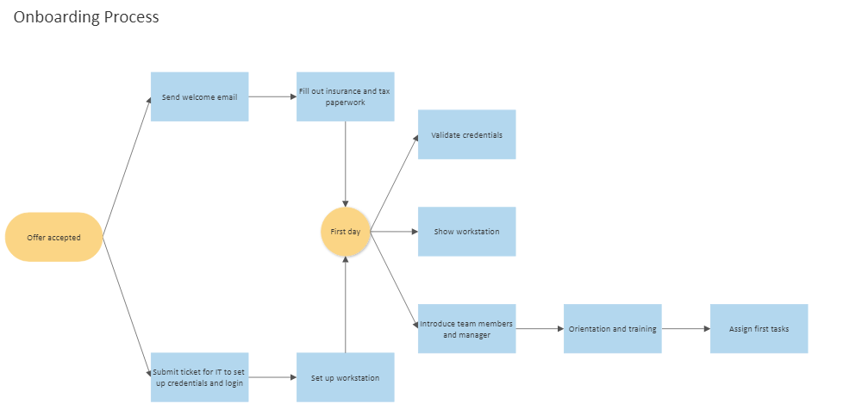
Onboarding
Can schedule:
  Pre-boarding
  First day and welcome
  First two weeks
  Policy acknowledgments
  IT use agreements
  Training sessions
  30, 60, and 90 day check ins
Notes:
Assign access to systems
User manuals
How to videos
Select a mentor to get the new hire acclimated

Slide 20

AI in Employee Relations & Self Services

Slide 21
Employee Counseling & Discipline
AI can generate:
  Template counseling memoranda related to specified policy violations or disciplinary causes with directives and support options.
  Scripts for providing constructive feedback to struggling employees.
  Professional development goals and training modules.
  Clear directives and performance expectations.
  Performance improvement plans and SMART goals with review schedules.
Notes:
AI is strongest here as a thinking partner for planning, drafting, and pressure-testing tone — always on de-identified facts, and never as the decision-maker.

Slide 22

AI in Workplace Investigations
Draft an investigation plan based on specified policies and de-identified facts
Identify issues to be determined
Generate format for witness list, data collection, and status tracking
Prepare sample witness questions
Structure template for investigation report
Draft notice letters

Slide 23
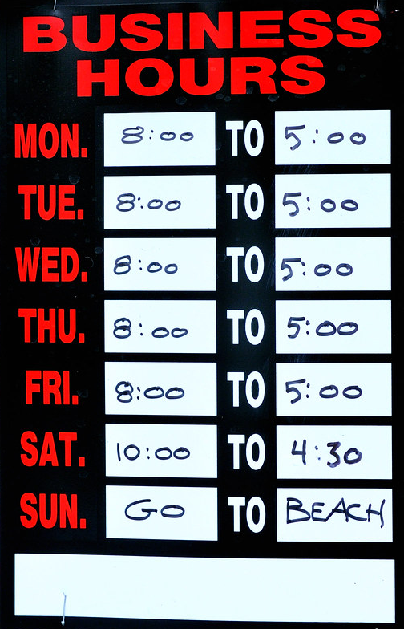
Using AI for Benefits
Communications
24/7 availability
Automated responses and FAQs
Timely communication
Tailored to District data
Notes:
Chatbots can answer common employee questions.
Chatbots can be used to perform some assist with navigating the district website and providing information regarding the District’s employee benefits plans.

Slide 24

Records Management
Using AI natural language processing and comprehension to analyze emails and other unstructured content in context for searches.
Sort and apply tags and extract information.
Automate information identification, classification, retrieval, archiving and disposal of records.
Mark documents that reach their retention period for disposal.
Notes:
Machine learning algorithms can scan large volumes of data to identify patterns or classify the contents of records for you.
Algorithms can interpret the subject matter, entities involved, dates, status, etc.
Helps with responses to CPRA requests as well.
Examples:
1. Ingestion
Digitize
Put into system
Label categorize
Index
2. Identify duplicates and spamming
Example: Iron Mountain InSight

Slide 25

AI for Employee Development

Slide 26
AI in Employee Learning & Development
  Develop personalized career goals, progression steps, and training plans
  Auto-assign mandatory learning by role
  Comply with sexual harassment training requirements
      Send reminders to employees who are overdue
  Automate safety training
  Meet new training requirements
  Goal-setting
  Offer on-demand or self-led learning
  Mobile learning
  Personalized learning based on employee’s skills
Notes:
Can have content libraries.
Can map skills employees have, want, and need for targeted training.
Generate certifications. Have audit trails. Gamify learning.
Example: Kallidus
Keenan (Active Shooter, Sexual Harassment, Concussion Awareness, New Hire Orientation, Workplace Bullying, School Intruders, Child Abuse and Mandatory Reporter, Transportation, etc.)

Slide 27
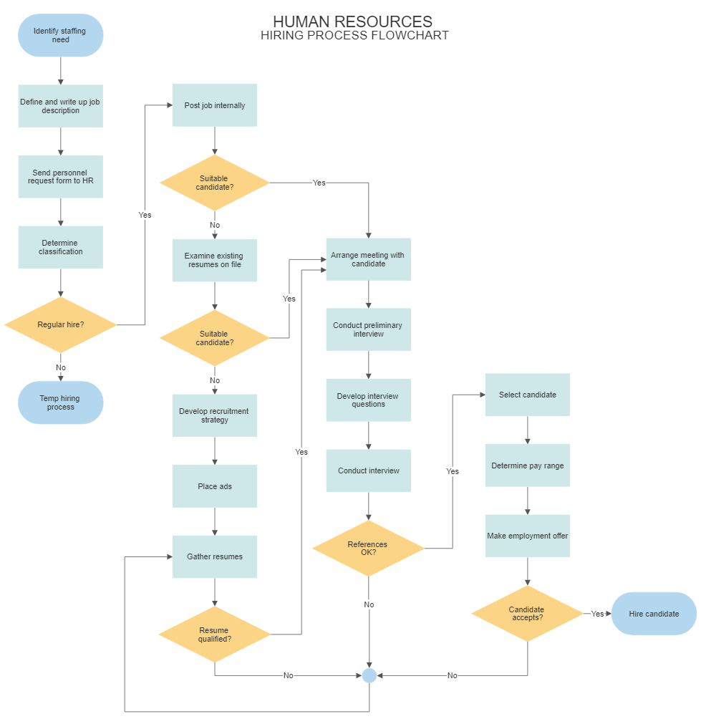
Workflow Optimization
Workflows are the sequences of tasks, actions, and decisions that need to be performed to achieve a specific goal.
Notes:
Can move from manually created flowcharts to easily AI generated workflows, with some of the processes at least automated.
Audit tasks to determine where AI or automation can improve efficiency.

Slide 28
AI in Performance Assessment
Eliminates human errors and biases that can come into play with performance review processes
Can look at a vast amount of data from multiple sources
Collect data on employee activity
    E.g., written communication amongst employees
Calendar evaluation steps and check-ins
Measures goals against actual performance
Personalized training suggestions for employee improvement
Compares employee progression
Craft feedback
Notes:
AI can help automate performance review rubrics. However, still human evaluator & collective bargaining.
Can have continuous real-time assessments through AI and data analytics.

Slide 29

Employee Engagement
  Employee survey.
      AI can summarize key insights
  Anonymous feedback
  Peer to peer recognition
  Employer recognition of employees
  Employee Incentive Strategies
  Personalized learning and development
  Improve collaboration by using predictive analytics to see who can work together the best
Notes:
Fast information sharing
24/7 conversational interfaces like chatbots
Analyze workplace policies
Example: officevibe

Slide 30

AI for Labor Relations

Slide 31
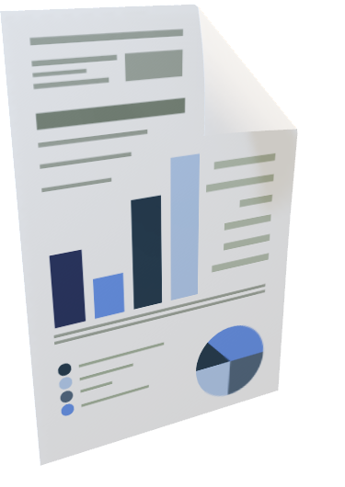
Bargaining Preparation
Create a framework for estimating costs of proposals based on adjustment of factors
Prepare interest-based positions related to identified articles
Suggest contract language or modification of language and review for ambiguity
Draft sample ground rules, sunshine descriptions, and proposal templates
Prepare summaries of agreements reached
Notes:
AI can accelerate the analytical and drafting work around the table — interest analysis, proposal costing structure, language drafting, ground rules, sunshine notices, and ratification summaries — but live strategy and any real numbers stay with you and your team. Never paste confidential proposals, board parameters, or closed-session content into a general tool.
Treat all costing math the AI produces as scratch work to be re-verified in your own validated spreadsheet. And keep board-authorized parameters, settlement ranges, and closed-session strategy out of any general AI tool entirely.

Slide 32
Compare Data & Create Visuals
Compare CBA language, compensation, benefits and other factors across Districts
Create tools to compare data across Districts
Create visual representations of complied data
Use comparative analysis to support District bargaining positions
Prepare talking points regarding District positioning
Generate options for collaborative resolutions
Notes:
Always confirm the accuracy of inputs and verify comparative values.

Slide 33
AI in Grievance Responses
Draft response templates.
Analyze claims in relation to identified contract provisions.
Generate options for informal resolution.
Draft script for grievance meetings.
Create review template for grievance responses, including list of possible defenses.
Schedule reminders regarding grievance timeline.
Notes:
A grievance response is contract interpretation under deadline pressure. AI helps you analyze the claim, organize the timeline, locate the implicated provisions, and draft a clean, level-appropriate response — grounded strictly in the contract text you provide, not in the model’s assumptions about “typical” contracts.

Slide 34

Cause for Concern
Potential issues for AI in Human Resources

Slide 35

Regulatory Reactions
Regulations clarify that the use of automated decision-making tools is subject to employment discrimination laws.
Record-keeping required for selection criteria and automated decision system data for four years.
Notes:
California's employment regulations expressly address automated-decision systems used in employment activities, including systems that screen, evaluate, categorize, or recommend applicants or employees. (2 CCR § 11008 et seq.)
California’s employment regulations concerning automated-decision systems became effective October 1, 2025.
California's Civil Rights Council approved regulations addressing automated-decision systems in employment.
The regulations became effective October 1, 2025.
They clarify that existing employment discrimination protections apply when AI, algorithms, or other automated systems are used in employment-related decisions. The regulations address activities including recruitment, hiring, promotion, screening, evaluation, and other employment benefits.

Slide 36
Major Records Privacy Laws
Federal Law
Family Educational Rights and Privacy Act of 1974 (“FERPA”)(20 U.S.C. § 1232g; 34 C.F.R. 99);
Health Insurance Portability and Accountability Act of 1996 (“HIPAA”)(45 C.F.R. 160.
California Law
California Information Practices Act (California Civil Code § 1798 et seq.);
California Education Code Sections 76230 & 76240 et seq. (Community College Districts);
Student Online Personal Information Protection Act (“SOPIPA”) (California Business & Professions Code § 22584 et seq.;
Article 1, Section 1 of the California Constitution; and
California Public Records Act (“CPRA”) (Govt. Code § 6250 et seq.)
Notes:
Family Educational Rights and Privacy Act (“FERPA”): Enacted to guarantee parents and students a certain degree of confidentiality and fundamental fairness with respect to the maintenance and use of student records. District must have written permission from the parent or eligible student in order to release any information from a student’s education record. (Some exceptions apply.)
The Health Insurance Portability and Accountability Act (“HIPAA”): When a school provides health care to students in the normal course of business, such as through its health clinic, it is also a “health care provider” as defined by HIPAA.
California Information Practices Act (California Civil Code § 1798 et seq.): The Information Practices Act requires public agencies (including school districts and community college districts) to notify affected California residents if their personal information has been, or is reasonably believed to have been, acquired by an unauthorized party.

Slide 37

Regulatory Reactions
Effective in Sept. 2025, CPPA regulations address the use of automated decision-making technology (“ADMT”), including consumer notices, opt-out rights, and data transparency requirements.
Notes:
11 CCR § 7001 et seq.

Slide 38
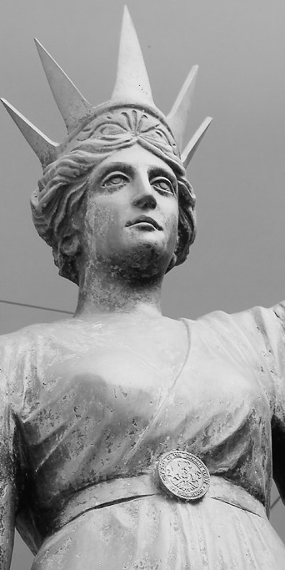
Concerns
Sufficient data for the algorithm
Legal regulation
Poor AI may exacerbate bias and misuse
Data privacy and security
Transparency/Employee Trust
Consent
Training on AI/Lack of AI expertise
Notes:
Monitoring
Replace humans
Technostress
AI Cannot Become an Accessibility Barrier
Federal EEOC guidance warns that AI and algorithmic tools can disadvantage applicants or employees with disabilities. Employers should have processes for reasonable accommodation when algorithmic tools are involved.

Slide 39
AI Implementation Takeaways
AI is an HR productivity tool.
    Use it to reduce administrative burden.
Consider risks, start with low-risk tasks.
    Drafting, summarizing, organizing, and training.
Protect employee information.
    Convenience does not override confidentiality or institutional data-governance requirements.
Employment decisions require heightened scrutiny.
    California and federal requirements increasingly address AI-assisted employment decisions.
Human judgment remains essential.
    AI can assist HR. AI cannot replace HR accountability.
Notes:
Implementation Strategy:
1. Identify one repetitive task.
2. Pilot AI on a low-risk activity.
3. Create a human-review standard.
4. Establish clear data/privacy rules.
5. Build AI literacy across the HR team.

Slide 40
QUESTIONS?
THANKS!

