Slide 1
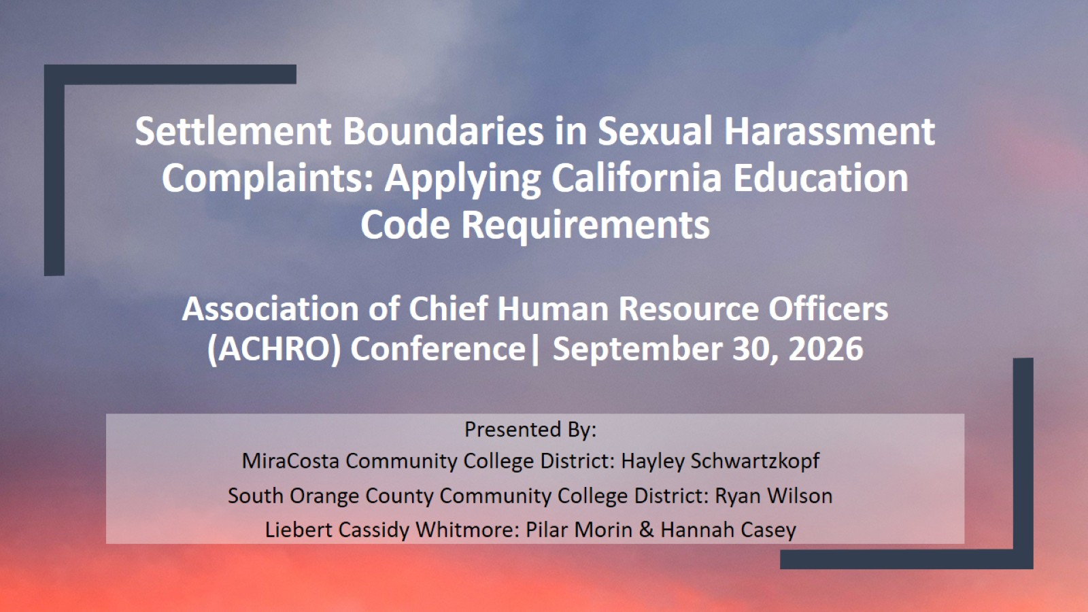
Settlement Boundaries in Sexual Harassment Complaints: Applying California Education Code Requirements
Association of Chief Human Resource Officers (ACHRO) Conference| September 30, 2026

Slide 2
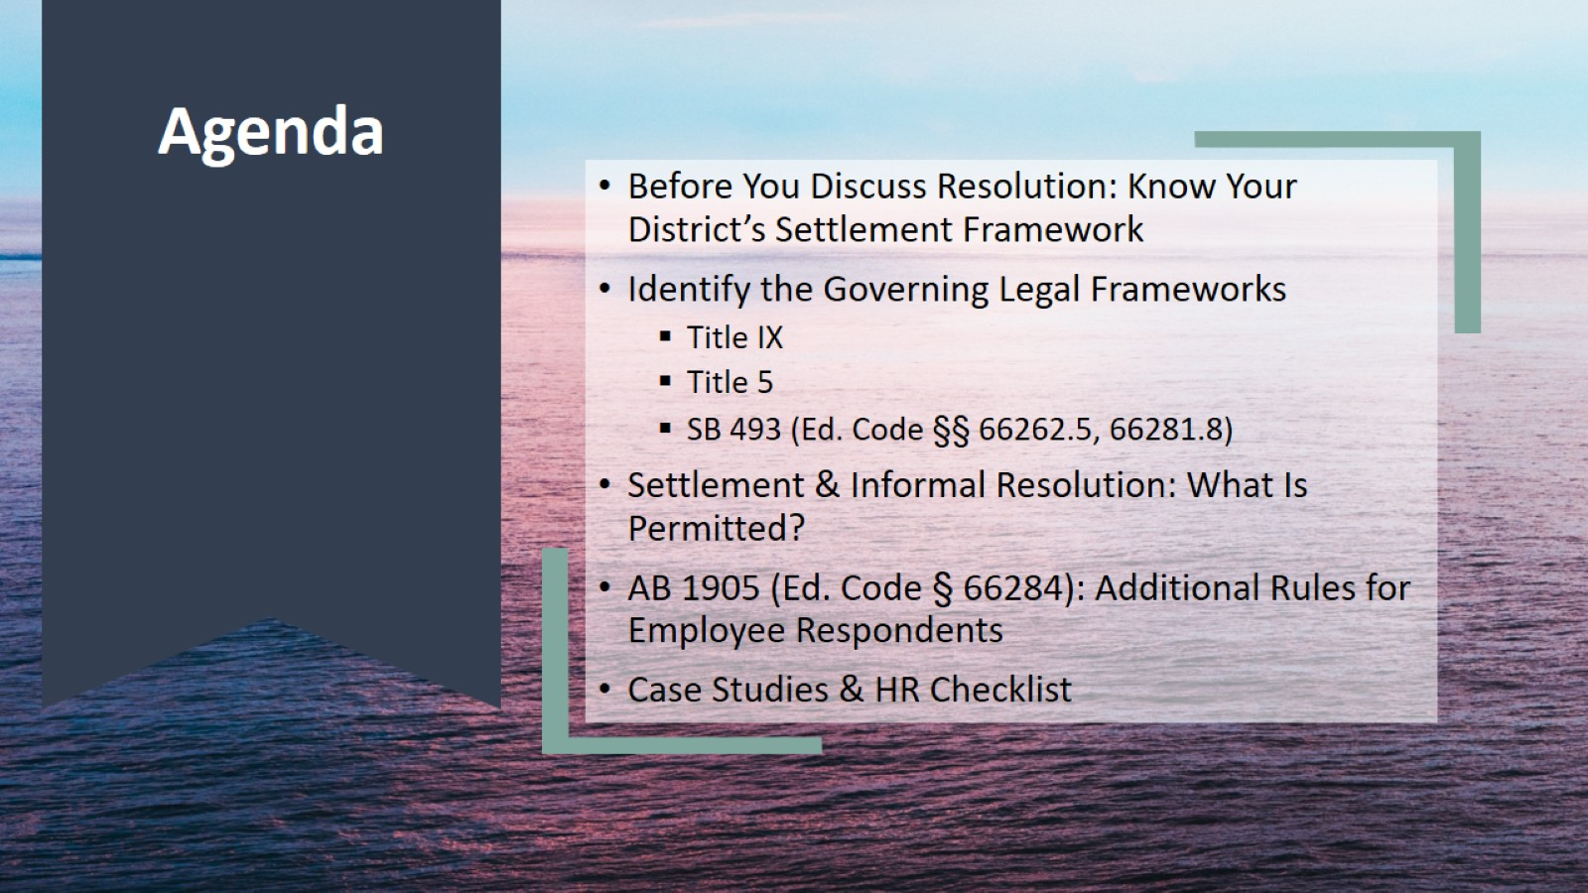
Agenda

Slide 3
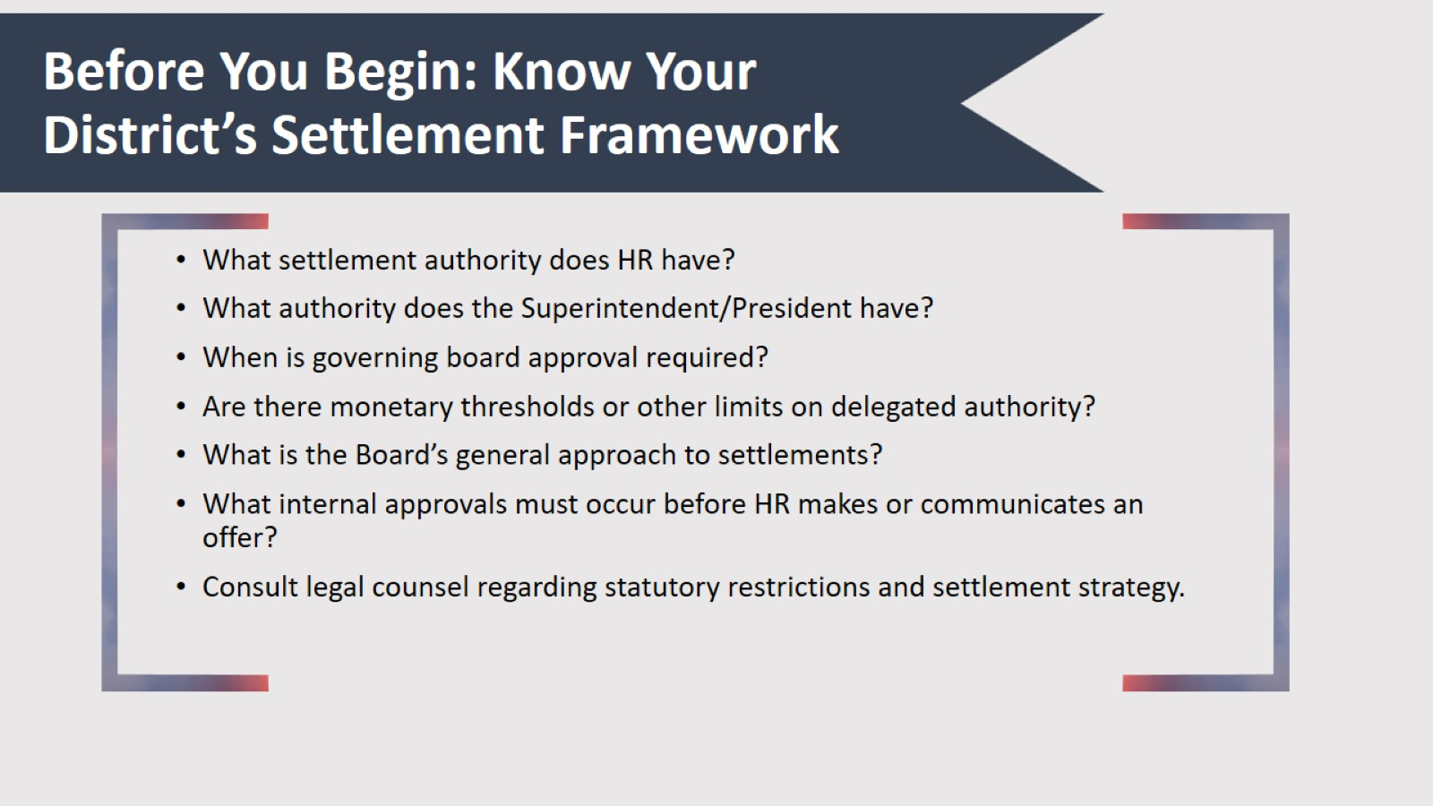
Before You Begin: Know Your District’s Settlement Framework

Slide 4
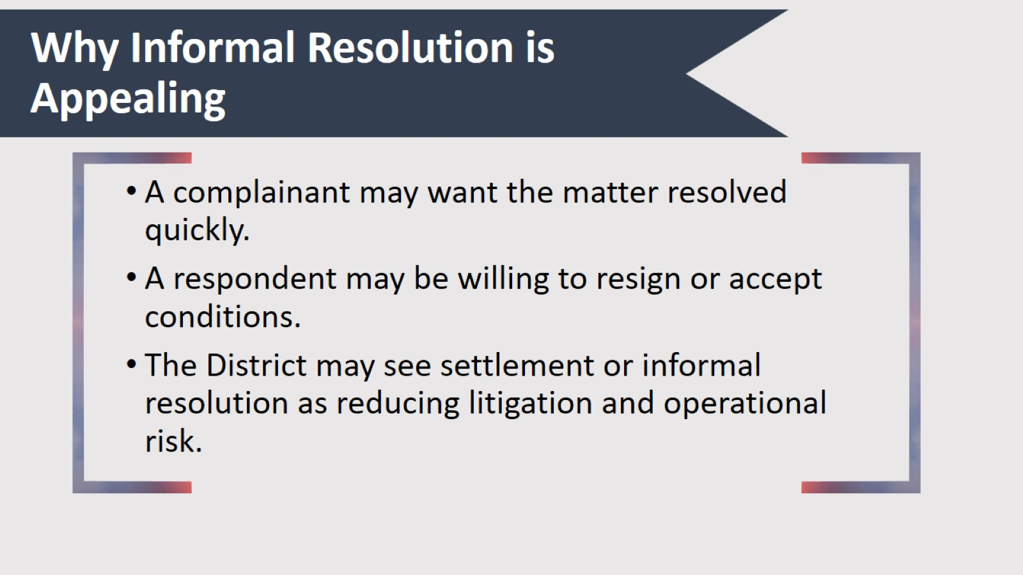
Why Informal Resolution is Appealing

Slide 5
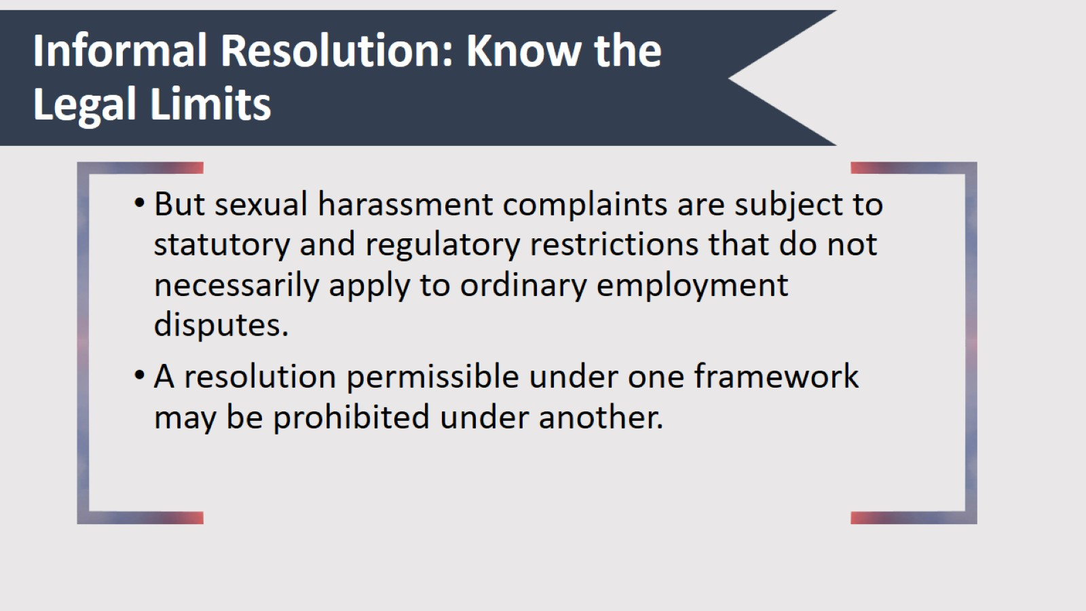
Informal Resolution: Know the Legal Limits

Slide 6
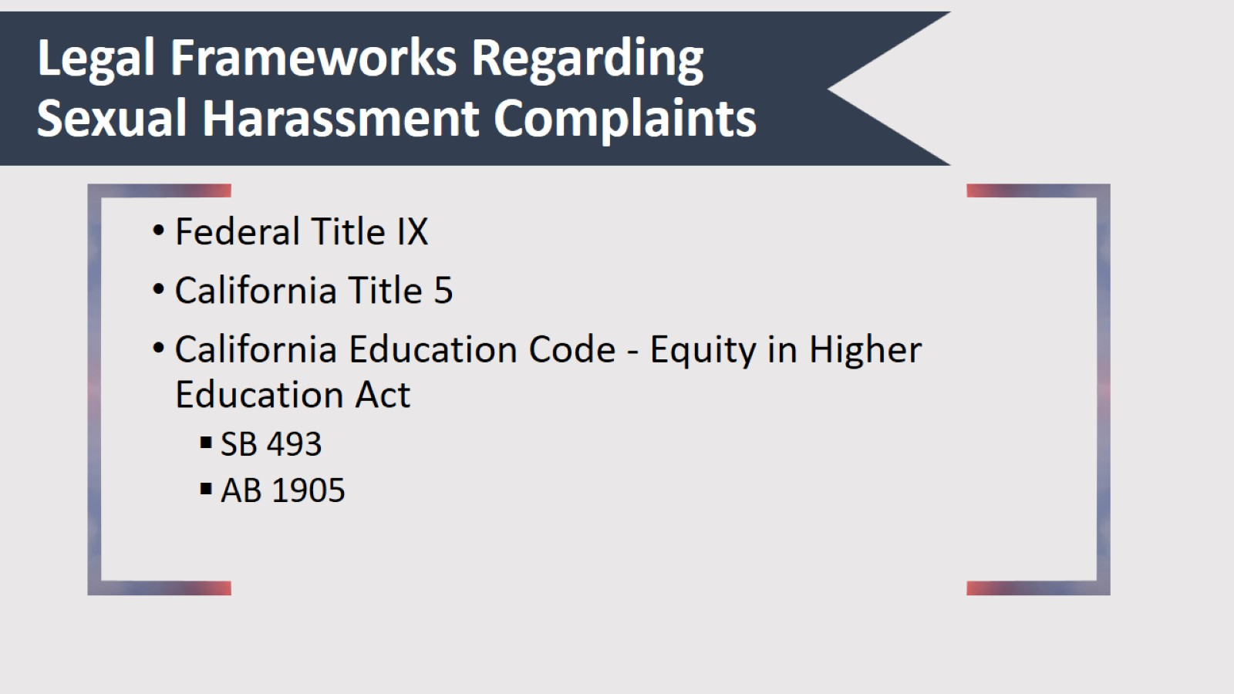
Legal Frameworks Regarding Sexual Harassment Complaints

Slide 7
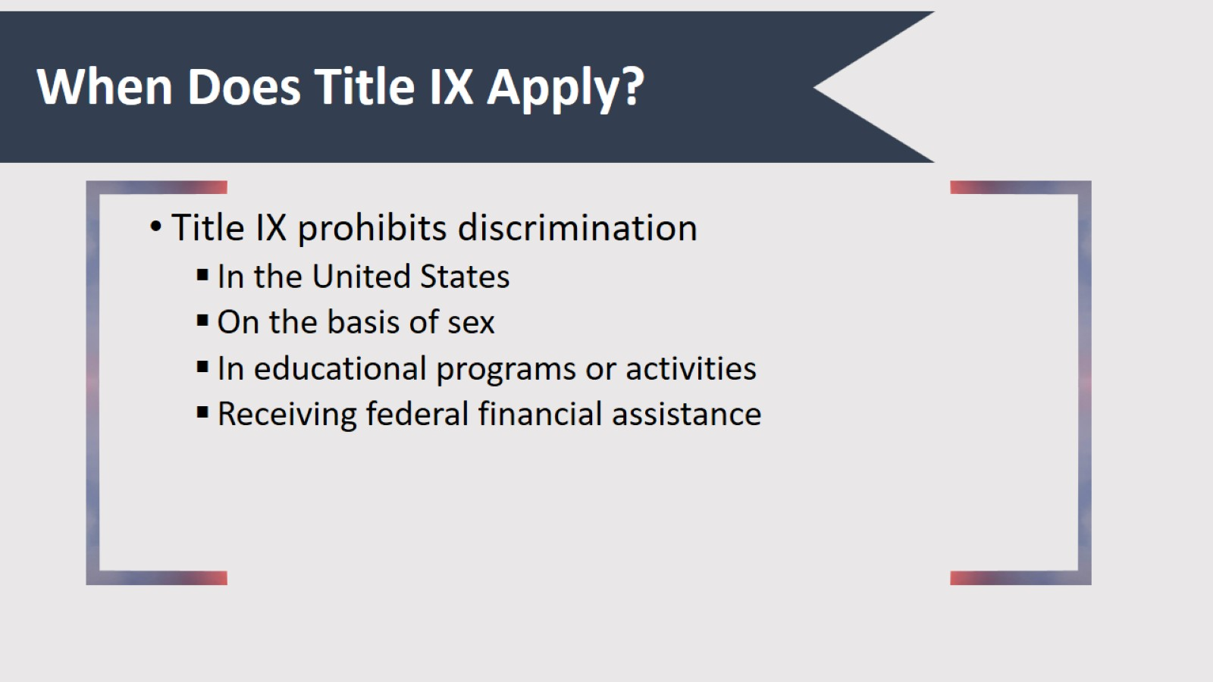
When Does Title IX Apply?

Slide 8
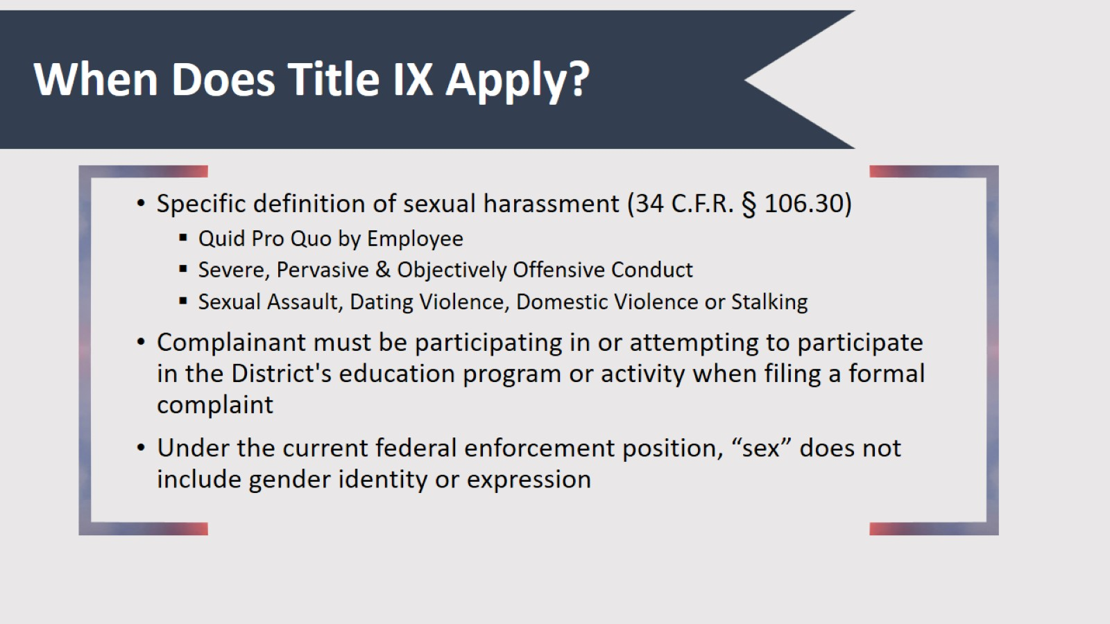
When Does Title IX Apply?

Slide 9
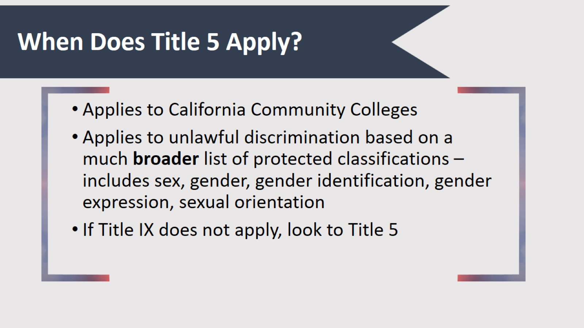
When Does Title 5 Apply?

Slide 10
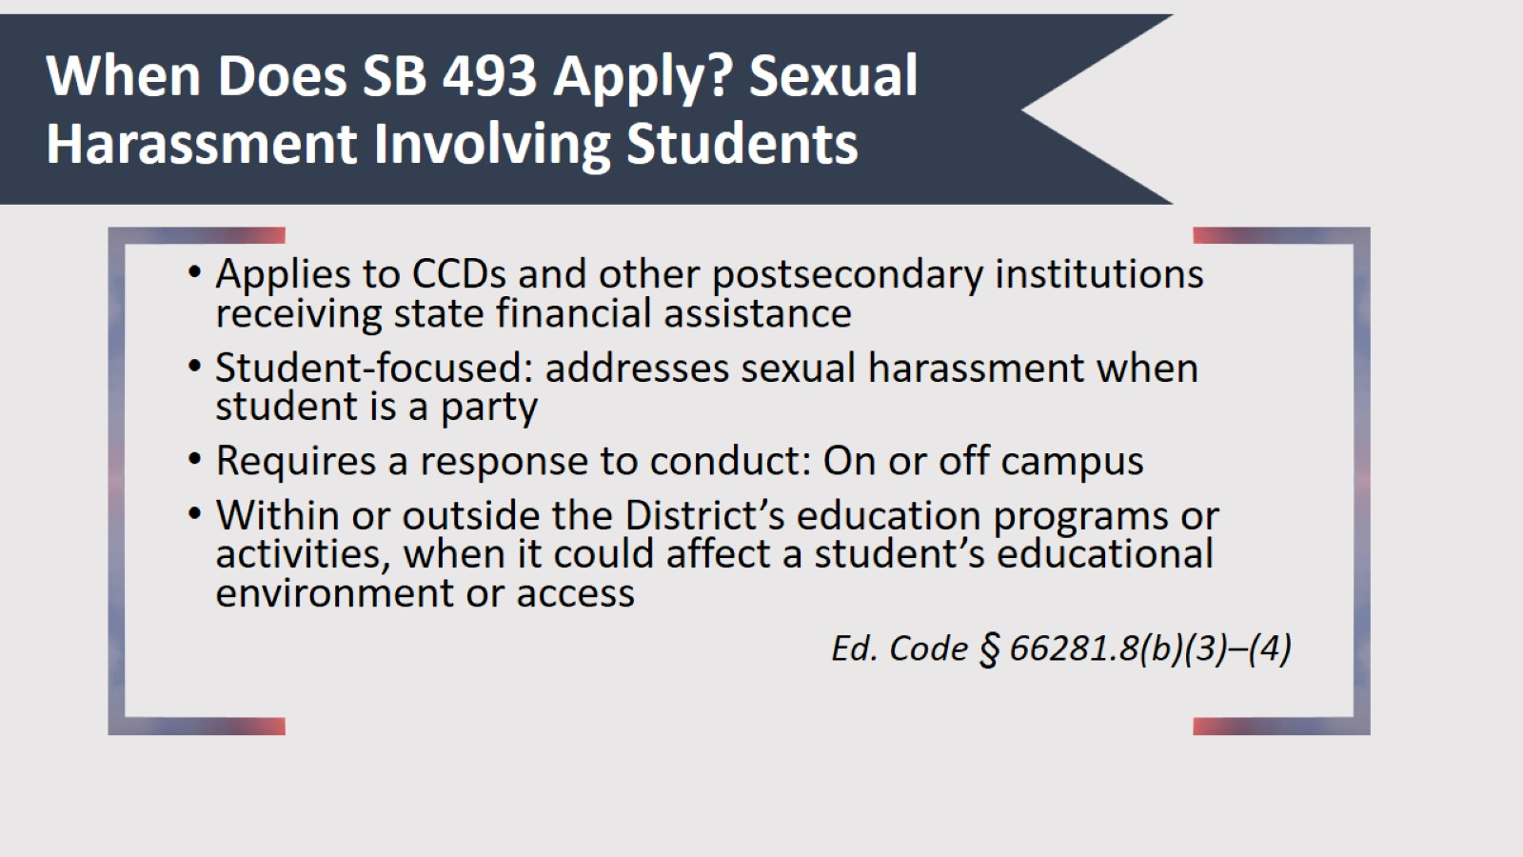
When Does SB 493 Apply? Sexual Harassment Involving Students

Slide 11
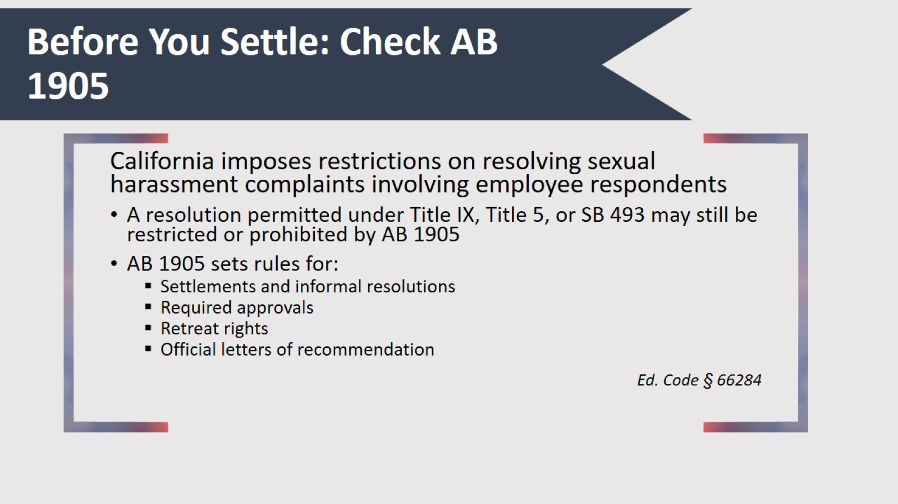
Before You Settle: Check AB 1905

Slide 12
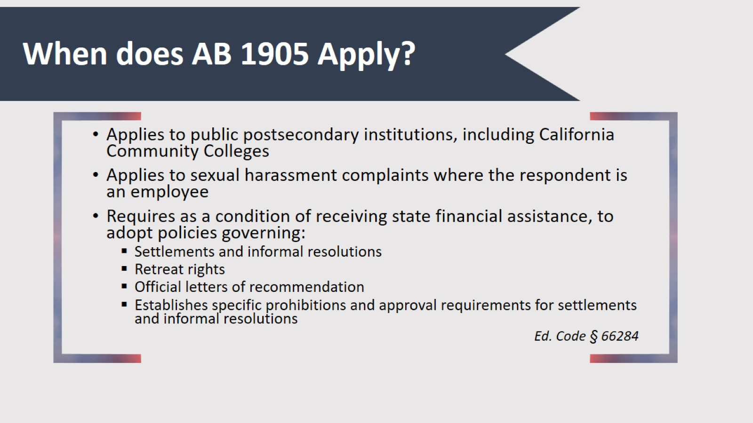
When does AB 1905 Apply?

Slide 13
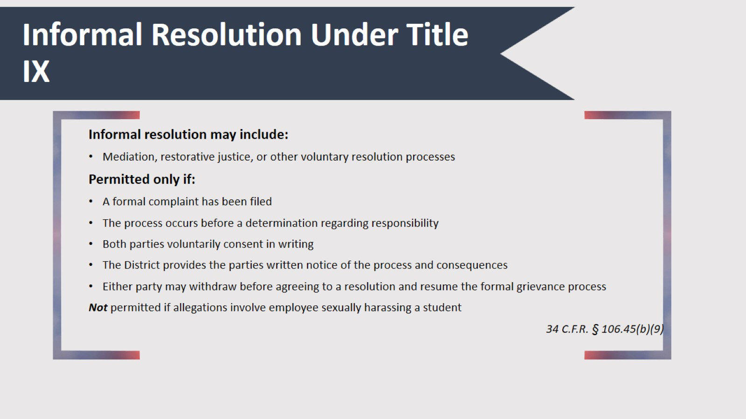
Informal Resolution Under Title IX

Slide 14
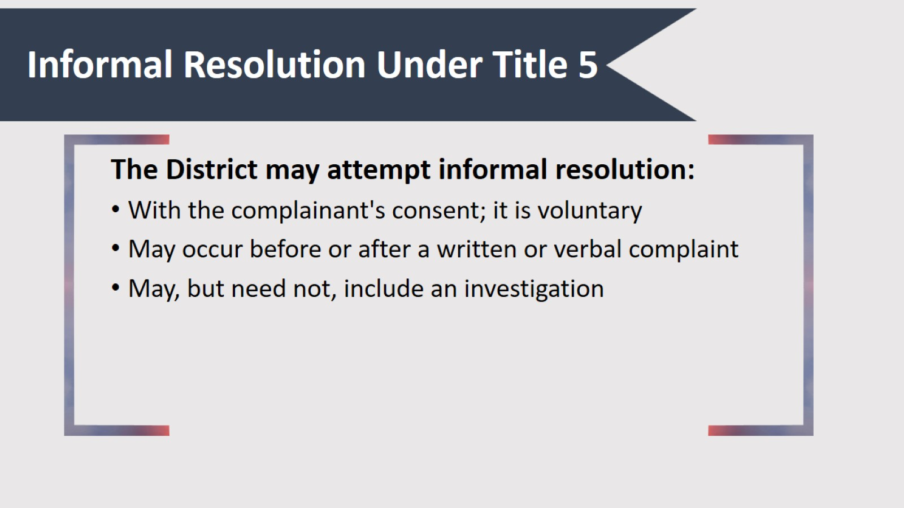
Informal Resolution Under Title 5

Slide 15
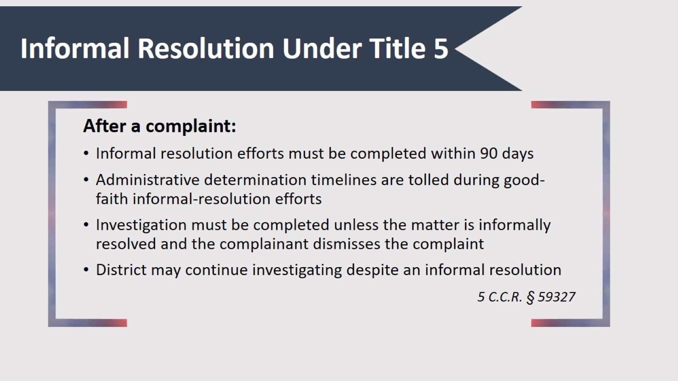
Informal Resolution Under Title 5

Slide 16
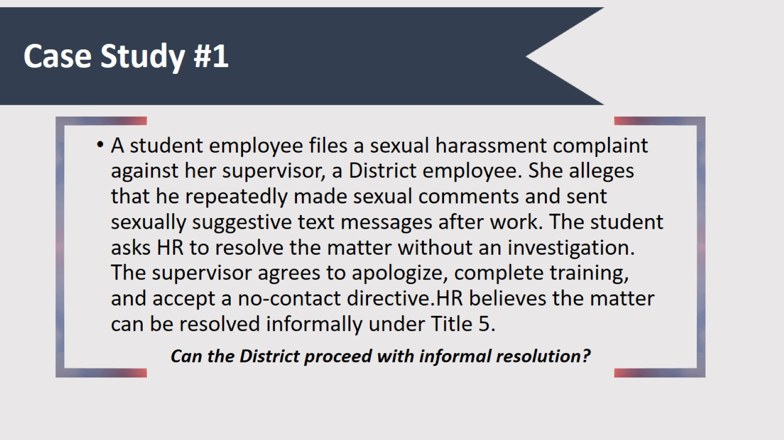
Case Study #1

Slide 17
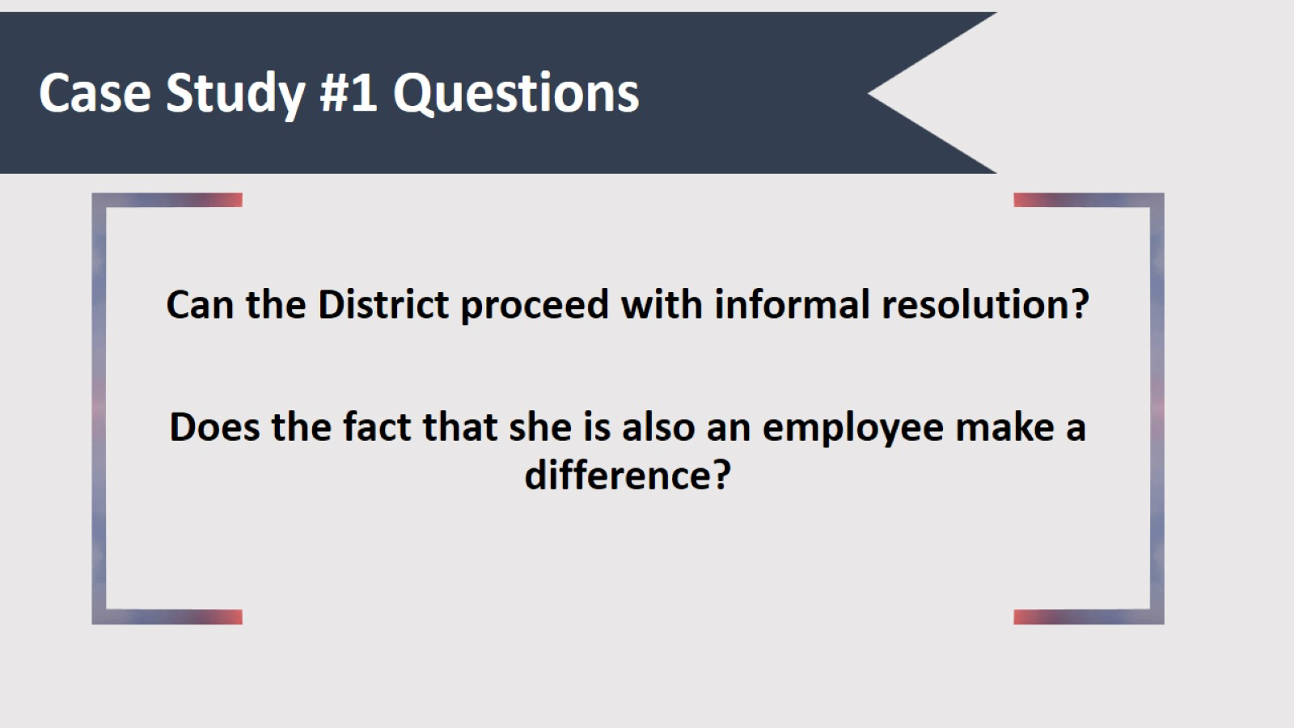
Case Study #1 Questions

Slide 18
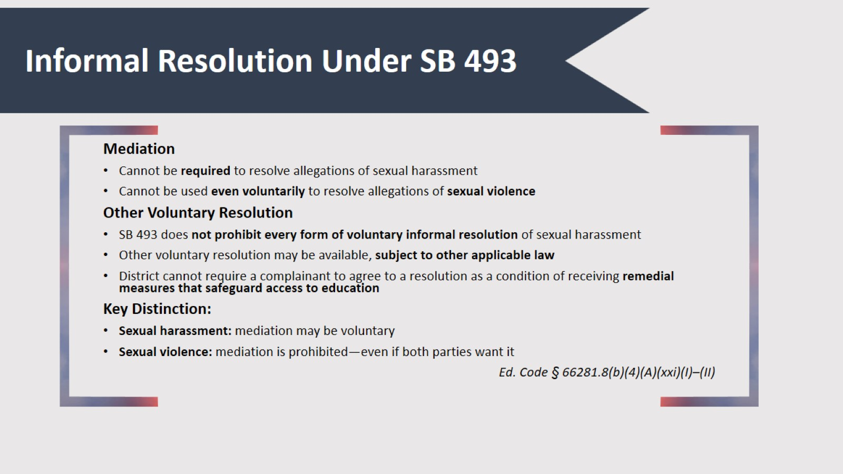
Informal Resolution Under SB 493

Slide 19
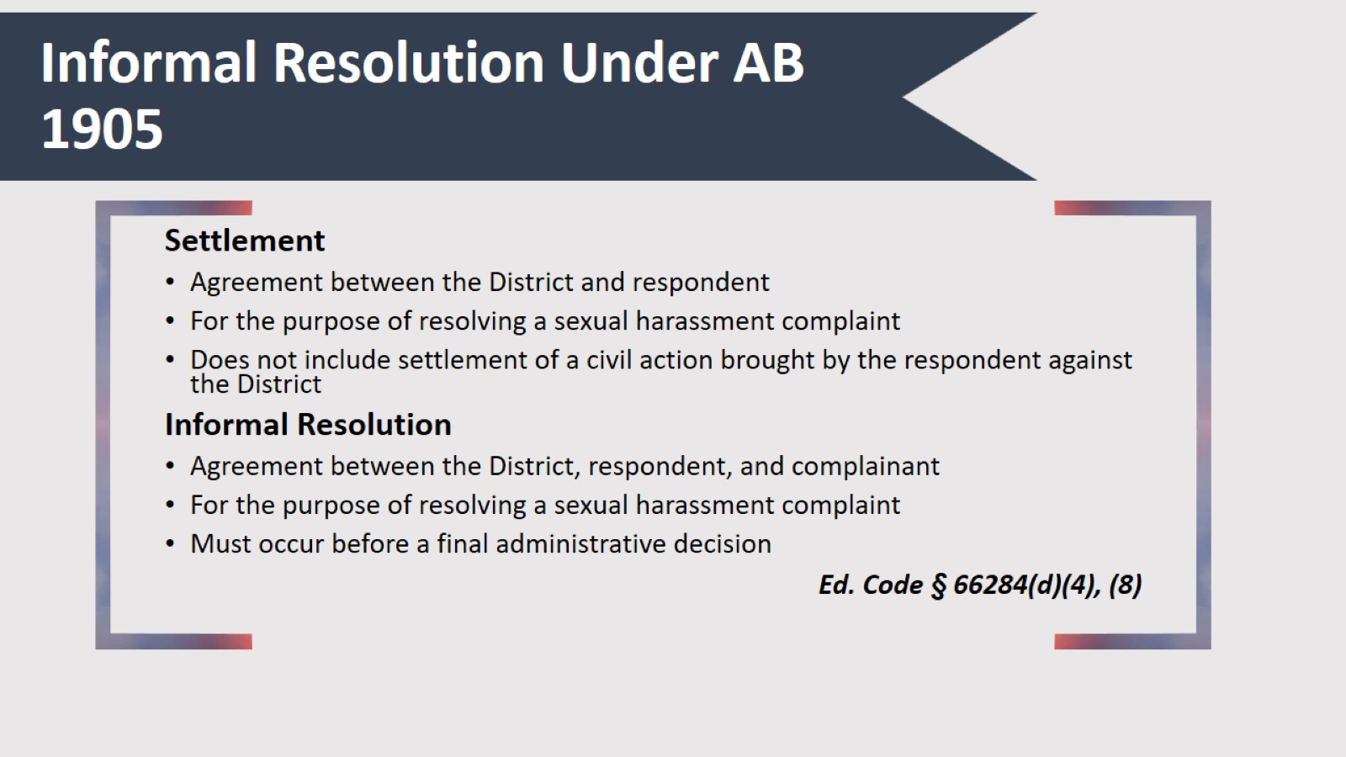
Informal Resolution Under AB 1905

Slide 20
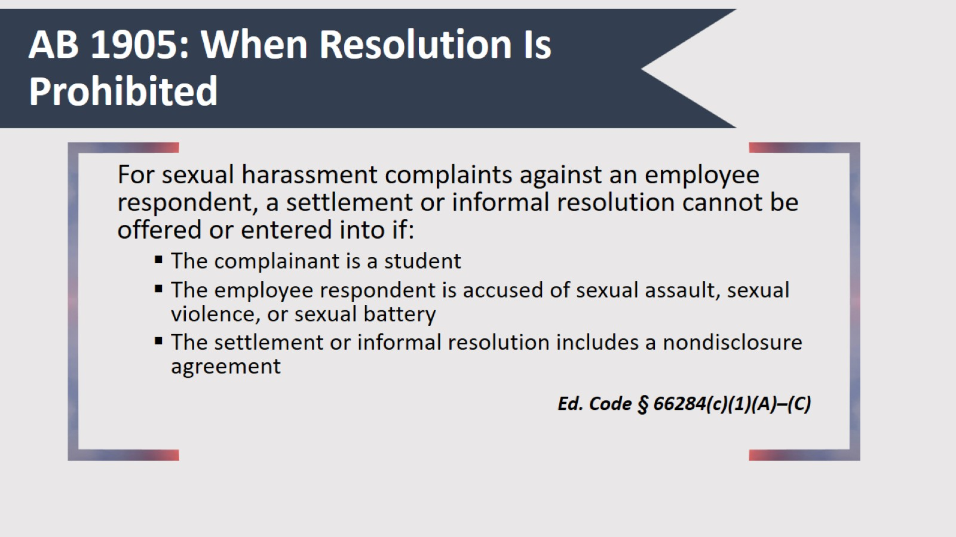
AB 1905: When Resolution Is Prohibited

Slide 21
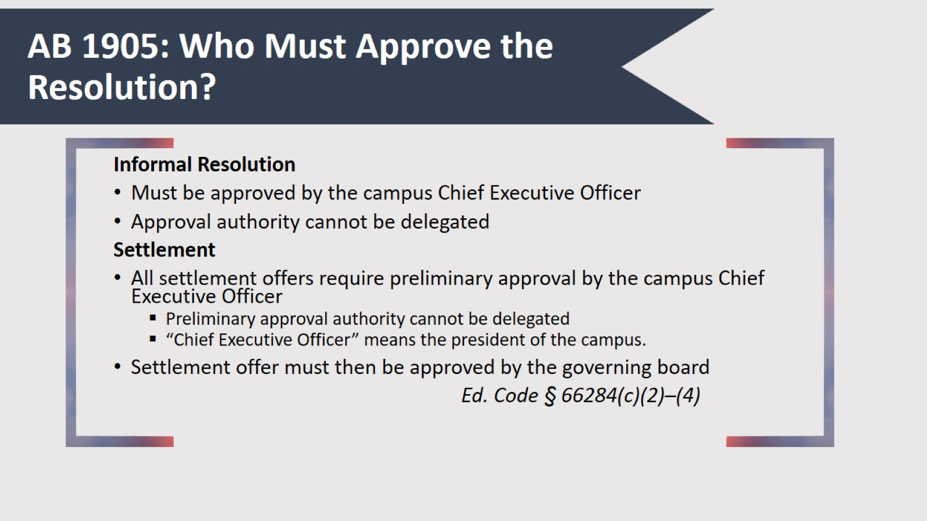
AB 1905: Who Must Approve the Resolution?

Slide 22
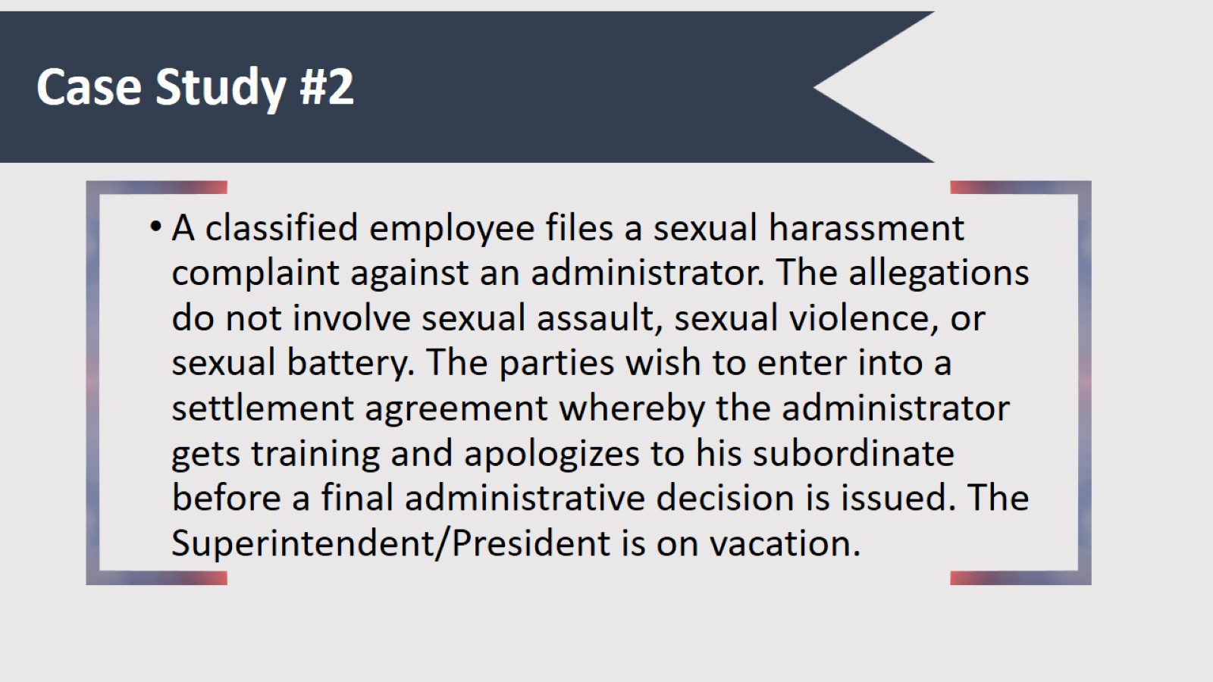
Case Study #2

Slide 23
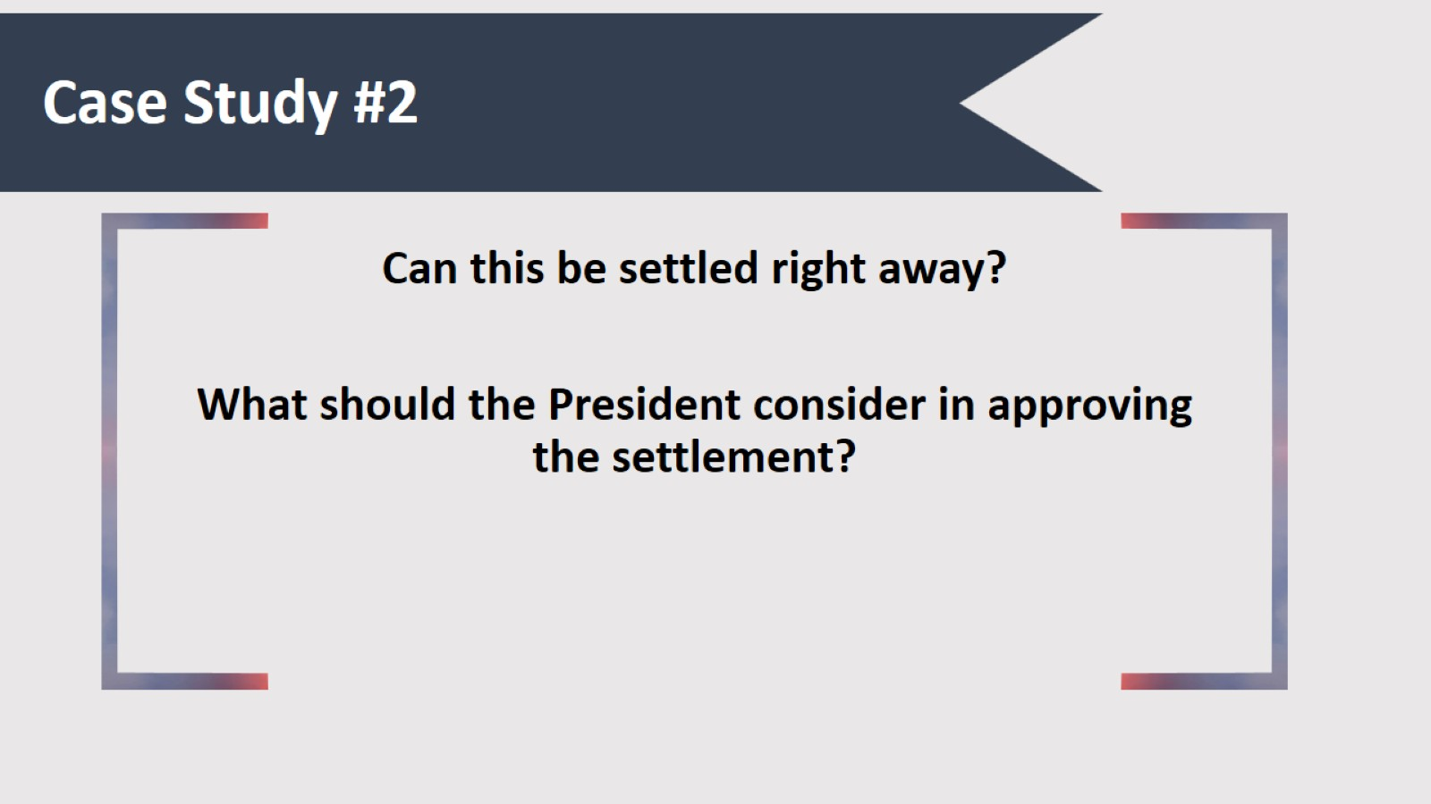
Case Study #2

Slide 24
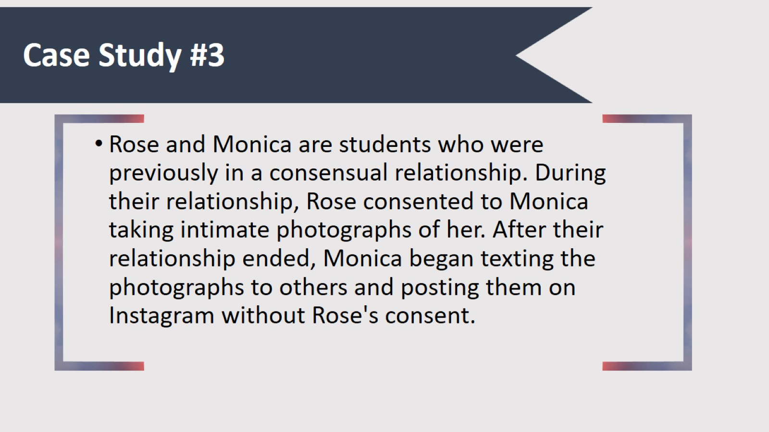
Case Study #3

Slide 25
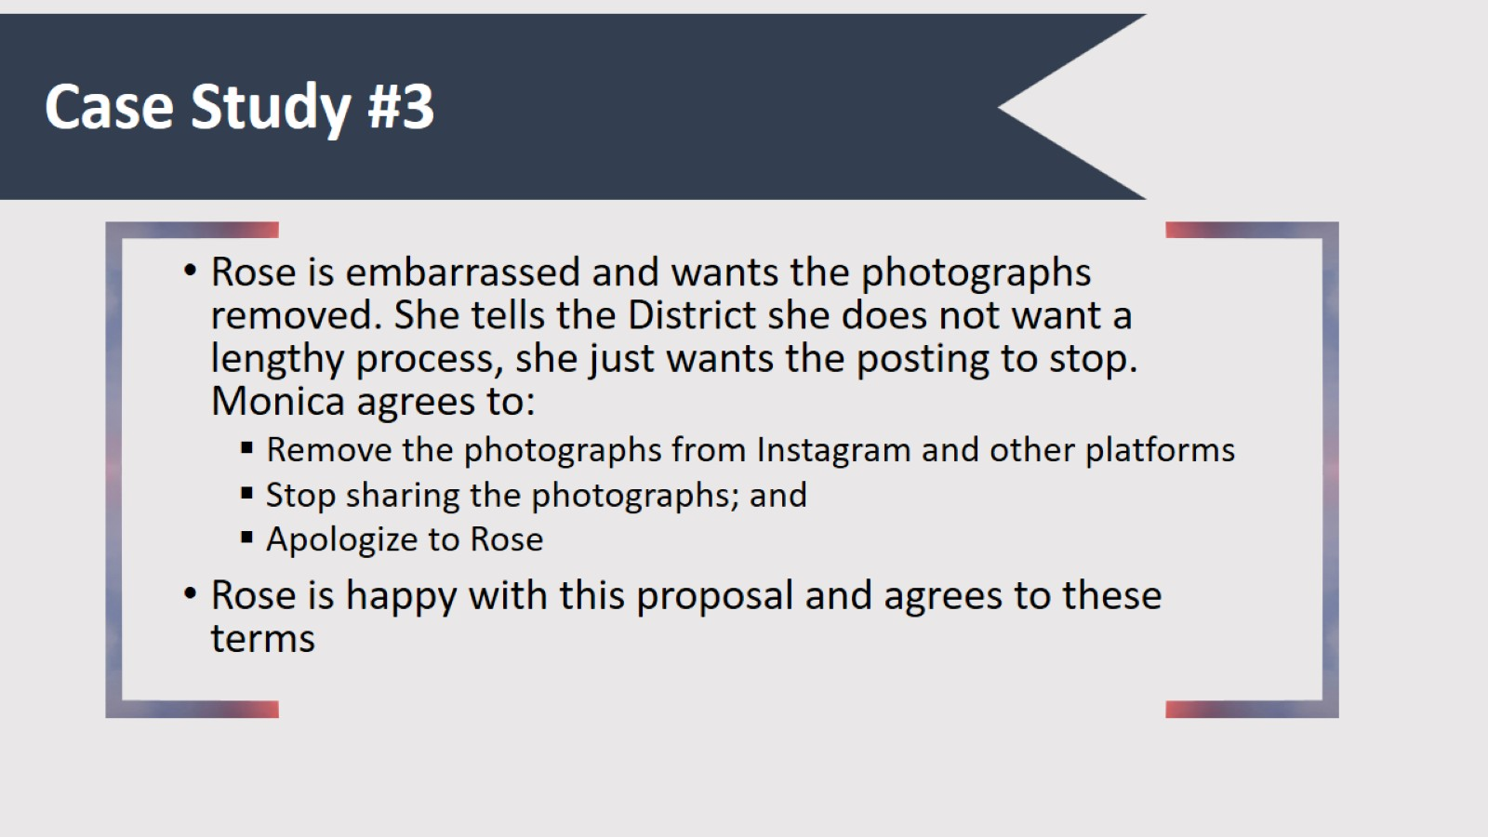
Case Study #3

Slide 26
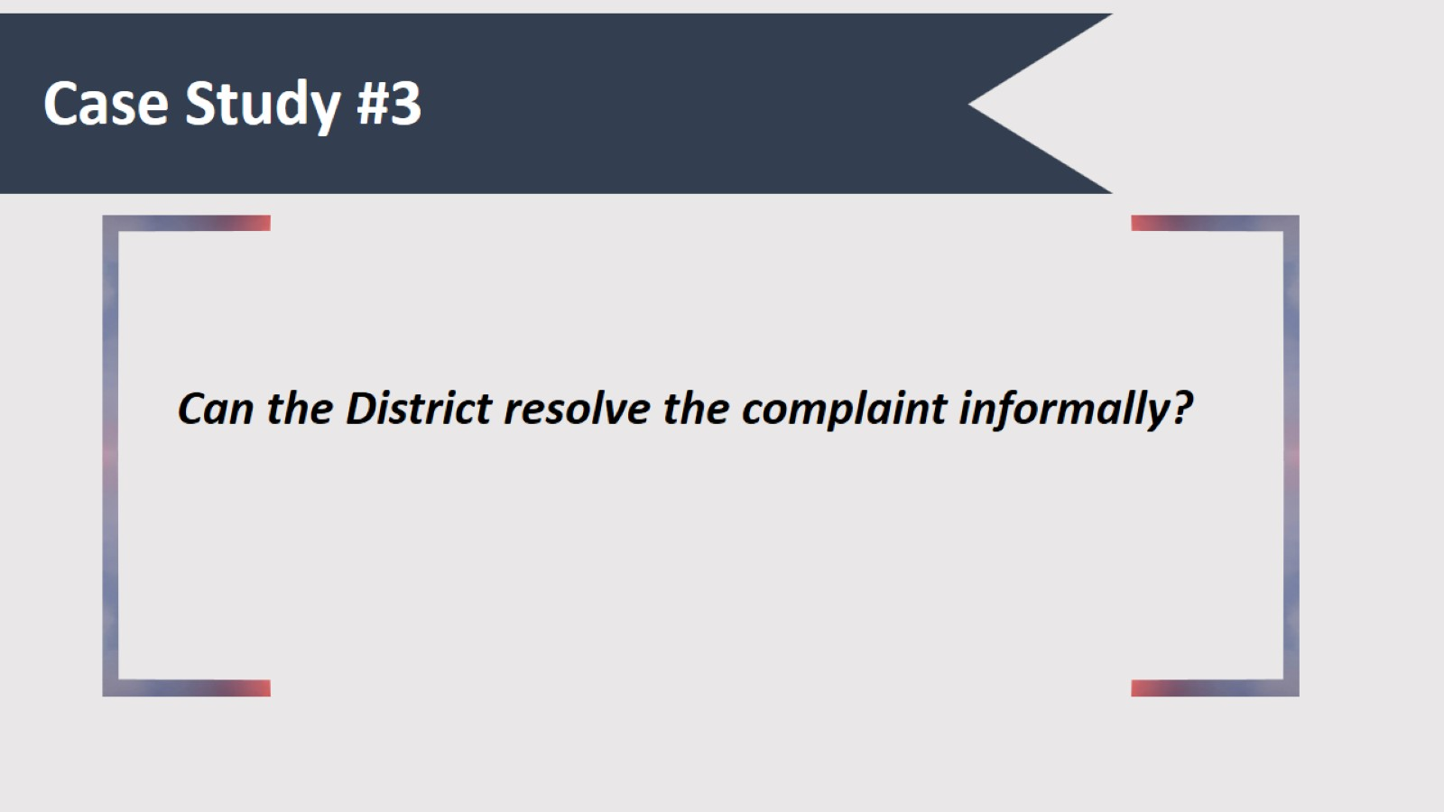
Case Study #3

Slide 27
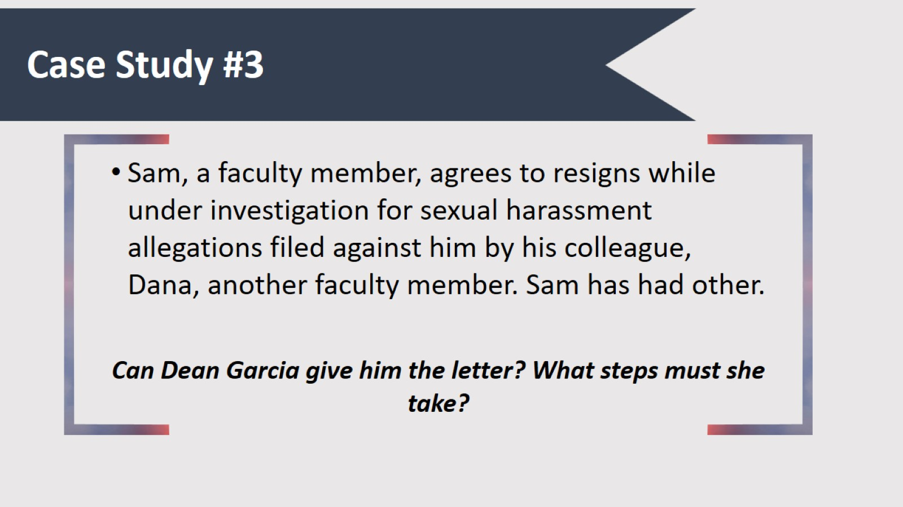
Case Study #3

Slide 28
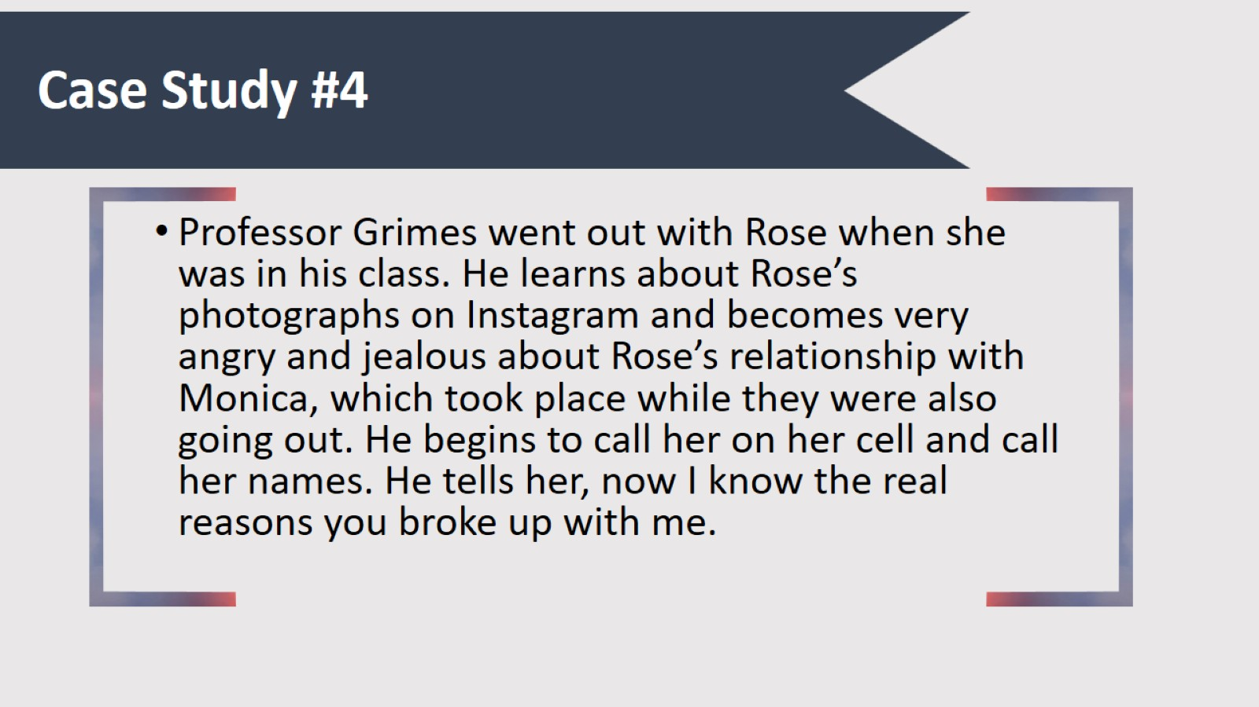
Case Study #4

Slide 29
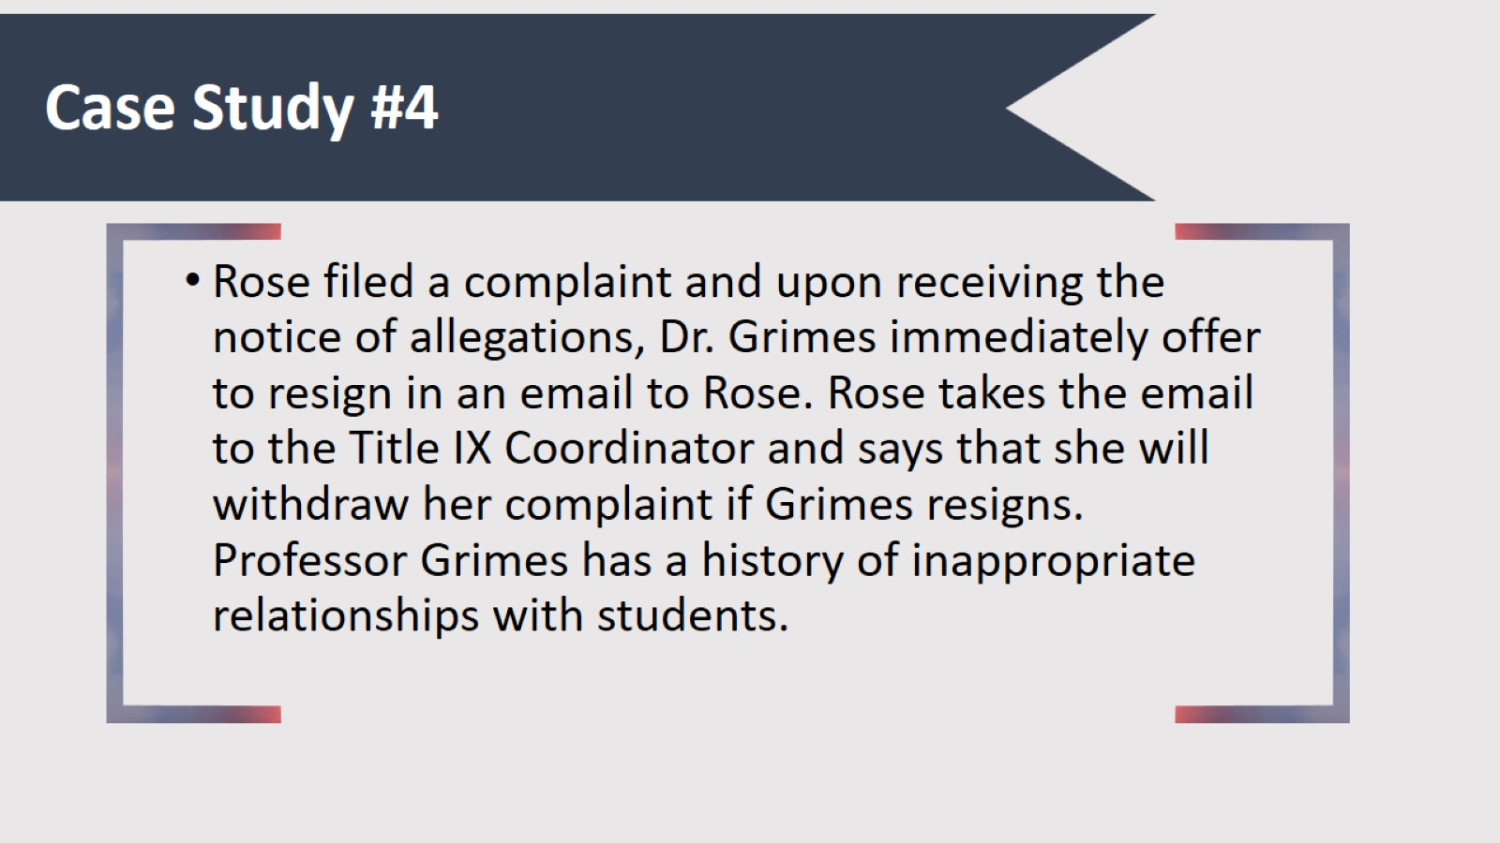
Case Study #4

Slide 30
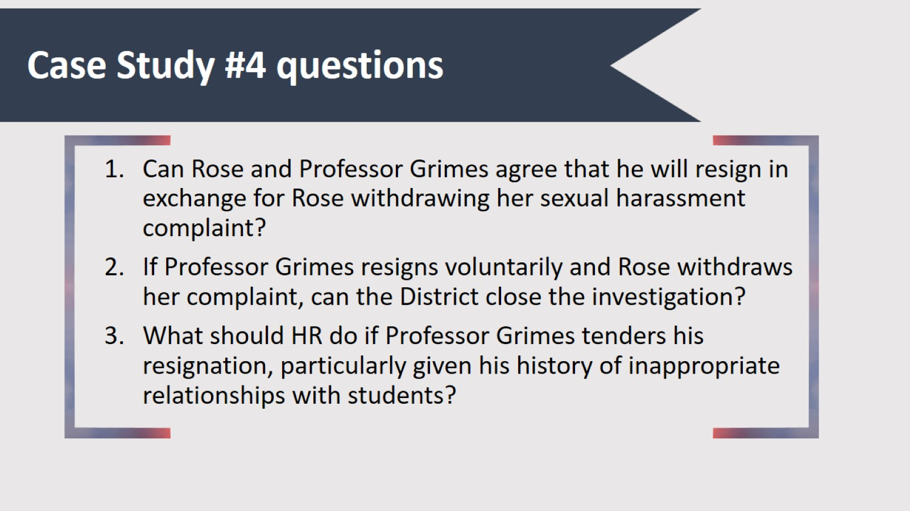
Case Study #4 questions

Slide 31
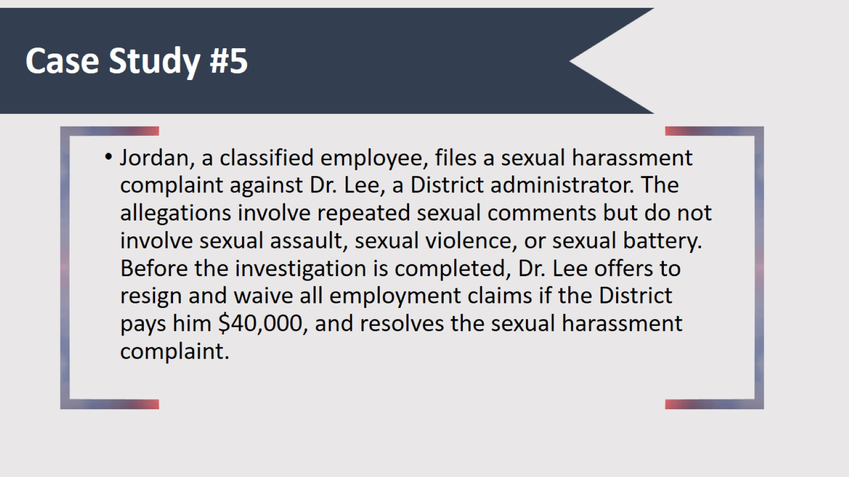
Case Study #5

Slide 32
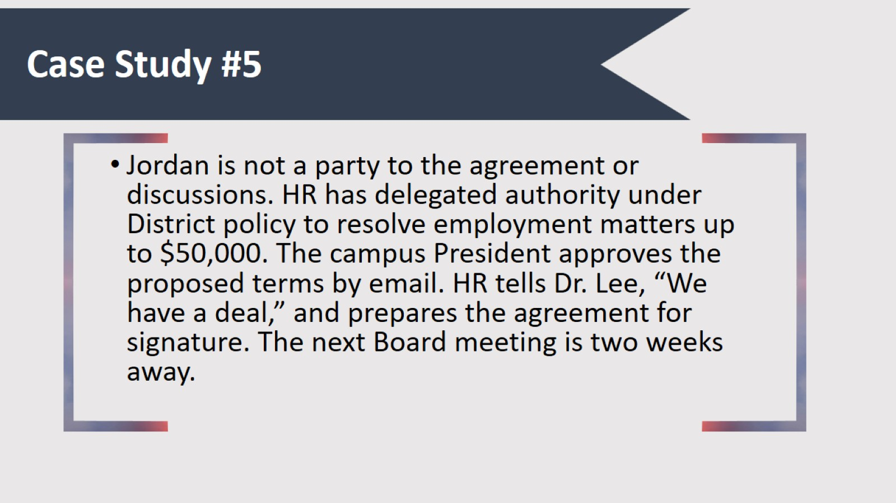
Case Study #5

Slide 33
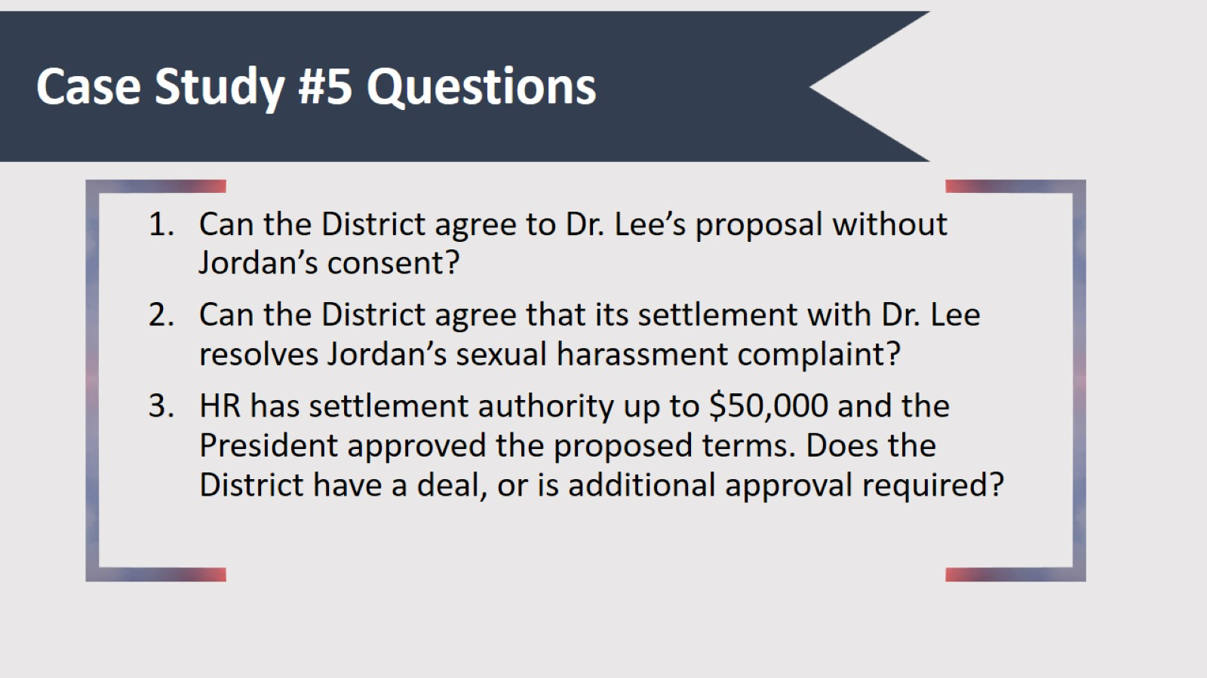
Case Study #5 Questions

Slide 34
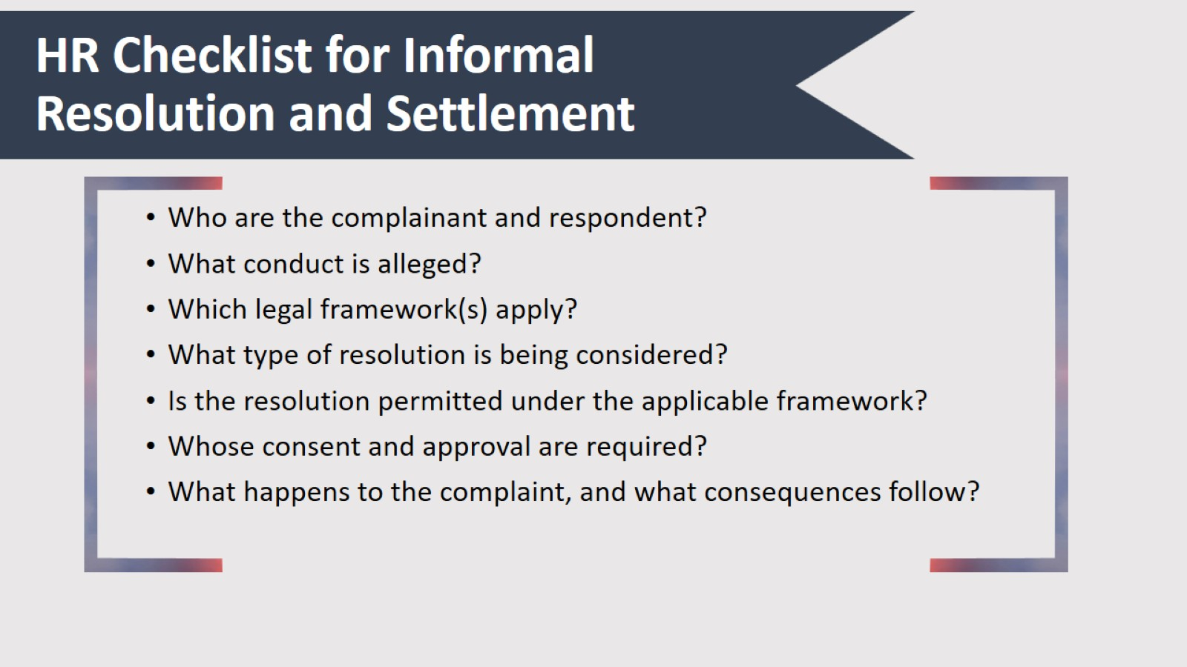
HR Checklist for Informal Resolution and Settlement

Slide 35

Questions?

Slide 36
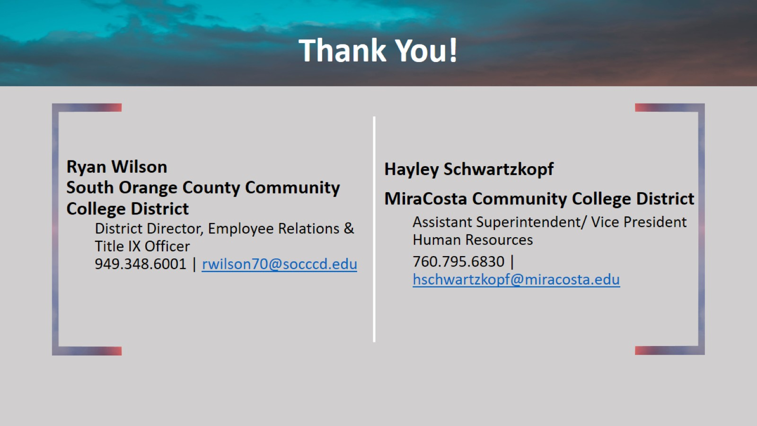
Thank You!

Slide 37
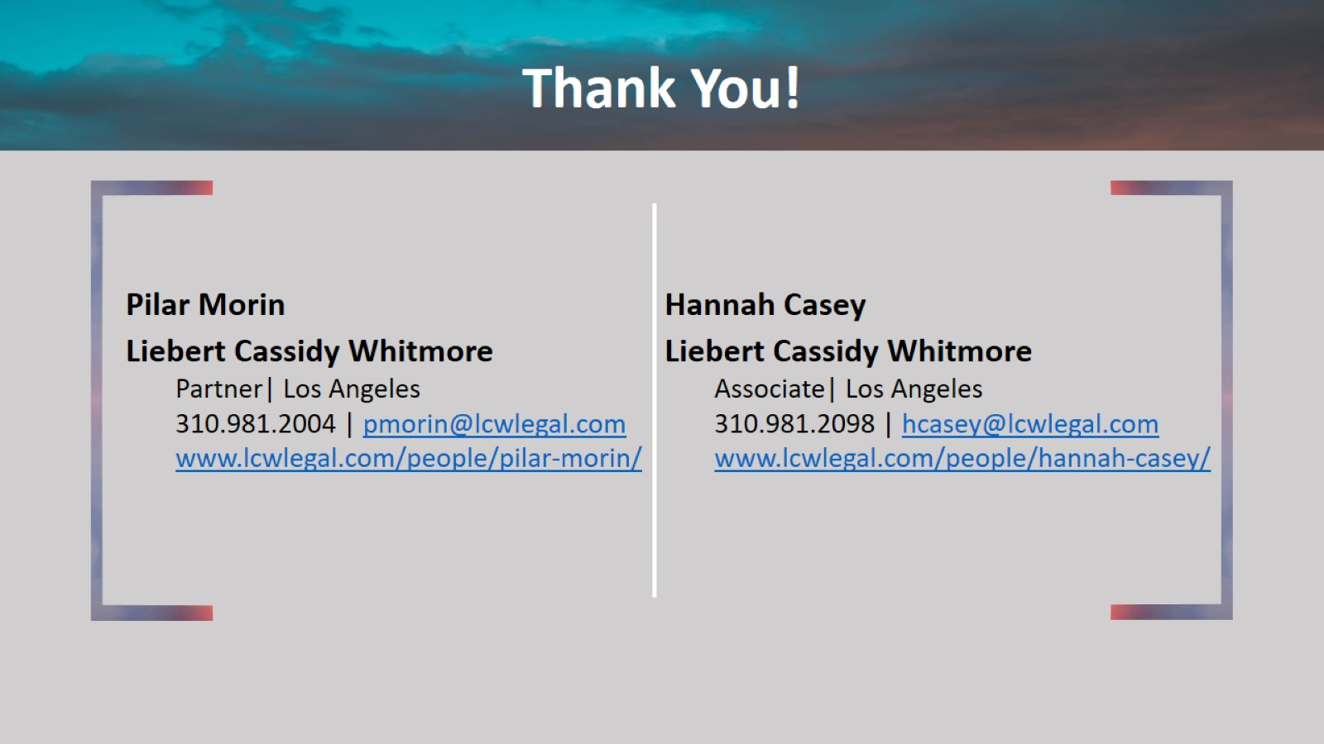
Thank You!

